Slide 1



Algorithm and Experiment Design with HeuristicLab
An Open Source Optimization Environment for
Research and Education
S. Wagner, G. Kronberger
Heuristic and Evolutionary Algorithms Laboratory (HEAL)
School of Informatics/Communications/Media, Campus Hagenberg
University of Applied Sciences Upper Austria

Slide 2


Instructor Biographies
Stefan Wagner
  MSc in computer science (2004)
  Johannes Kepler University Linz, Austria
  PhD in technical sciences (2009)
  Johannes Kepler University Linz, Austria
  Associate professor (2005 – 2009)
  University of Applied Sciences Upper Austria
  Full professor for complex software systems (since 2009)
  University of Applied Sciences Upper Austria
  Co-founder of the HEAL research group
  Project manager and chief architect of HeuristicLab
  http://heal.heuristiclab.com/team/wagner
Gabriel Kronberger
  MSc in computer science (2005)
  Johannes Kepler University Linz, Austria
  PhD in technical sciences (2010)
  Johannes Kepler University Linz, Austria
  Research assistant (2005 – 2011)
  University of Applied Sciences Upper Austria
  Research assistant (2005 – 2011)
  University of Applied Sciences Upper Austria
  Full professor for business intelligence (since 2011)
  University of Applied Sciences Upper Austria
  Member of the HEAL research group
  Architect of HeuristicLab
  http://heal.heuristiclab.com/team/kronberger

Slide 3
Agenda
Objectives of the Tutorial
Introduction
Where to get HeuristicLab?
Plugin Infrastructure
Graphical User Interface
Available Algorithms & Problems
Demonstration Part I: Working with HeuristicLab
Demonstration Part II: Data-based Modeling
Some Additional Features
Planned Features
Team
Suggested Readings
Bibliography
Questions & Answers

Slide 4
Objectives of the Tutorial
Introduce general motivation and design principles of HeuristicLab
Show where to get HeuristicLab
Explain basic GUI usability concepts
Demonstrate basic features
Demonstrate editing and analysis of optimization experiments
Demonstrate custom algorithms and graphical algorithm designer
Demonstrate data-based modeling features
Outline some additional features

Slide 5
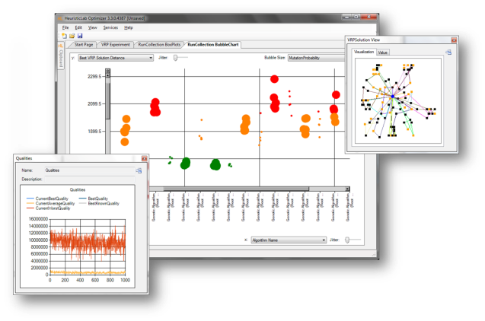
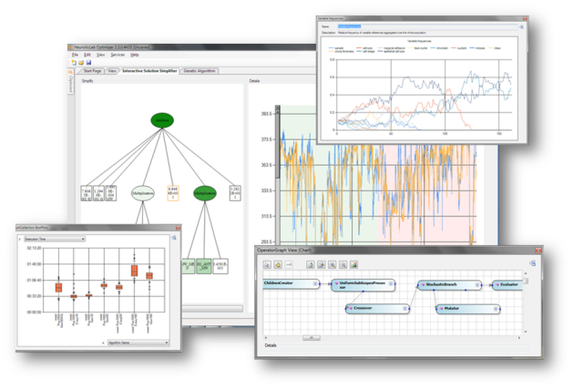

Introduction
Motivation and Goals
  graphical user interface
  paradigm independence
  multiple algorithms and problems
  large scale experiments and analyses
  parallelization
  extensibility, flexibility and reusability
  visual and interactive algorithm development
  multiple layers of abstraction
Facts
  development of HeuristicLab started in 2002
  based on Microsoft .NET and C#
  used in research and education
  second place at the Microsoft Innovation Award 2009
  open source (GNU General Public License)
  version 3.3.0 released on May 18th, 2010
  latest version 3.3.6 released on January 3rd, 2012

Slide 6
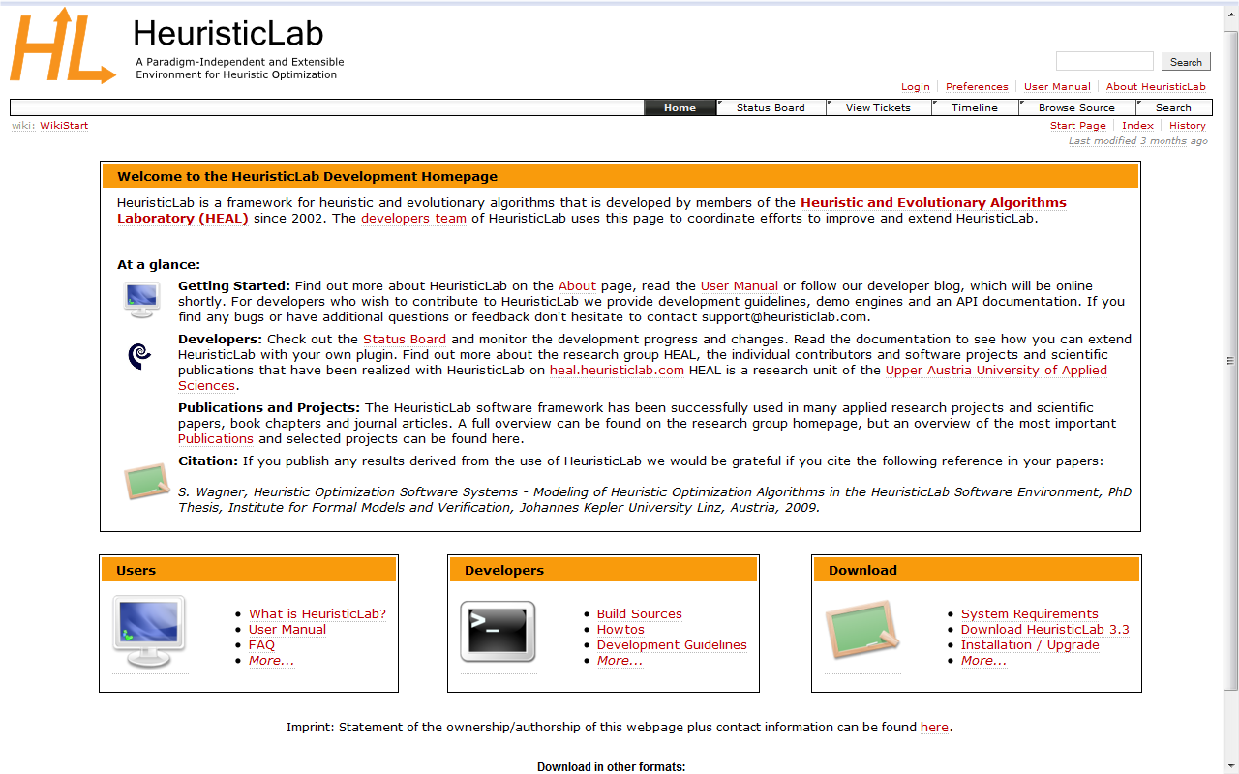
Where to get HeuristicLab?
Download binaries
  deployed as ZIP archives
  latest stable version 3.3.6
    released on January 3rd, 2012
  daily trunk builds
  http://dev.heuristiclab.com/download
Check out sources
  SVN repository
  HeuristicLab 3.3.6 tag
    http://dev.heuristiclab.com/svn/hl/core/tags/3.3.6
  current development trunk
    http://dev.heuristiclab.com/svn/hl/core/trunk
License
  GNU General Public License (Version 3)
System requirements
  Microsoft .NET Framework 4.0 Full Version
  enough RAM and CPU power ;-)

Slide 7
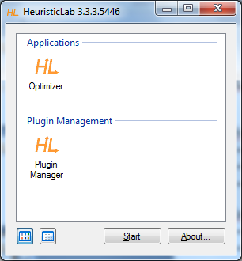
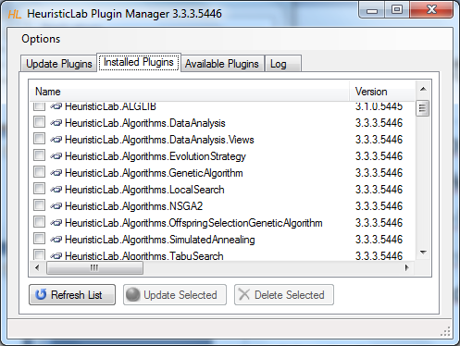
Plugin Infrastructure
HeuristicLab consists of many assemblies
  94 plugins in HeuristicLab 3.3.6
  plugins can be loaded or unloaded at runtime
  plugins can be updated via internet
  application plugins provide GUI frontends
Extensibility
  developing and deploying new plugins is easy
  dependencies are explicitly defined, automatically checked and resolved
  automatic discovery of interface implementations (service locator pattern)
Plugin Manager
  GUI to check, install, update or delete plugins

Slide 8
Graphical User Interface
HeuristicLab GUI is made up of views
  views are visual representations of content objects
  views are composed in the same way as their content
  views and content objects are loosely coupled
  multiple different views may exist for the same content
Drag & Drop
  views support drag & drop operations
  content objects can be copied or moved (shift key)
  enabled for collection items and content objects

Slide 9
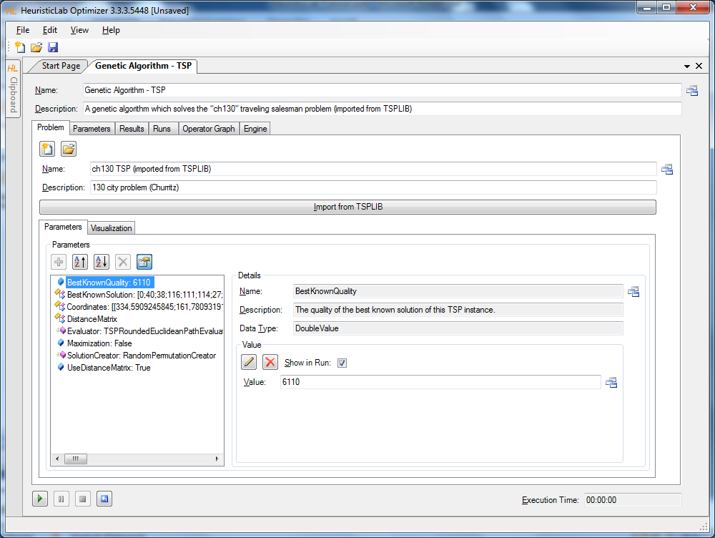
Graphical User Interface
Algorithm View
Problem View
Parameter
Collection
View
Parameter View
Double Value View

Slide 10
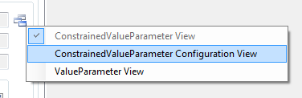
Graphical User Interface
ViewHost
  control which hosts views
  right-click on windows icon to switch views
  double-click on windows icon to open another view
  drag & drop windows icon to copy contents

Slide 11
Available Algorithms & Problems
Algorithms
Problems
Evolution Strategy
Genetic Algorithm
Genetic Programming
Island Genetic Algorithm
Island Offspring Selection Genetic Algorithm
Local Search
NSGA-II
Offspring Selection Genetic Algorithm
Particle Swarm Optimization
Robust Taboo Search
SASEGASA
Simulated Annealing
Tabu Search
User-defined Algorithm
Variable Neighborhood Search
Performance Benchmarks
Cross Validation
k-Means
Linear Discriminant Analysis
Linear Regression
Multinomial Logit Classification
Nearest Neighbor Regression and Classification
Neural Network Regression and Classification
Random Forest Regression and Classification
Support Vector Regression and Classification
Artificial Ant
Classification
Clustering
External Evaluation Problem
Knapsack
OneMax
Quadratic Assignment
Regression
Single-Objective Test Function
Symbolic Classification
Symbolic Regression
Traveling Salesman
User-defined Problem
Vehicle Routing

Slide 12
Agenda
Objectives of the Tutorial
Introduction
Where to get HeuristicLab?
Plugin Infrastructure
Graphical User Interface
Available Algorithms & Problems
Demonstration Part I: Working with HeuristicLab
Demonstration Part II: Data-based Modeling
Some Additional Features
Planned Features
Team
Suggested Readings
Bibliography
Questions & Answers

Slide 13
Demonstration Part I:
Working with HeuristicLab
Create, Parameterize and Execute Algorithms
Save and Load Items
Create Batch Runs and Experiments
Multi-core CPUs and Parallelization
Analyze Runs
Analyzers
Building User-Defined Algorithms

Slide 14
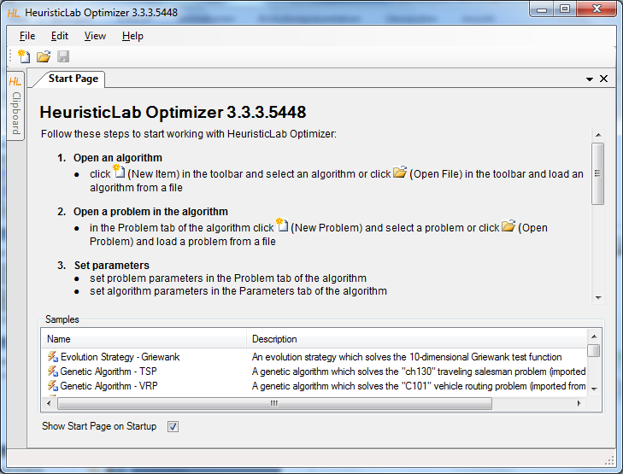
HeuristicLab Optimizer
double-click to open
sample algorithms and problems

Slide 15
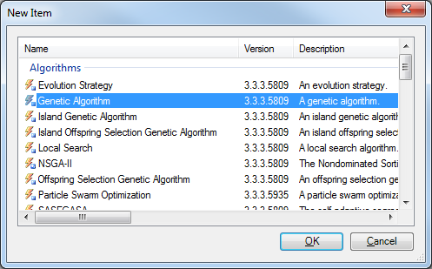
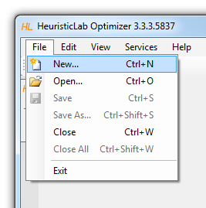
Create Algorithm

Slide 16
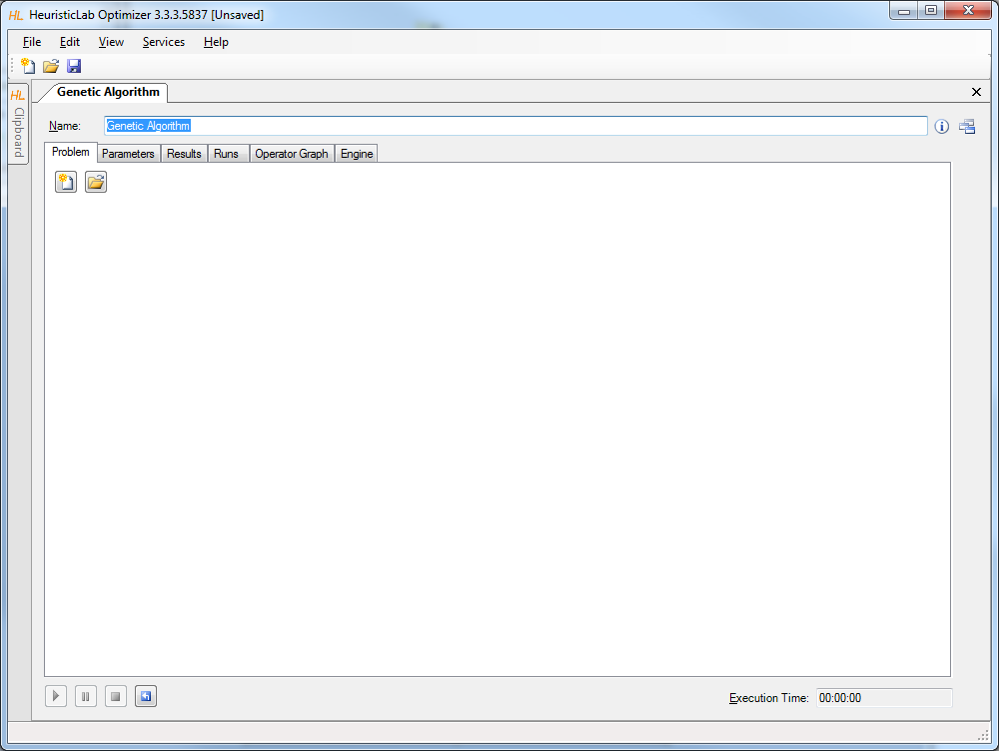
Create or Load Problem

Slide 17
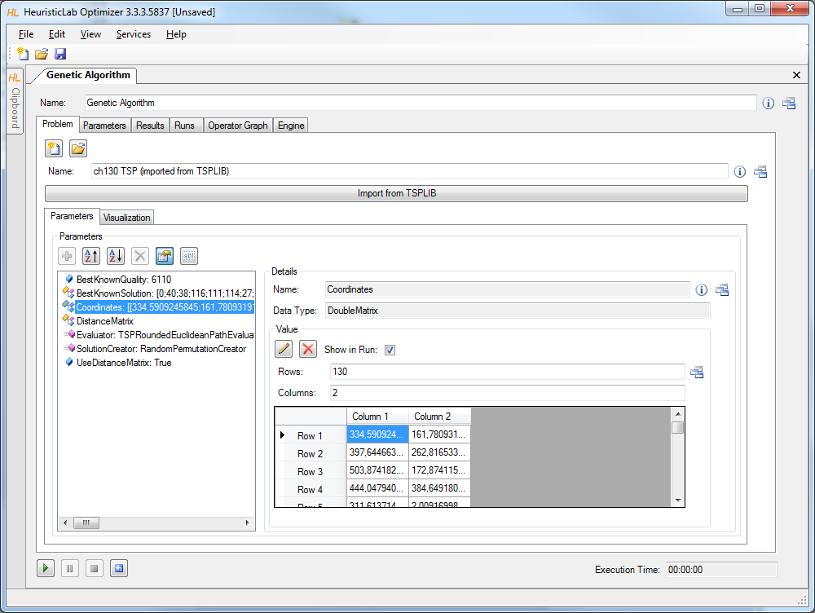
Import or Parameterize Problem Data

Slide 18
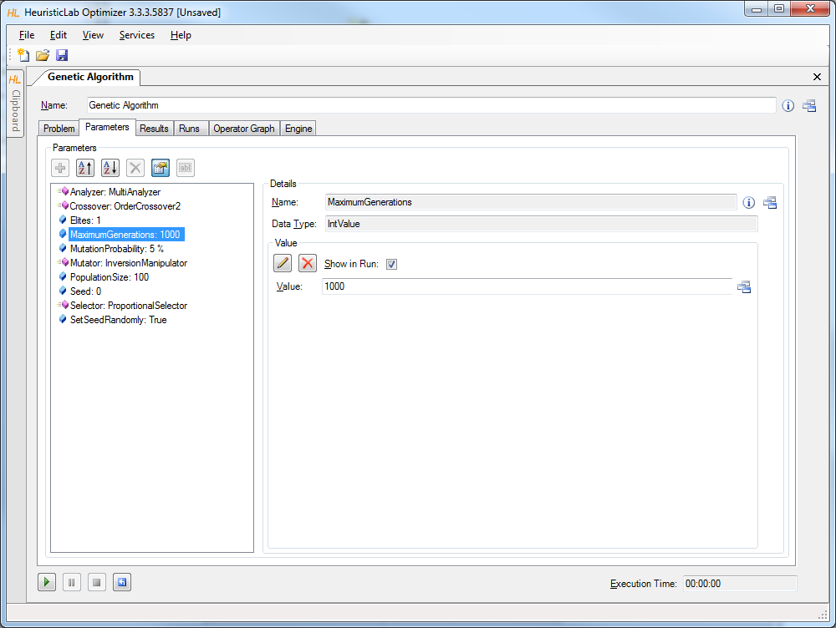
Parameterize Algorithm

Slide 19
Start, Pause, Resume, Stop and Reset

Slide 20
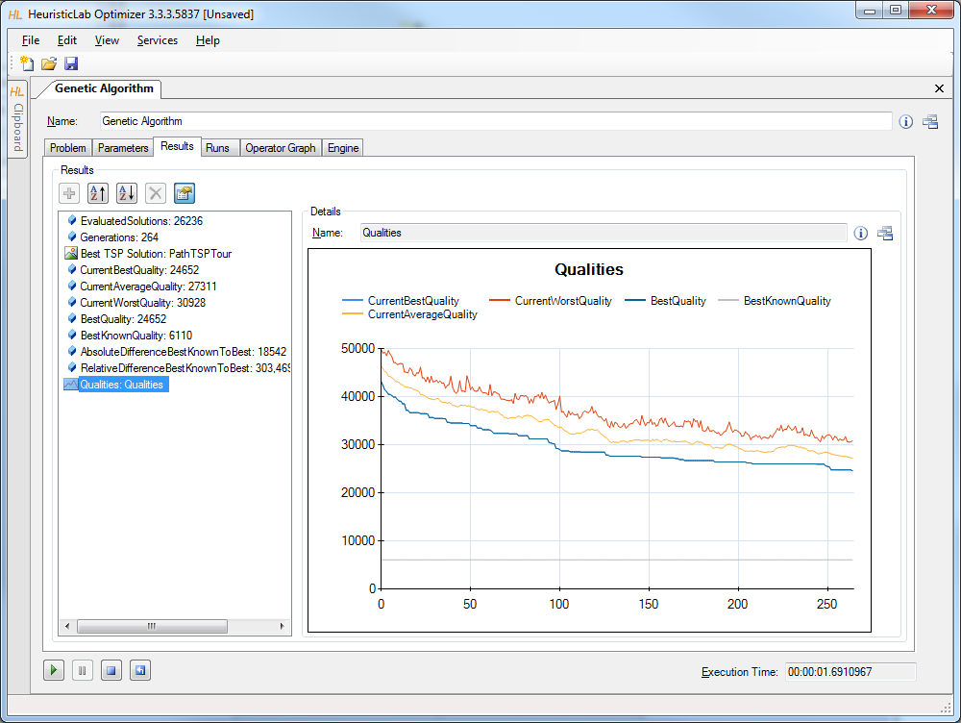
Inspect Results

Slide 21
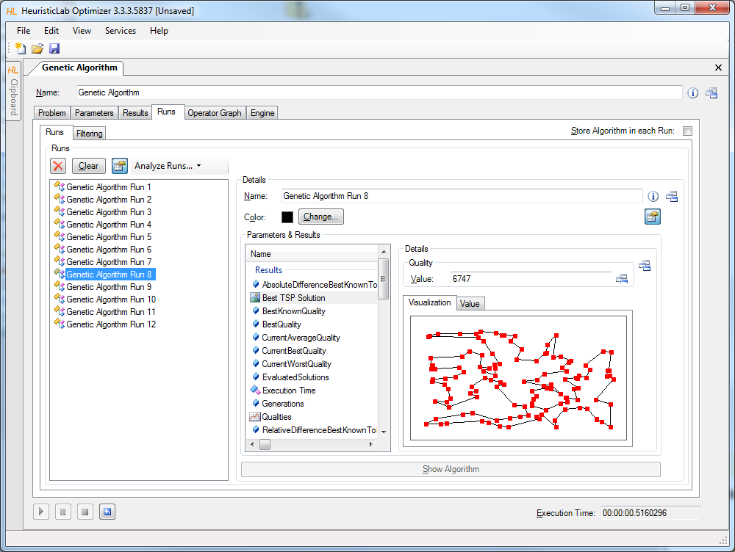
Compare Runs
A run is created each time when the algorithm is stopped
  runs contain all results and parameter settings
  previous results are not forgotten and can be compared

Slide 22
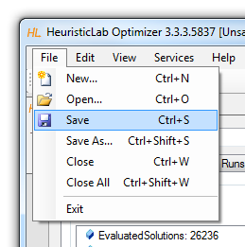
Save and Load
Save to and load from disk
  HeuristicLab items (i.e., algorithms, problems, experiments, …) can be saved to and loaded from a file
  algorithms can be paused, saved, loaded and resumed
  data format is custom compressed XML
  saving and loading files might take several minutes
  saving and loading large experiments requires some memory

Slide 23
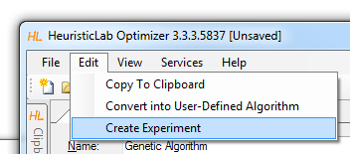
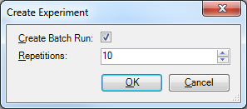
Create Batch Runs and Experiments
Batch runs
  execute the same optimizer (e.g. algorithm, batch run, experiment) several times
Experiments
  execute different optimizers
  suitable for large scale algorithm comparison and analysis
Experiments and batch runs can be nested
Generated runs can be compared afterwards

Slide 24
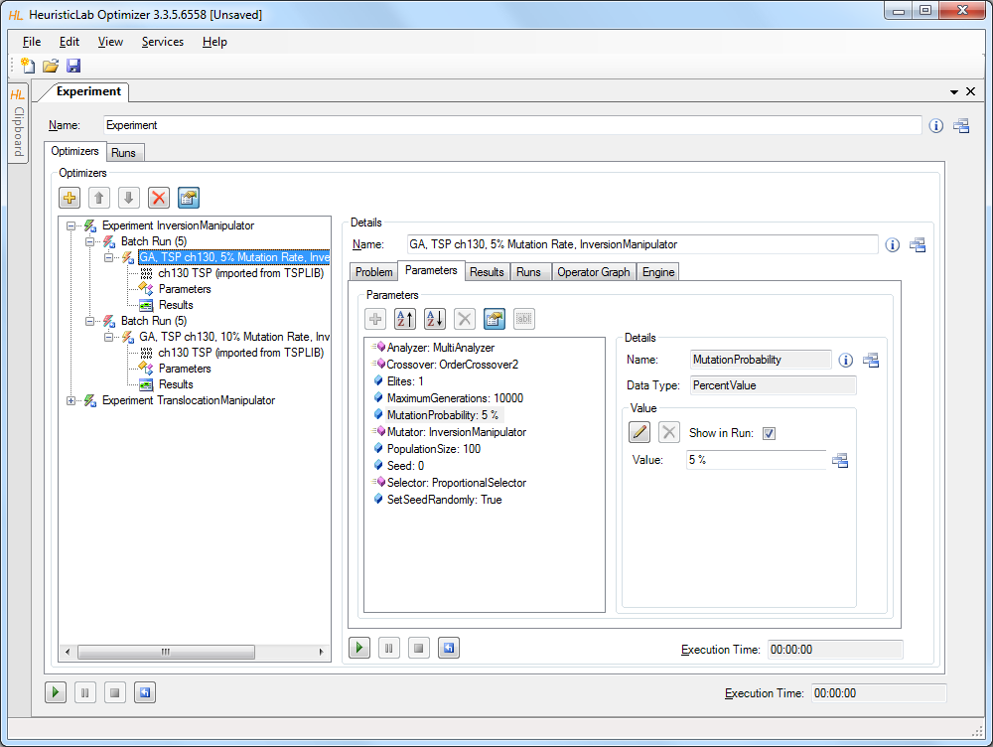
Create Batch Runs and Experiments
drag & drop here
to add additional
algorithms,
batch runs, experiments, etc.

Slide 25
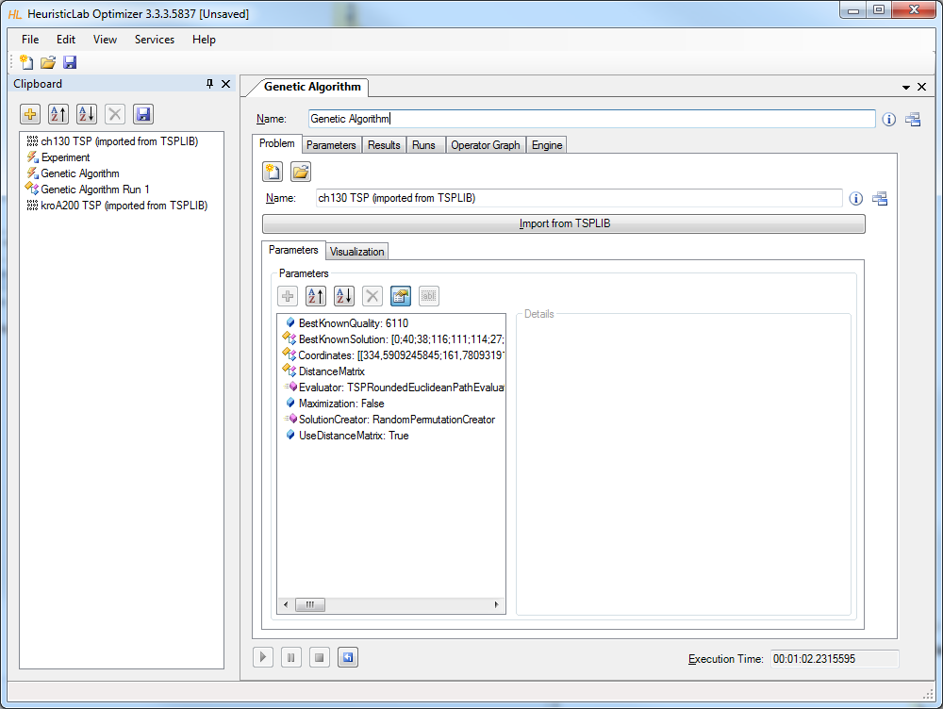
Clipboard
drag & drop here to add algorithms, problems, batch runs, experiments, etc.

Slide 26
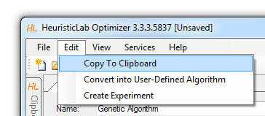
Clipboard
Store items
  click on the buttons to add or remove items
  drag & drop items on the clipboard
  use the menu to add a copy of a shown item to the clipboard
Show items
  double-click on an item in the clipboard to show its view
Save and restore clipboard content
  click on the save button to write the clipboard content to disk
  clipboard is automatically restored when HeuristicLab is started the next time

Slide 27
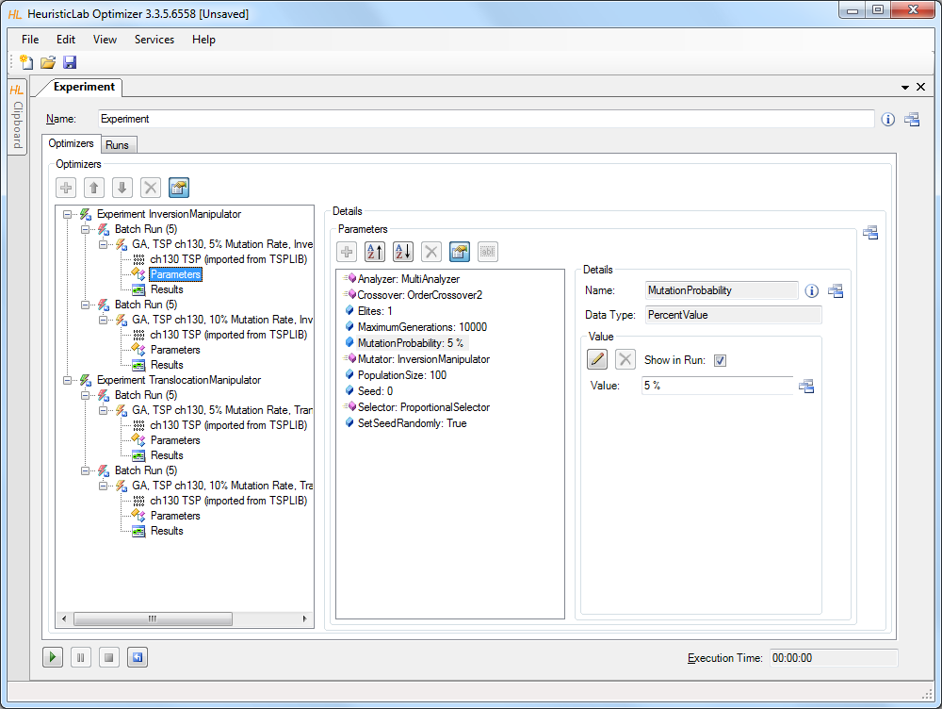
Start, Pause, Resume, Stop, Reset

Slide 28
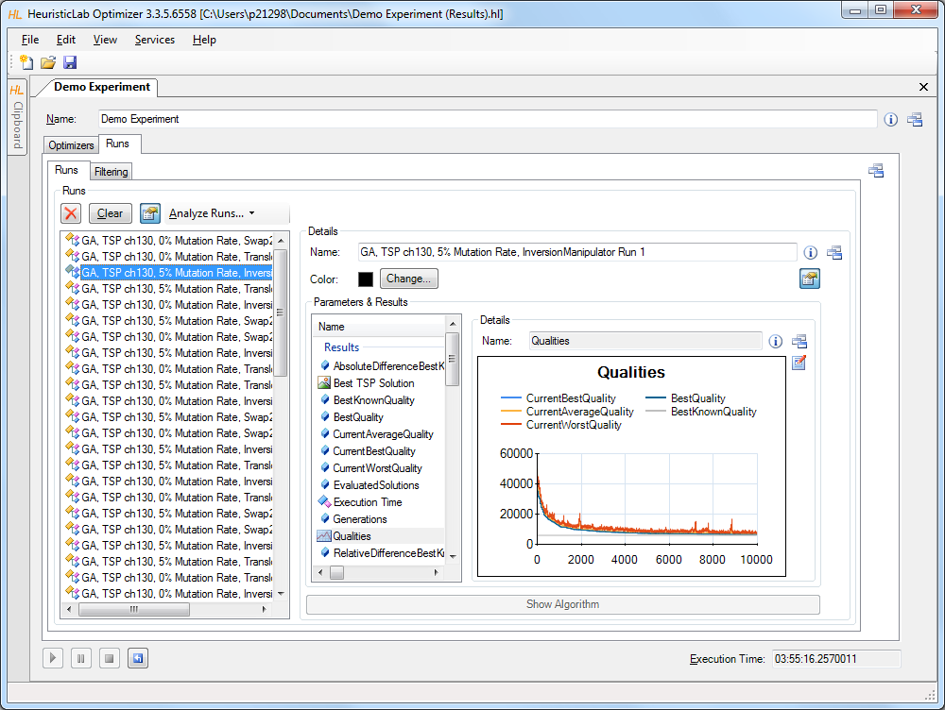
Compare Runs

Slide 29
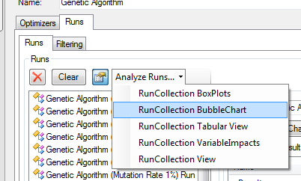
Analyze Runs
HeuristicLab provides interactive views to analyze and compare all runs of a run collection
  textual analysis
    RunCollection Tabular View
  graphical analysis
    RunCollection BubbleChart
    RunCollection BoxPlots
Filtering is automatically applied to all open run collection views

Slide 30
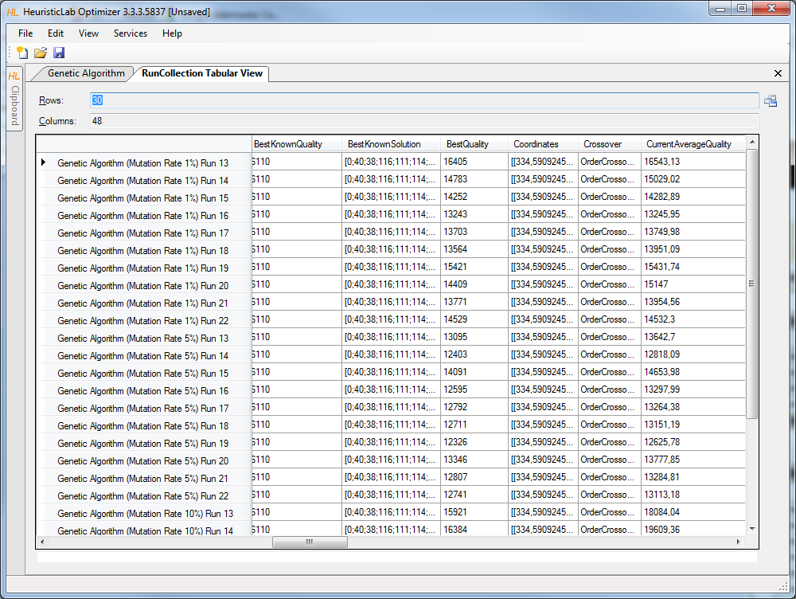
RunCollection Tabular View

Slide 31
RunCollection Tabular View
Sort columns
  click on column header to sort column
  Ctrl-click on column header to sort multiple columns
Show or hide columns
  right-click on table to open dialog to show or hide columns
Compute statistical values
  select multiple numerical values to see count, sum, minimum, maximum, average and standard deviation
Select, copy and paste into other applications

Slide 32
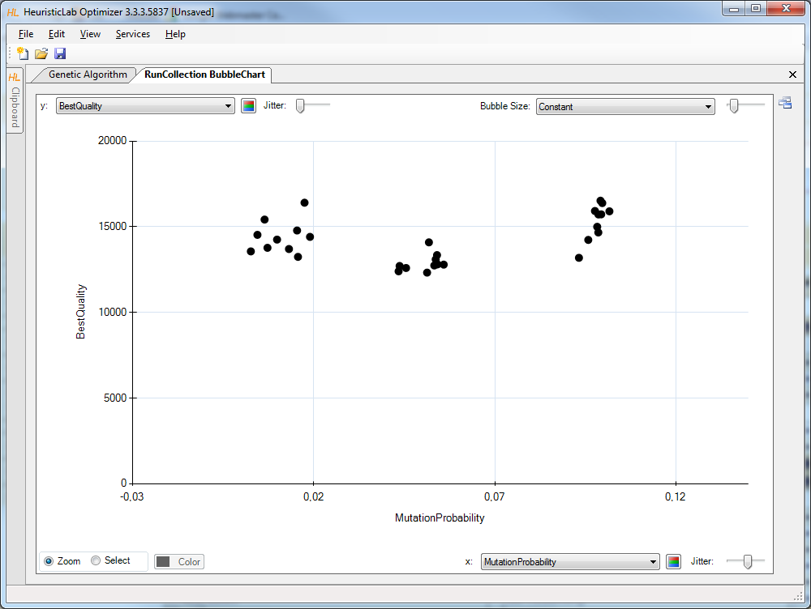
RunCollection BubbleChart

Slide 33
RunCollection BubbleChart
Choose values to plot
  choose which values to show on the x-axis, the y-axis and as bubble size
  possible values are all parameter settings and results
Add jitter
  add jitter to separate overlapping bubbles
Zoom in and out
  click on Zoom and click and drag in the chart area to zoom in
  double click on the chart area background or on the circle buttons beside the scroll bars to zoom out
Color bubbles
  click on Select, choose a color and click and drag in the chart area to select and color bubbles
  apply coloring automatically by clicking on the axis coloring buttons
Show runs
  double click on a bubble to open its run
Export image
  right-click to open context menu to copy or save image
  save image as pixel (BMP, JPG, PNG, GIF, TIF) or vector graphics (EMF)
Show box plots
  right-click to open context menu to show box plots view

Slide 34
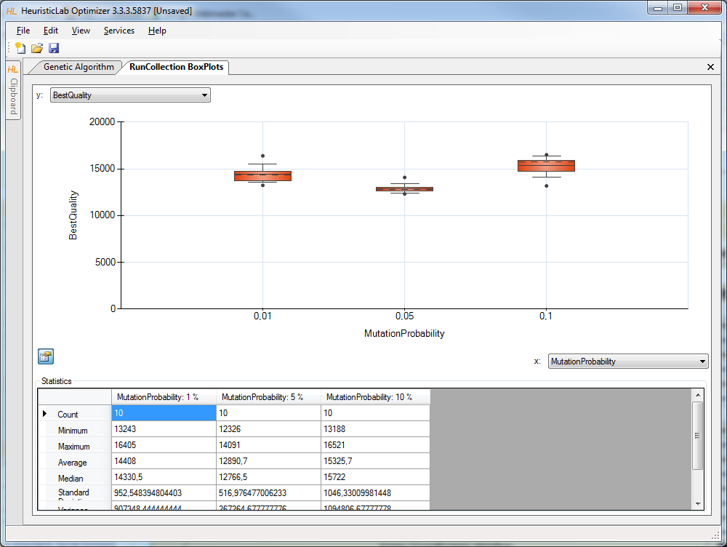
RunCollection BoxPlots

Slide 35
RunCollection BoxPlots
Choose values to plot
  choose which values to show on the x-axis and y-axis
  possible values are all parameter settings and results
Zoom in and out
  click on Zoom and click and drag in the chart area to zoom in
  double click on the chart area background or on the circle buttons beside the scroll bars to zoom out
Show or hide statistical values
  click on the lower left button to show or hide statistical values
Export image
  right-click to open context menu to copy or save image
  save image as pixel (BMP, JPG, PNG, GIF, TIF) or vector graphics (EMF)

Slide 36
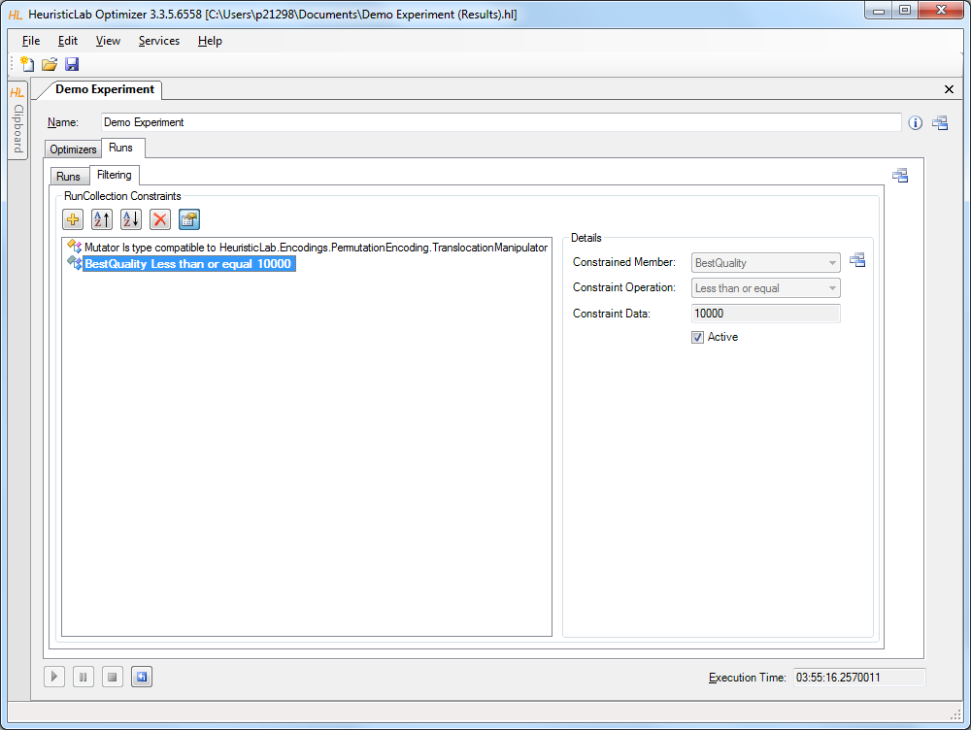
Filter Runs

Slide 37
Multi-core CPUs and Parallelization
Parallel execution of optimizers in experiments
  optimizers in an experiment are executed sequentially from top to bottom per default
  experiments support parallel execution of their optimizers
  select a not yet executed optimizer and start it manually to utilize another core
  execution of one of the next optimizers is started automatically after an optimizer is finished
Parallel execution of algorithms
  HeuristicLab provides special operators for parallelization
  engines decide how to execute parallel operations
  sequential engine executes everything sequentially
  parallel engine executes parallel operations on multiple cores
  Hive engine (under development) executes parallel operations on multiple computers
  all implemented algorithms support parallel solution evaluation

Slide 38
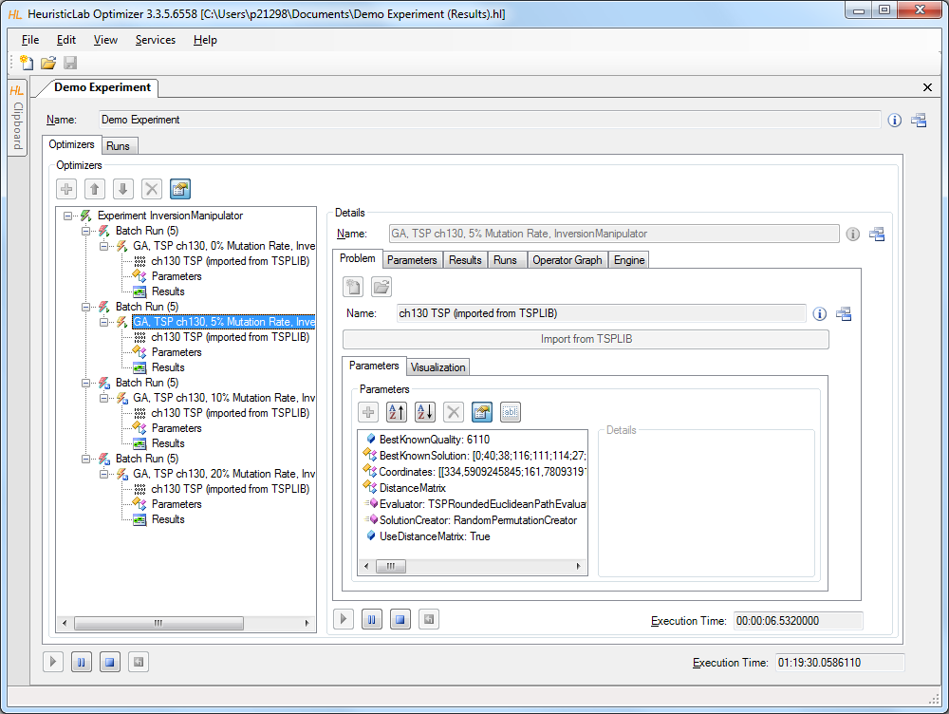
Parallel Execution of Experiments
2. start other optimizers
1. start experiment

Slide 39
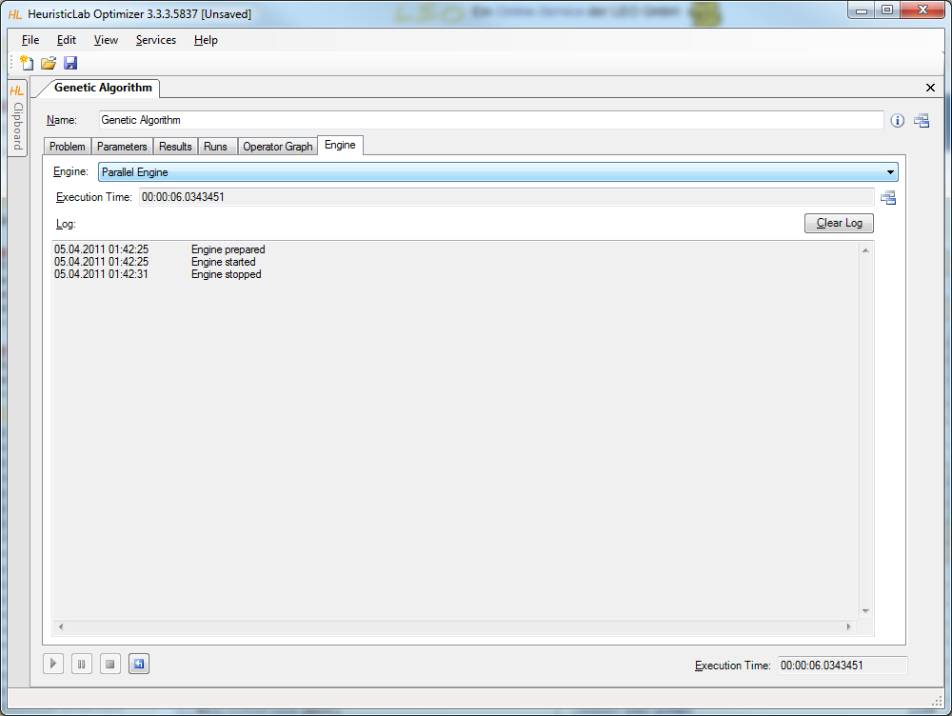
Parallel Execution of Algorithms

Slide 40
Analyzers
Special operators for analysis purposes
  are executed after each iteration
  serve as general purpose extension points of algorithms
  can be selected and parameterized in the algorithm
  perform algorithm-specific and/or problem-specific tasks
  some analyzers are quite costly regarding runtime and memory
  implementing and adding custom analyzers is easy
Examples
  TSPAlleleFrequencyAnalyzer
  TSPPopulationDiversityAnalyzer
  SuccessfulOffspringAnalyzer
  SymbolicDataAnalysisVariableFrequencyAnalyzer
  SymbolicRegressionSingleObjectiveTrainingBestSolutionAnalyzer
  …

Slide 41
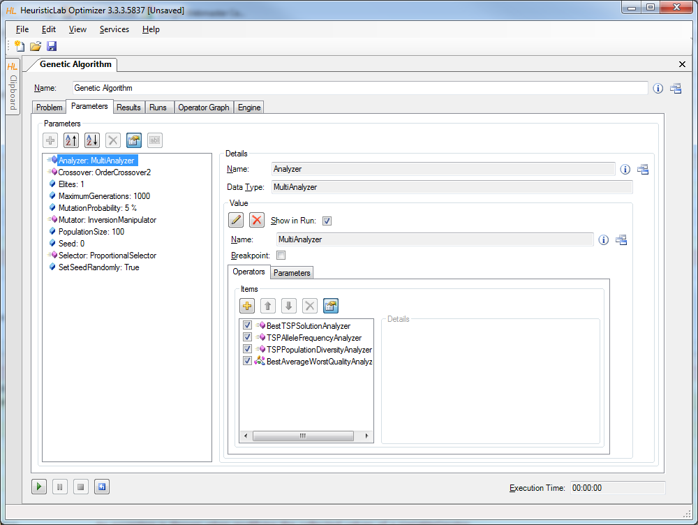
Analyzers

Slide 42
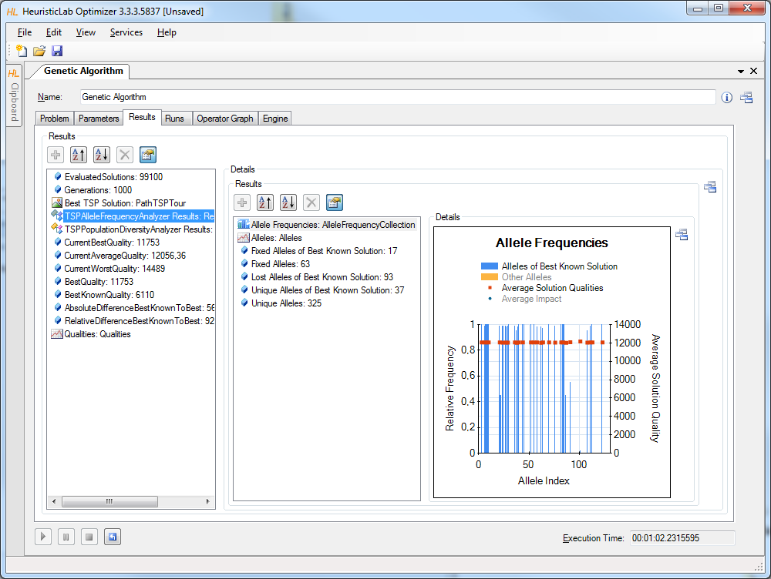
TSPAlleleFrequencyAnalyzer

Slide 43
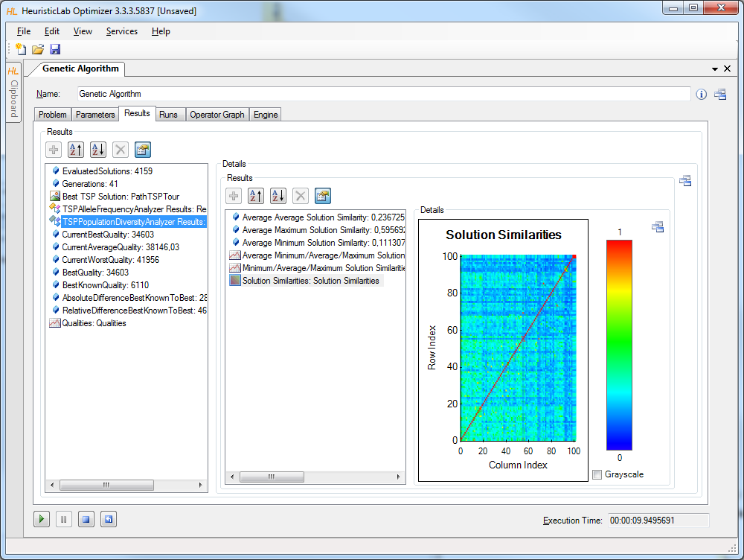
TSPPopulationDiversityAnalyzer

Slide 44
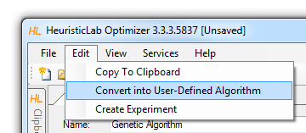
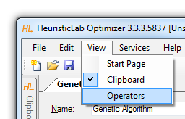
Building User-Defined Algorithms
Operator graphs
  algorithms are represented as operator graphs
  operator graphs of user-defined algorithms can be changed
  algorithms can be defined in the graphical algorithm designer
  use the menu to convert a standard algorithm into a user-defined algorithm
Operators sidebar
  drag & drop operators into an operator graph
Programmable operators
  add programmable operators in order to implement custom logic in an algorithm
  no additional development environment needed
Debug algorithms
  use the debug engine to obtain detailed information during algorithm execution

Slide 45
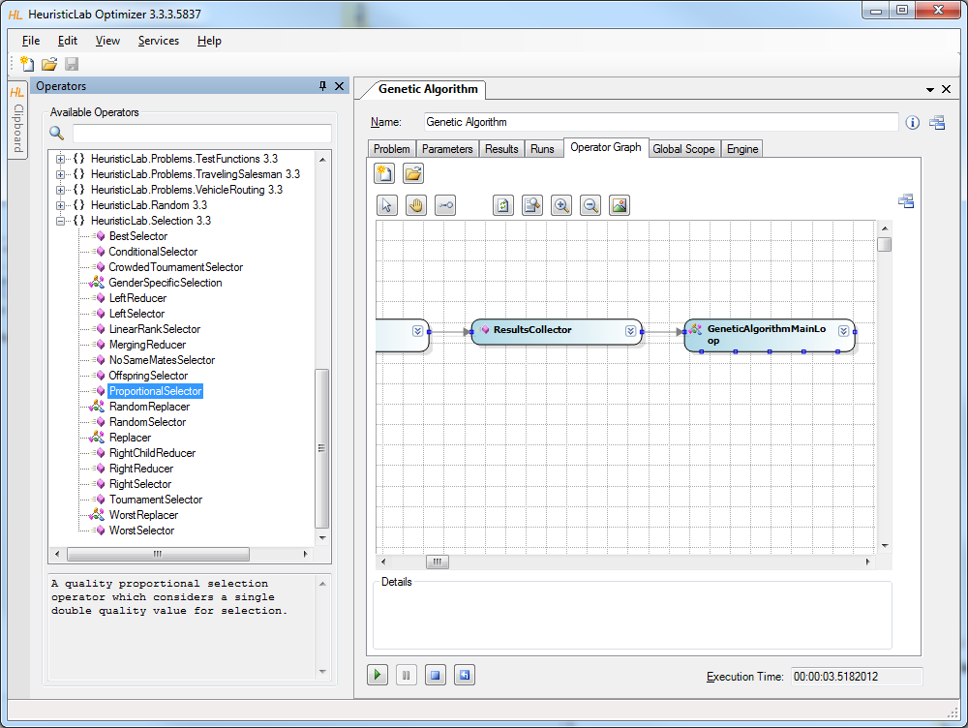
Building User-Defined Algorithms

Slide 46
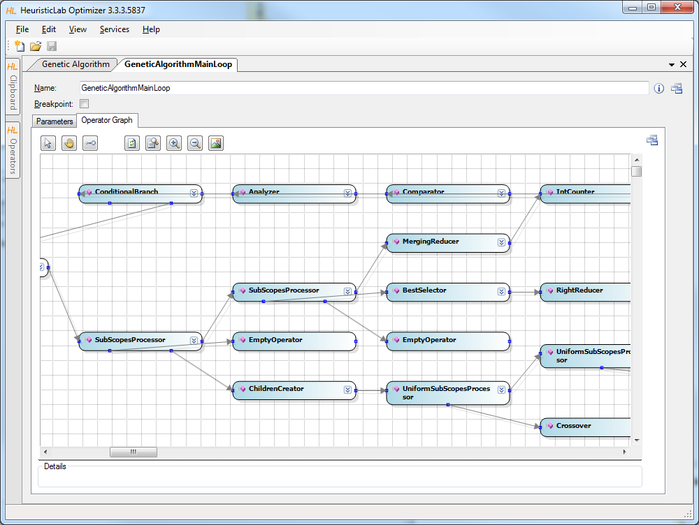
Building User-Defined Algorithms

Slide 47
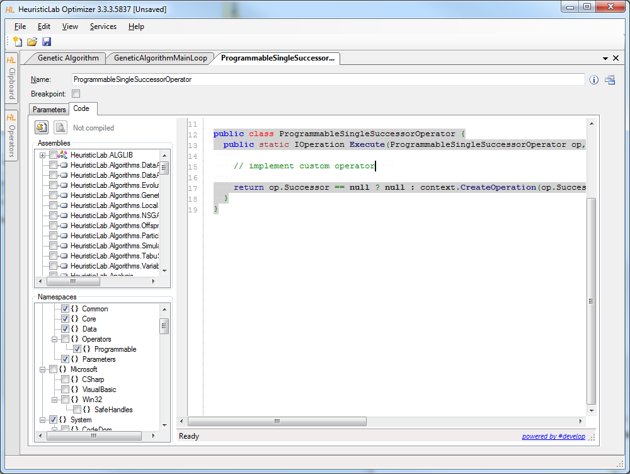
Programmable Operators

Slide 48
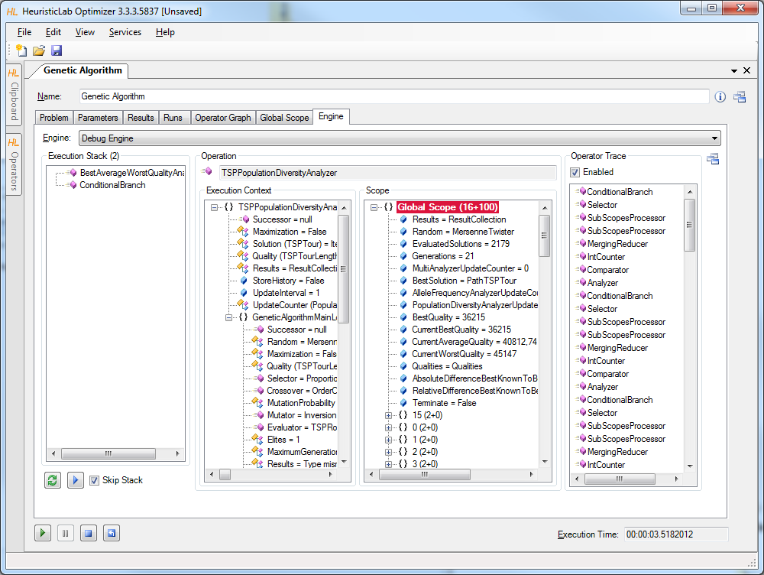
Debugging Algorithms

Slide 49
Agenda
Objectives of the Tutorial
Introduction
Where to get HeuristicLab?
Plugin Infrastructure
Graphical User Interface
Available Algorithms & Problems
Demonstration Part I: Working with HeuristicLab
Demonstration Part II: Data-based Modeling
Some Additional Features
Planned Features
Team
Suggested Readings
Bibliography
Questions & Answers

Slide 50
Demonstration Part II:
Data-based Modeling
Introduction
Regression with HeuristicLab
Model simplification and export
Variable relevance analysis
Classification with HeuristicLab

Slide 51
Introduction to Data-based Modeling
Dataset: Matrix (x_{i,j}) _{i=1..N, j= 1..K}
  N observations of K input variables
  x_{i,j} = i-th observation of j-th variable
  Additionally: Vector of labels (y₁…y_{N})^{T}
Goal: learn association of input variable values to labels
Common tasks
  Regression (real-valued labels)
  Classification (discrete labels)
  Clustering (no labels, group similar observations)

Slide 52
Data-based Modeling Algorithms in HeuristicLab
Symbolic regression and classification based on genetic programming
External Libraries:
  Support Vector Machines for Regression and Classification
  Linear Regression
  Linear Discriminate Analysis
  K-Means clustering

Slide 53
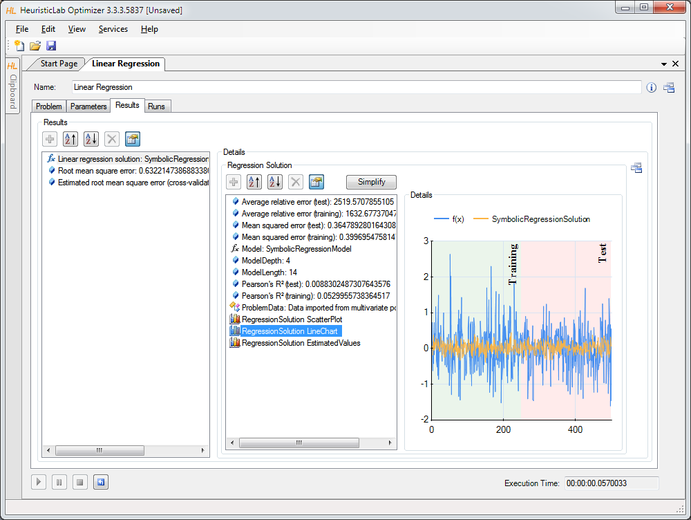
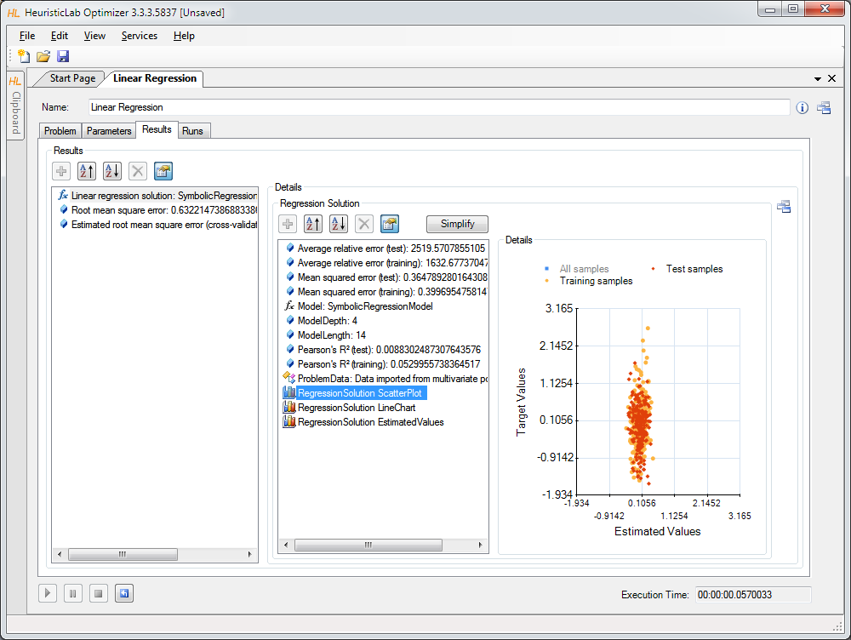
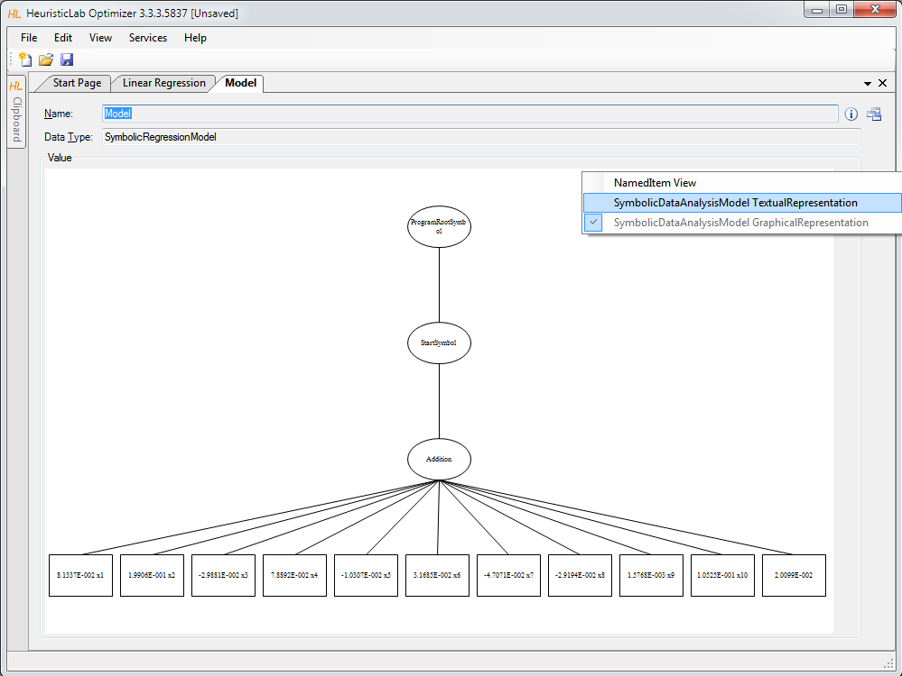
Case Studies
Demonstration
  problem configuration
    data import
    target variable
    input variables
    data partitions (training and test)
  analysis of results
    accuracy metrics
    visualization of model output

Slide 54
Case Study: Regression
Poly-10 benchmark problem dataset
  10 input variables x₁ … x₁₀
  y = x₁ ∙ x₂ + x₃ ∙ x₄ + x₅ ∙ x₆ + x₁ ∙ x₇ ∙ x₉ + x₃ ∙ x₆ ∙ x₁₀
  non-linear modeling approach necessary
  frequently used in GP literature
  download http://dev.heuristiclab.com/AdditionalMaterial#ICCGI2011

Slide 55
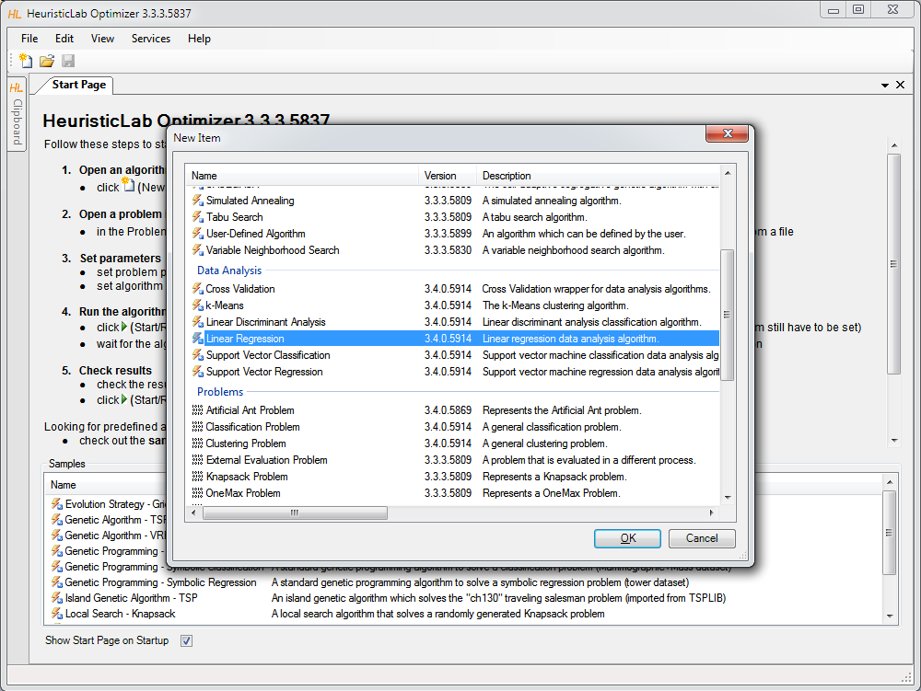
Linear Regression
Create new algorithm

Slide 56
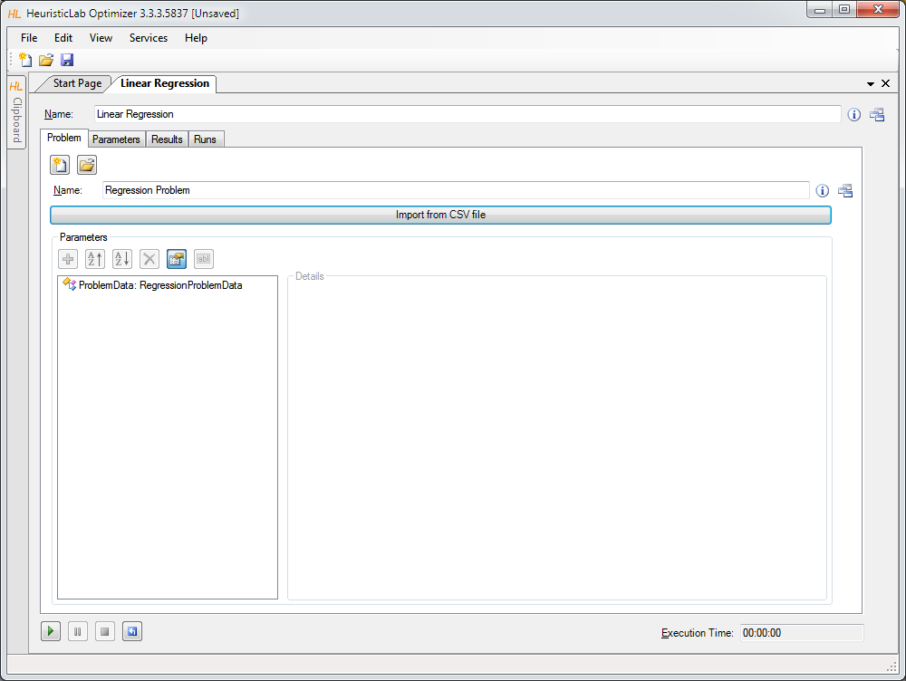
Import Data from CSV-File

Slide 57
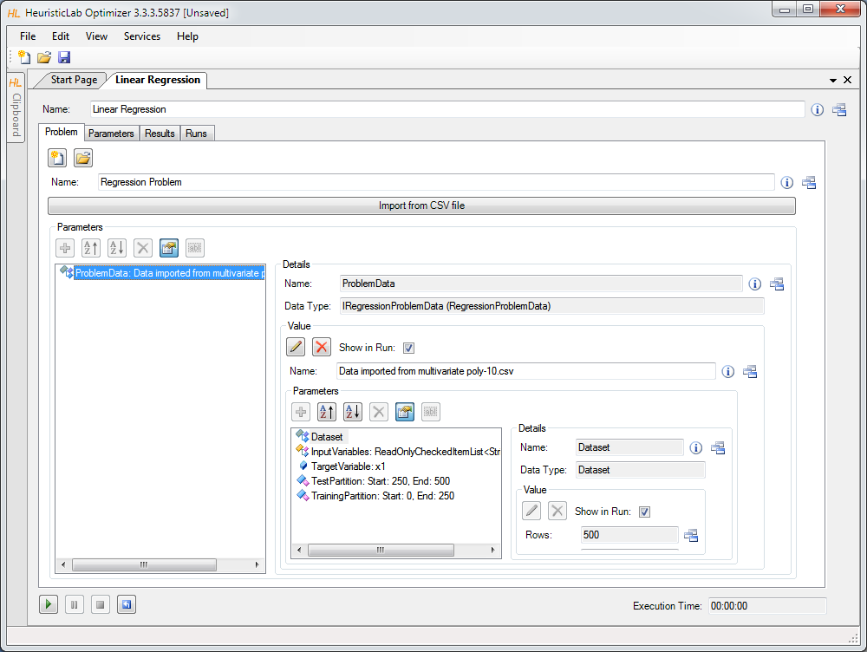
Inspect and Configure Dataset

Slide 58
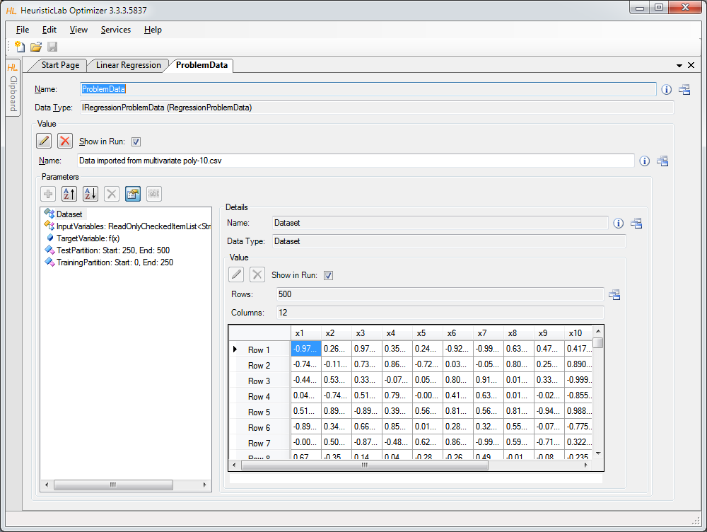
Inspect Imported Data

Slide 59
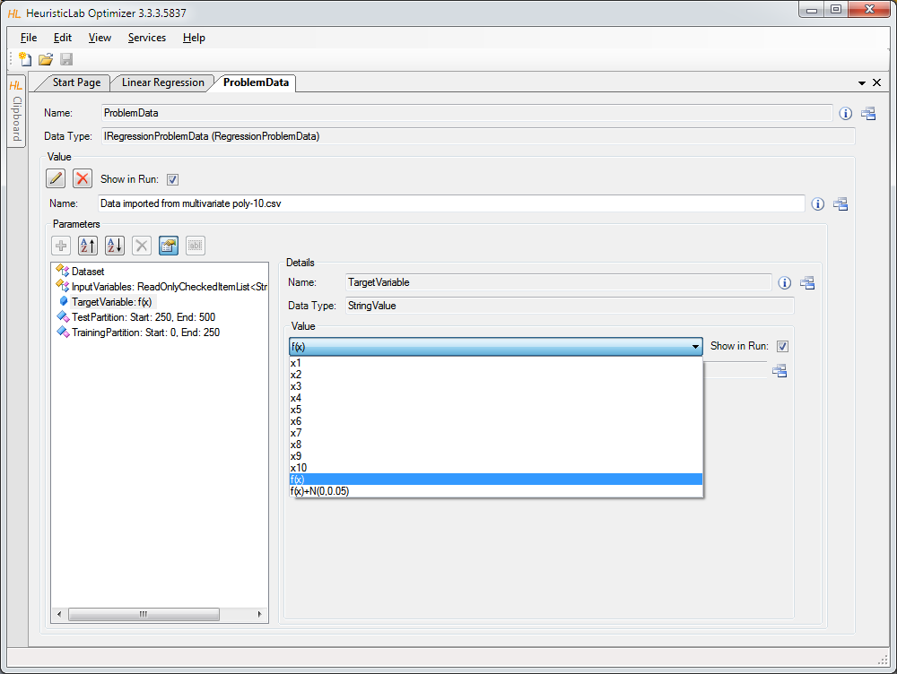
Set Target Variable

Slide 60
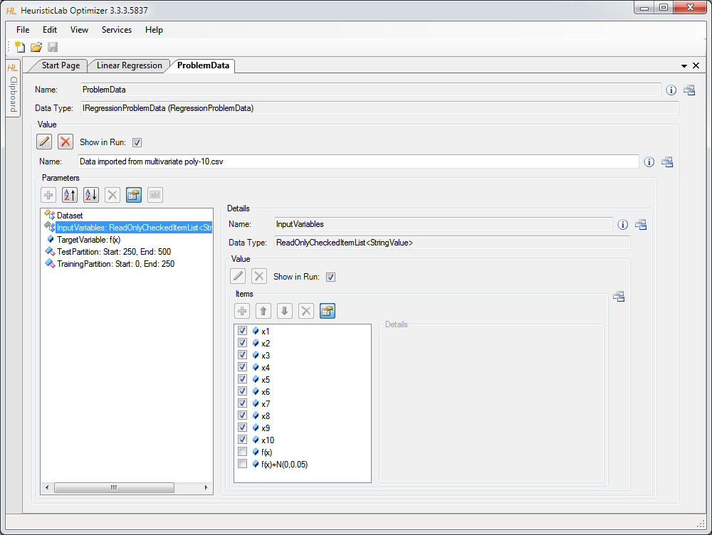
Select Input Variables

Slide 61
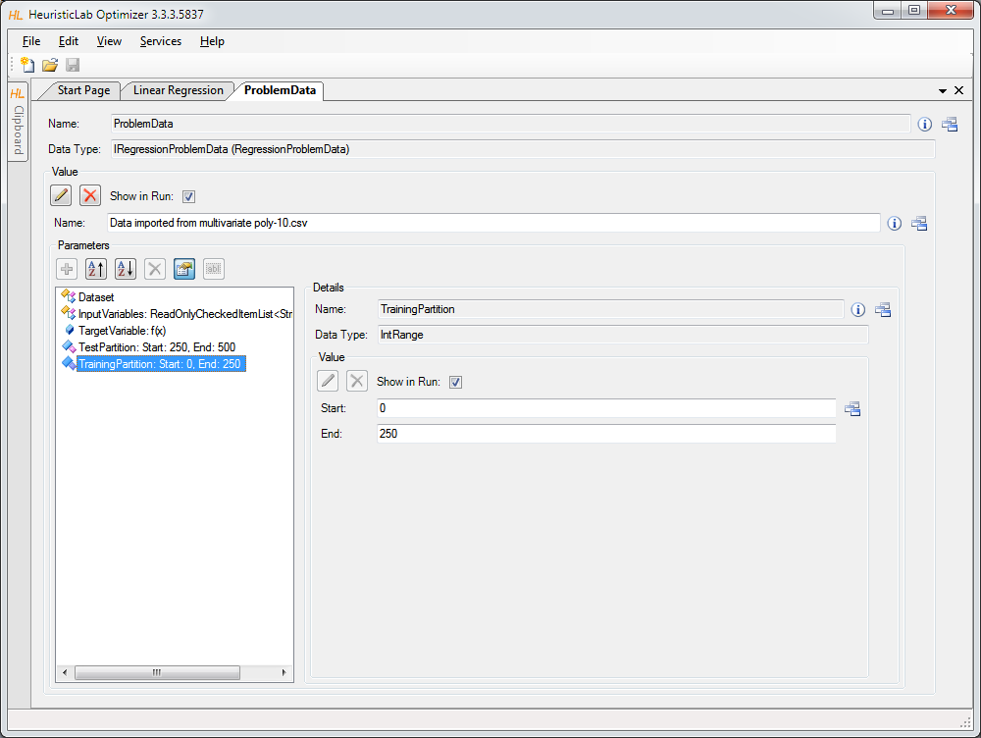
Configure Training and Test Partitions

Slide 62
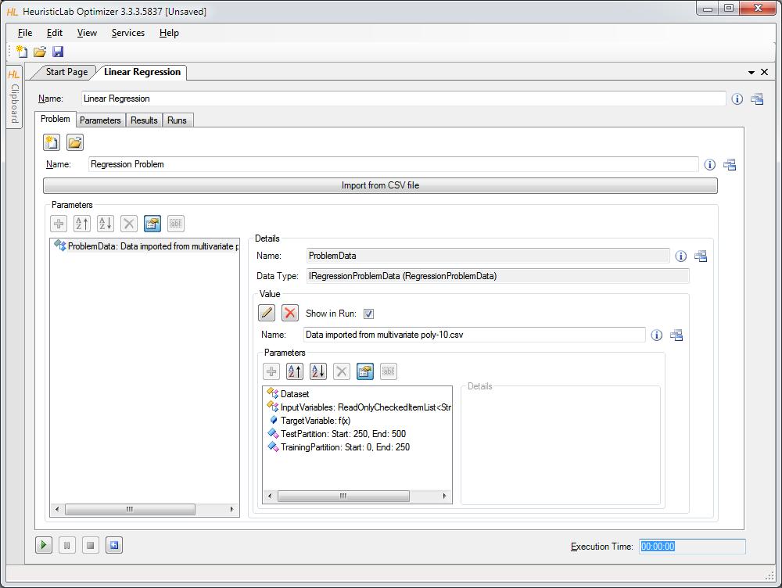
Run Linear Regression

Slide 63

Inspect Results

Slide 64
Inspect Scatterplot of Predicted and Target Values

Slide 65
Inspect Linechart

Slide 66

Inspect Graphical Representation of Model

Slide 67
Symbolic Regression with HeuristicLab
Linear regression produced an inaccurate model.
Next: produce a nonlinear symbolic regression model using genetic programming
Genetic programming
  evolve variable-length models
  model representation: symbolic expression tree
  structure and model parameters are evolved side-by-side
  white-box models
-
+
x3
x1
*
x1
x2

Slide 68


Symbolic Regression with HeuristicLab
Demonstration
  problem configuration
  function set and terminal set
  model size constraints
  Evaluation
Algorithm configuration
  selection
  Mutation
Analysis of results
  model accuracy
  model structure and parameters

Slide 69

Create New Genetic Algorithm

Slide 70

Create New Symbolic Regression Problem

Slide 71

Import Data

Slide 72

Inspect Data and Configure Dataset

Slide 73

Set Target and Input Variables

Slide 74

Configure Maximal Model Depth and Length

Slide 75

Configure Function Set (Grammar)

Slide 76

Configure Function Set (Grammar)

Slide 77

Configure Algorithm Parameters

Slide 78

Configure Mutation Operator

Slide 79

Configure Selection Operator

Slide 80

Configure Tournament Group Size

Slide 81

Start Algorithm and Inspect Results

Slide 82

Inspect Quality Chart

Slide 83

Inspect Best Model on Training Partition

Slide 84

Inspect Linechart of Best Model on Training Partition

Slide 85
Inspect Structure of Best Model on Training Partition

Slide 86


Model Simplification and Export
Demonstration
  automatic simplification
  visualization of node impacts
  manual simplification
    online update of results
  model export
    MATLAB
    LaTeX

Slide 87

Detailed Model Analysis and Simplification

Slide 88

Symbolic Simplification and Node Impacts

Slide 89

Manual Simplification
double-click nodes

Slide 90
Automatic Symbolic Simplification

Slide 91
Textual Representations Are Also Available
Use ViewHost to switch to textual representation view.

Slide 92

Default Textual Representation for Model Export

Slide 93


Textual Representation for Export to LaTeX

Slide 94

LaTeX Export

Slide 95


Variable Relevance Analysis
Which variables are important to predict classes correctly?
Demonstration
  Variable frequency analyzer
  symbol frequency analyzer
  variable impacts

Slide 96
Inspect Variable Frequency Chart

Slide 97
Inspect Variable Impacts

Slide 98

Inspect Symbol Frequencies

Slide 99



Classification with HeuristicLab
Symbolic classification
  evolve discriminating function using GP
  find thresholds to assign classes
Demonstration
  real world medical application
  model accuracy
  visualization of model output
    discriminating function output
    ROC-curve
    confusion matrix

Slide 100
Case Study: Classification
Real world medical dataset (Mammographic Mass) from UCI Machine Learning Repository
  data from non-invasive mammography screening
  variables:
    patient age
    visual features of inspected mass lesions: shape, margin, density
  target variable: severity (malignant, benign)
  download http://dev.heuristiclab.com/AdditionalMaterial#ICCGI2011

Slide 101

Open Sample

Slide 102

Configure and Run Algorithm

Slide 103

Inspect Quality Linechart

Slide 104

Inspect Best Training Solution

Slide 105
Inspect Model Output and Thresholds

Slide 106
Inspect Confusion Matrix

Slide 107
Inspect ROC Curve

Slide 108


Validation of Results
Overfitting = memorizing data
Strategies to reduce overfitting
  validation partition
  cross-validation

Slide 109



Validation of Results
Demonstration
  Configuration of a validation set
  Inspection of best solution on validation set
  Analysis of training- and validation fitness correlation
  Cross-validation
    Configuration
    Analysis of results

Slide 110

Configuration of Validation Partition

Slide 111

Inspect Best Model on Validation Partition

Slide 112
Inspect Linechart of Correlation of Training and Validation Fitness

Slide 113
Agenda
Objectives of the Tutorial
Introduction
Where to get HeuristicLab?
Plugin Infrastructure
Graphical User Interface
Available Algorithms & Problems
Demonstration Part I: Working with HeuristicLab
Demonstration Part II: Data-based Modeling
Some Additional Features
Planned Features
Team
Suggested Readings
Bibliography
Questions & Answers

Slide 114

Some Additional Features
HeuristicLab Hive
  parallel and distributed execution of algorithms
  and experiments on many computers in a network
Optimization Knowledge Base (OKB)
  database to store algorithms, problems, parameters and results
  open to the public
  open for other frameworks
  analyze and store characteristics of problem instances and problem classes
External solution evaluation and simulation-based optimization
  interface to couple HeuristicLab with other applications (MatLab,
  AnyLogic, …)
  supports different protocols (command line parameters, TCP, …)
Parameter grid tests and meta-optimization
  automatically create experiments to test large ranges of parameters
  apply heuristic optimization algorithms to find optimal parameter settings for heuristic optimization algorithms

Slide 115
Planned Features
Algorithms & Problems
  steady-state genetic algorithm
  unified tabu search for vehicle routing
  scatter search
  …
Cloud Computing
  port HeuristicLab Hive to Windows Azure
Linux
  port HeuristicLab to run on Mono and Linux machines
Have a look at the HeuristicLab roadmap
  http://dev.heuristiclab.com/trac/hl/core/roadmap
Any other ideas, requests or recommendations?
  join our HeuristicLab Google group heuristiclab@googlegroups.com or
  write an e-mail to support@heuristiclab.com

Slide 116

HeuristicLab Team
Heuristic and Evolutionary Algorithms Laboratory (HEAL)
School of Informatics, Communications and Media
University of Applied Sciences Upper Austria
Softwarepark 11
A-4232 Hagenberg
AUSTRIA
WWW: http://heal.heuristiclab.com

Slide 117


Suggested Readings
S. Voß, D. Woodruff (Edts.)
Optimization Software Class Libraries
Kluwer Academic Publishers, 2002
M. Affenzeller, S. Winkler, S. Wagner, A. Beham
Genetic Algorithms and Genetic Programming
Modern Concepts and Practical Applications
CRC Press, 2009

Slide 118
Bibliography
S. Wagner, M. Affenzeller
HeuristicLab: A generic and extensible optimization environment
Adaptive and Natural Computing Algorithms, pp. 538-541
Springer, 2005
S. Wagner, S. Winkler, R. Braune, G. Kronberger, A. Beham, M. Affenzeller
Benefits of plugin-based heuristic optimization software systems
Computer Aided Systems Theory - EUROCAST 2007, Lecture Notes in Computer Science, vol. 4739, pp. 747-754
Springer, 2007
S. Wagner, G. Kronberger, A. Beham, S. Winkler, M. Affenzeller
Modeling of heuristic optimization algorithms
Proceedings of the 20th European Modeling and Simulation Symposium, pp. 106-111
DIPTEM University of Genova, 2008
S. Wagner, G. Kronberger, A. Beham, S. Winkler, M. Affenzeller
Model driven rapid prototyping of heuristic optimization algorithms
Computer Aided Systems Theory - EUROCAST 2009, Lecture Notes in Computer Science, vol. 5717, pp. 729-736
Springer, 2009
S. Wagner
Heuristic optimization software systems - Modeling of heuristic optimization algorithms in the HeuristicLab software environment
Ph.D. thesis, Johannes Kepler University Linz, Austria, 2009.
S. Wagner, A. Beham, G. Kronberger, M. Kommenda, E. Pitzer, M. Kofler, S. Vonolfen, S. Winkler, V. Dorfer, M. Affenzeller
HeuristicLab 3.3: A unified approach to metaheuristic optimization
Actas del séptimo congreso español sobre Metaheurísticas, Algoritmos Evolutivos y Bioinspirados (MAEB'2010), 2010
Detailed list of all publications of the HEAL research group: http://research.fh-ooe.at/de/orgunit/detail/356#showpublications

Slide 119
Questions & Answers
http://dev.heuristiclab.com
heuristiclab@googlegroups.com

