Slide 1



HeuristicLab Hive
An Open Source Environment for Parallel and Distributed
Execution of Heuristic Optimization Algorithms
S. Wagner, C. Neumüller, A. Scheibenpflug
Heuristic and Evolutionary Algorithms Laboratory (HEAL)
School of Informatics, Communications and Media, Campus Hagenberg
Upper Austria University of Applied Sciences

Slide 2
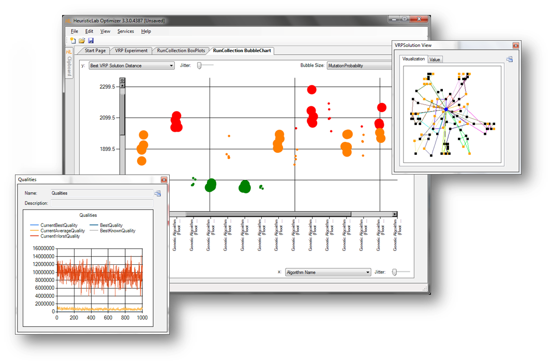

Introduction to HeuristicLab
Motivation and Goals
  graphical user interface
  paradigm independence
  multiple algorithms and problems
  large scale experiments and analyses
  parallelization
  extensibility, flexibility and reusability
  visual and interactive algorithm development
  multiple layers of abstraction
Facts
  development of HeuristicLab started in 2002
  based on Microsoft .NET and C#
  used in research and education
  second place at the Microsoft Innovation Award 2009
  open source (GNU General Public License)
  version 3.3.0 released on May 18th, 2010
  latest version 3.3.4 released on May 4th, 2011

Slide 3
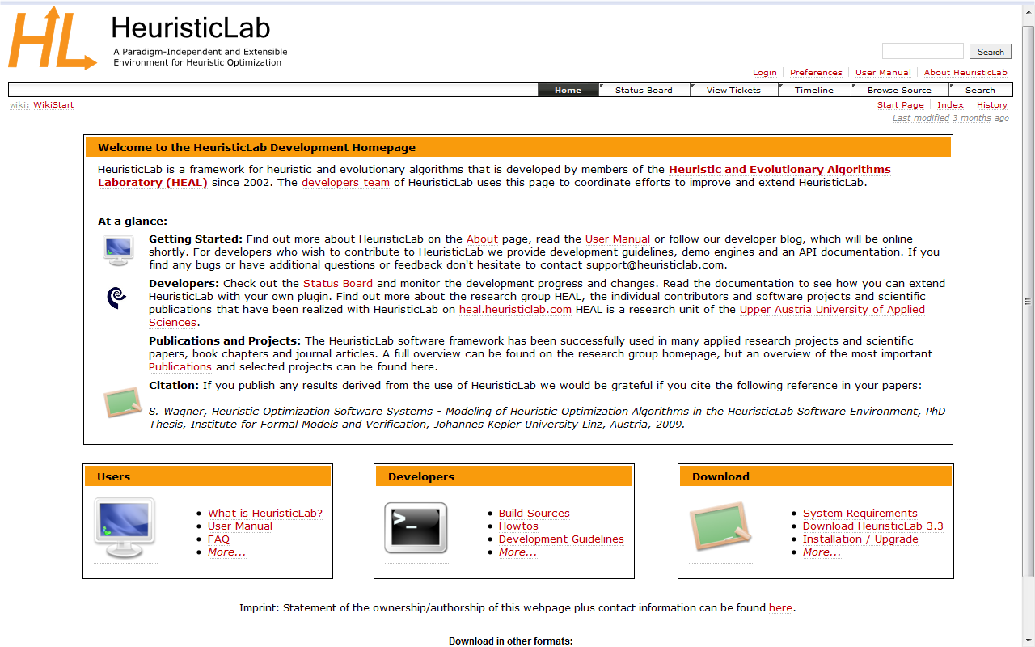
Where to get HeuristicLab?
Download binaries
  deployed as ZIP archives
  latest stable version 3.3.4
    released on May 4th, 2011
  daily trunk build
  http://dev.heuristiclab.com/download
Check out sources
  SVN repository
  HeuristicLab 3.3.4 tag
    http://dev.heuristiclab.com/svn/hl/core/tags/3.3.4
  current development trunk
    http://dev.heuristiclab.com/svn/hl/core/trunk
License
  GNU General Public License (Version 3)
System requirements
  Microsoft .NET Framework 4.0 Full Version
  enough RAM and CPU power ;-)

Slide 4
Available Algorithms & Problems
Algorithms
Problems
Genetic Algorithm
Island Genetic Algorithm
Offspring Selection Genetic Algorithm
Island Offspring Selection Genetic Alg.
SASEGASA
Evolution Strategy
NSGA-II
Local Search
Simulated Annealing
Tabu Search
Linear Regression
Support Vector Machine
User-Defined Algorithm
Single-Objective Test Function
Traveling Salesman Problem
Vehicle Routing Problem
Knapsack
OneMax
Data Analysis
Symbolic Regression
Classification
Artificial Ant
External Evaluation Problem
User-Defined Problem

Slide 5
Batch Runs & Experiments
Batch runs
  execute the same optimizer (e.g. algorithm, batch run, experiment) several times
Experiments
  execute different optimizers
  suitable for large scale algorithm comparison and analysis
Experiments and batch runs can be nested
Generated runs can be compared afterwards

Slide 6
Multi-core CPUs & Parallelization
Parallel execution of optimizers in experiments
  optimizers in an experiment are executed sequentially from top to bottom per default
  experiments support parallel execution of their optimizers
  select a not yet executed optimizer and start it manually to utilize another core
  execution of one of the next optimizers is started automatically after an optimizer is finished
Parallel execution of algorithms
  HeuristicLab provides special operators for parallelization
  engines decide how to execute parallel operations
  sequential engine executes everything sequentially
  parallel engine executes parallel operations on multiple cores
  all implemented algorithms support parallel solution evaluation
  Hive engine executes parallel operations on multiple computers

Slide 7
Motivation for HeuristicLab Hive
Experiments are very runtime consuming
  many different optimization algorithms and parameter settings have to be executed and analyzed
  very runtime consuming task, but parallelizable
Peak time demands
  HPC infrastructure is overloaded before conference deadlines
Flexible resource usage
  avoid explicit reservations
  resources are used as long as they are needed
  multicore resources can be shared
Utilize desktop computers of FH OÖ and research partners
  hundreds of powerful multicore desktop machines can be used during the night
Notes:
Experimentation with different parameters
Peak times
Usage of university resources

Slide 8
Other Existing Frameworks
BOINC
  C/C++, open source
  no client groups, no timetables
Utilify
  .NET, closed source
ParadisEO
  C/C++, MPI, open source
  specialized for evolutionary algorithms (not generic)
ECJ
  Java, open source
  specialized for evolutionary algorithms (not generic)
Notes:
several open source frameworks
no c# frameworks

Slide 9
HeuristicLab Hive Requirements
Open source, based on .NET and C#
Distributed execution of arbitrary jobs
  not only HeuristicLab algorithms
Utilization of heterogeneous resources
  HPC infrastructure, desktop computers, …
Scalability and Elasticity
  add or remove slaves at any time
  helps to overcome demand peaks
Time schedule
  use some resources only during the night, in the holidays, …
Notes:
% * distributed computing of ``jobs'' - mainly heuristiclab algorithms
% * open source c# distributed computing
% * heterogenity - utilization of hpc infrastructure and desktop computers (multi core). also from other networks (bypass firewalls and nats) : because distribution time is not critical
% * elasticity, slaves can be added/removed any time - for peak demand
% * deployment of assemblies
% * security - groups, encryption, sandboxing

Slide 10
HeuristicLab Hive Requirements
Deployment of assemblies
  jobs can specify assembly dependencies
  slave loads assemblies into AppDomain for execution
  no need to update slaves with new versions of software
Security
  jobs can specify to be executed only on specific slaves
  encrypted communication
  sandboxed job execution
Notes:
% * distributed computing of ``jobs'' - mainly heuristiclab algorithms
% * open source c# distributed computing
% * heterogenity - utilization of hpc infrastructure and desktop computers (multi core). also from other networks (bypass firewalls and nats) : because distribution time is not critical
% * elasticity, slaves can be added/removed any time - for peak demand
% * deployment of assemblies
% * security - groups, encryption, sandboxing

Slide 11
HeuristicLab Hive Components
Hive Client (HeuristicLab)
  GUI to upload and control jobs
  administration interface
Hive Slave
  job execution (sandboxed)
  plugin management and caching
Hive Server
  slave management (detect dead slaves)
  job scheduling (rescheduling of dead jobs)
  controls timetable for each slave
Hive Client
Hive Slave
IIS
Hive Server
DB
Notes:
% * components: server, slave, client
% * technologies
% * job: IJob, Storable
% * heartbeat mechanism

Slide 12
HeuristicLab Hive Components
Two different ways of parallelization using HeuristicLab Hive
  execution of separate algorithm instances
    each algorithm is a job
  execution of one algorithm in parallel (HiveEngine)
    each solution evaluation is a job
Job
Job
Job
Job
Initialize
Selection
Recombination
Evaluation
Parallel=true
Job
Job
Job
Job
Job
Mutation
Notes:
% * components: server, slave, client
% * technologies
% * job: IJob, Storable
% * heartbeat mechanism

Slide 13
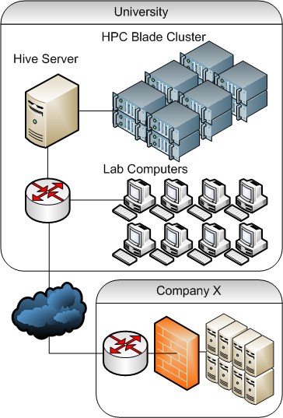
HeuristicLab Hive Communication
Slave Communication
  periodic messages containing current status (progress of jobs)
  communication is initiated only by slaves
  avoid NAT and Firewalls problems
  server response contains next actions
    CalculateJob
    AbortJob
    DoNothing
    …
Notes:
Möglichkeit zur Ausweitung in die Cloud erwähnen

Slide 14

HeuristicLab Hive Infrastructure
Current Setup
  Blade System: Dell PowerEdge M1000e
    28x Intel Xeon E5420, 2.5GHz = 112 Cores
  Workstation Cluster:
    14x Intel Pentium 4, 2.8GHZ = 28 Cores
  Computer Labs (at night)
    Lab1: 10x Intel Core 2 Duo, 2.8Ghz = 20 Cores
    Lab2: 10x Intel Core i5 750, 2.66GHz = 40 Cores
Future Setup
  add more desktop computers
    up to approx. 500 PCs at FH OÖ Campus Hagenberg
  add external partners
Notes:
HPC Blade
* 12x8 Xeon blubb
Desktop Computers (PLS3+PLS4)
* 10x2 Intel blubb (PLS3)
* 10x4 Intel bla (PLS4)
Goal (future)
* whole university (=? desktops) at night

Slide 15
HeuristicLab Hive Applications
Metaheuristic Optimization Experiments
  execution of different instances of an algorithm with different parameter settings
  intensively used by HEAL researchers to speed up tests
Meta-Optimization
  special parameter optimization algorithm
  very expensive solution evaluation (done by HiveEngine)
  ongoing master thesis
    time on Hive: 1598,26 days (4 years, 4 months, 16 days)
    during approx. 5 weeks

Slide 16
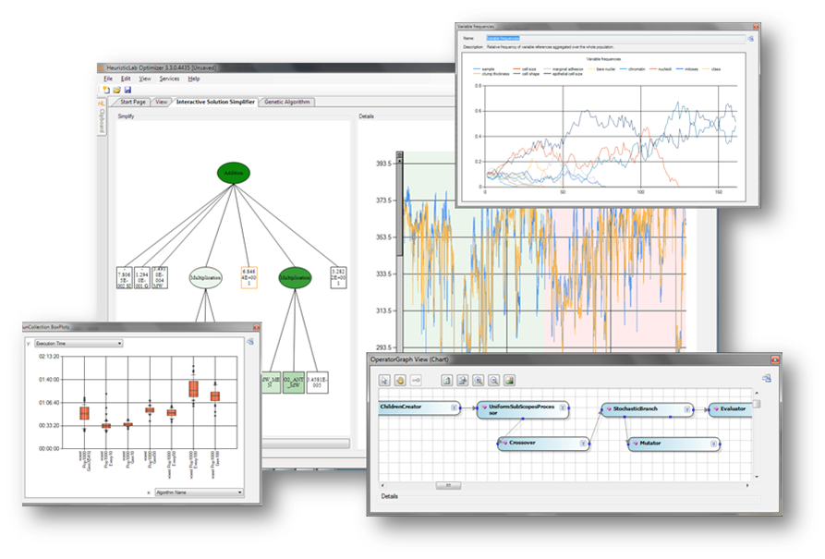
Demonstration

Slide 17
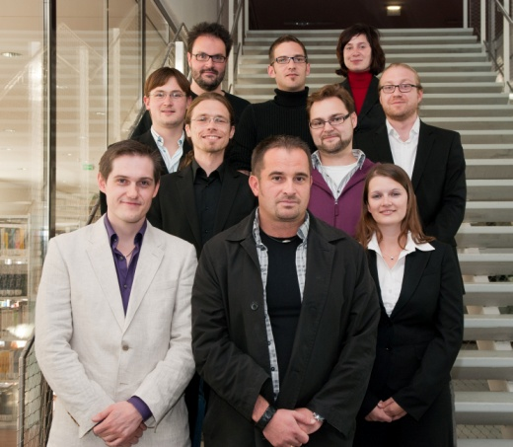
Team & Contact
Heuristic and Evolutionary Algorithms Laboratory (HEAL)
School of Informatics, Communications and Media
Upper Austria University of Applied Sciences
Softwarepark 11
A-4232 Hagenberg
AUSTRIA
WWW: http://heal.heuristiclab.com

Slide 18
Questions & Answers
http://dev.heuristiclab.com
support@heuristiclab.com

