Slide 1
Heuristiclab Hive
Goals
Realization
Deployment

Slide 2
HeuristicLab Hive
Motivation
Experimentation is runtime comsuming
  Testing different optimization algorithms and parameters is runtime consuming, but also parallelizable
Peak time demand
  HPC infrastructure is overloaded before conferences
Flexible resource usage
  No more reservations required
  Resources are used as long as they are needed
  Multicore resources can be shared
Utilization of desktop computers at University
  Hundrets of powerful multicore desktop machines could be used at night
Notes:
Experimentation with different parameters
Peak times
Usage of university resources

Slide 3
HeuristicLab Hive
Existing Software
BOINC
  C/C++, Open Source
  No client groups, not timetables
Utilify
  .NET, Closed Source
ParadisEO
  C/C++, MPI, Open Source
  Specialized for evolutionary algorithms (not generic)
ECJ
  Java, Open Source
  Specialized for evolutionary algorithms (not generic)
Notes:
several open source frameworks
no c# frameworks

Slide 4
HeuristicLab Hive
Requirements
  Open source, .NET based
  Distributed execution of “jobs”
    not just HeuristicLab algorithms
  Utilization of heterogeneous resources
    HPC infrastructure, desktop computers, …
  Elasticity
    adding and removing slaves any time
    to overcome peaks computational needs
  Time schedule
    to use resources only during the night
Notes:
% * distributed computing of ``jobs'' - mainly heuristiclab algorithms
% * open source c# distributed computing
% * heterogenity - utilization of hpc infrastructure and desktop computers (multi core). also from other networks (bypass firewalls and nats) : because distribution time is not critical
% * elasticity, slaves can be added/removed any time - for peak demand
% * deployment of assemblies
% * security - groups, encryption, sandboxing

Slide 5
HeuristicLab Hive
Requirements
  Deployment of assemblies
    Jobs can specify assembly dependencies
    Slave loads assemblies into AppDomain for execution
    No need to update slaves with new versions of software
  Security
    Jobs can specify to be executed on specific slaves
    Encrypted communication
    Sandboxed job execution
Notes:
% * distributed computing of ``jobs'' - mainly heuristiclab algorithms
% * open source c# distributed computing
% * heterogenity - utilization of hpc infrastructure and desktop computers (multi core). also from other networks (bypass firewalls and nats) : because distribution time is not critical
% * elasticity, slaves can be added/removed any time - for peak demand
% * deployment of assemblies
% * security - groups, encryption, sandboxing

Slide 6
HeuristicLab Hive
Realization
Hive Client (HeuristicLab)
  GUI to upload and control jobs
  Administration interface
Hive Slave
  Job execution (sandboxed)
  Plugin management and caching
Hive Server
  Slave management (detect dead slaves)
  Job scheduling (rescheduling of dead jobs)
  Satisfy timetable for each slave
Hive Client
Hive Slave
IIS
Hive Server
DB
Notes:
% * components: server, slave, client
% * technologies
% * job: IJob, Storable
% * heartbeat mechanism

Slide 7
HeuristicLab Hive
Realization
Two types of parallelization in HeuristicLab
  Execution of separate algorithm instances
    Each algorithm is a job
  Execution of one algorithm in parallel (HiveEngine)
    Each solution evaluation is a job
Job
Job
Job
Job
Initialize
Selection
Recombination
Evaluation
Parallel=true
Job
Job
Job
Job
Job
Mutation
Notes:
% * components: server, slave, client
% * technologies
% * job: IJob, Storable
% * heartbeat mechanism

Slide 8
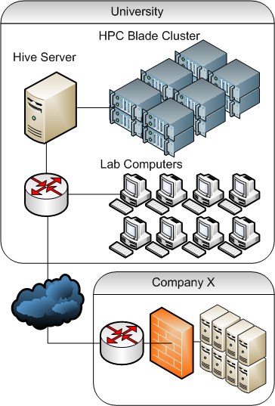
HeuristicLab Hive
Realization
Slave Communication
  Periodic message containing current status (progress of jobs)
  Communication only initiated by slave
  Avoid NAT and Firewalls problems
  Server response contains next actions
      CalculateJob
      AbortJob
      DoNothing
Notes:
Möglichkeit zur Ausweitung in die Cloud erwähnen

Slide 9

HeuristicLab Hive
Deployment
Current Deployment
  Blade System: Dell PowerEdge M1000e
    28x Intel Xeon E5420, 2.5GHz = 112 Cores
  Wulfpack Cluster:
    14x Intel Pentium 4, 2.8GHZ = 28 Cores
  Laboratories (at night)
    Lab1: 10x Intel Core 2 Duo, 2.8Ghz = 20 Cores
    Lab2: 10x Intel Core i5 750, 2.66GHz = 40 Cores
Future Deployment
  More University Desktop Computers
    Up to …
  External Companies
Notes:
HPC Blade
* 12x8 Xeon blubb
Desktop Computers (PLS3+PLS4)
* 10x2 Intel blubb (PLS3)
* 10x4 Intel bla (PLS4)
Goal (future)
* whole university (=? desktops) at night

Slide 10
HeuristicLab Hive
Current Applications
Experimentation / Research
  Execution of different instances of an algorithm with different parameters
  Heavily used by HEAL researchers to speed up tests
Meta-Optimization
  Special parameter optimization algorithm
  Very expensive solution evaluation (usage of HiveEngine)
  Ongoing master thesis
    Time on Hive: 1598,26 days (4 years, 4 months, 16 days)
    during ~5 weeks

