Slide 2
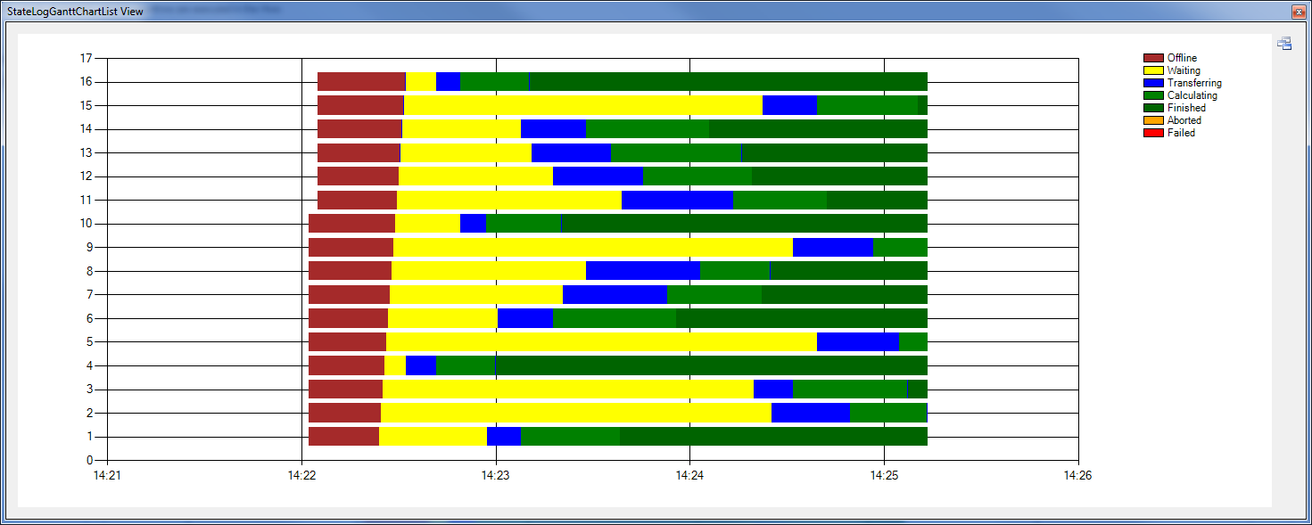
Offline
Transferring
Waiting
Transferring
Calculating
Transferring
Finished
Client
UploadJob
AssignJob
Server
AddJob
DetermineAction
SendFinished
Job
SendFinished
Job
Slave

