Slide 1
HeuristicLab.Hive

Slide 2
Overview
Hive Overview
What is a Job?
Job Lifecycle
Demo
Future

Slide 3
Hive Overview
HL.Authentication
HL.Hive
Client Management
Keep track of online clients
Determine broken jobs
ASP.NET Authentication
Authentication
Authorization
Job Scheduling
Available Cores/RAM
Time Schedule
DataAccess (LinqToSql)
Hive Server
Job Distribution
Job Requests
Job Transport
Calendar Exchange
WCF Services
Plugin Deployment
Dependency Resolution
Transport
Storage
Hive Server GUI
Client Mgmt.
Job Mgmt.
Time Scheduling
Hive Slave
HeuristicLab
WCF Service
Hive Client GUI
Configuration of Jobs
HiveExperiments Mgmt.
Downloading of Results
Job Execution
Sandboxing (App Domains)
Progress Reporting (Heartbeats)
Hive Slave GUI
Calendar Mgmt.
Job Mgmt.

Slide 4
Hive Overview
Communication
  WCF
  HTTP / MessageSecurity
  NETTCP / TransportSecurityWithCredentials
    Streaming for heavy weight Operations
Authentication
  ASP.NET Authentication
  SqlServer as Provider
  Will be SSO with other HL Services

Slide 5
Hive Overview
Job Scheduling
  Time Schedule
  Free Memory
  Free Cores (= TotalCores – JobsCalculating)
Plugin-Deployment
  Determines dependencies before submitting Job
  When Slave executes a job, it requests the plugins from Server
    Slave caches already downloaded plugins
    Server must* have those plugins
      * this is subject of future change, so that a client can submit the plugins

Slide 6



Hive Overview
Server-Slave Communication realized with „Heartbeats“
  Slave sends heartbeat signals in intervals
  To avoid Firewall and NAT-Problems
  Contains
    FreeMemory, FreeCores
    Ids & ExecutionTime of calculating Jobs
  Response tells the Slave
  what to do next
    FetchNewJob
    AbortJob

Slide 7
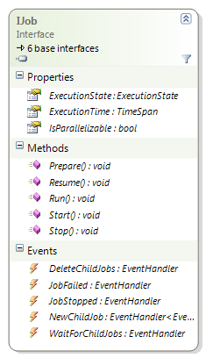
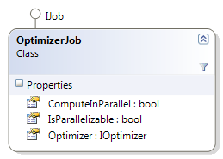
Jobs
IJob
  Any object which implements IJob can be sent to the Hive Server
OptimizerJob
  Is an implementation for executing of HL.Optimizers
  Can also specify to be executed in parallel
  (only if its a Experiment or BatchRun)

Slide 8
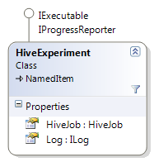
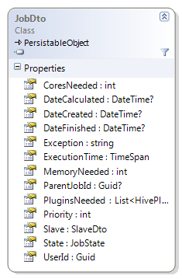
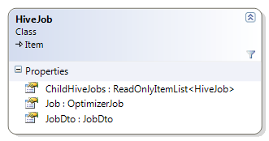
Jobs
HiveExperiment
  Contains one Root-HiveJob
HiveJob
  HiveJobs are items displayed in HeuristicLab
  They maintain a tree of HiveJobs
  (synchronized with the Optimizer-Tree from an HL.Experiment)
  Contains JobDto
  (status info from database)
JobDto
  Database Entity
  Configuration

Slide 9
Job Object Trees
Parallel=true
Experiment
HiveJob
OptimizerJob
JobDto
Parallel=true
GP - TSP
Experiment
HiveJob
HiveJob
OptimizerJob
OptimizerJob
JobDto
JobDto
GP - TSP
BatchRun(3)
Parallel=false
HiveJob
HiveJob
OptimizerJob
OptimizerJob
GP - TSP
JobDto
JobDto

Slide 10
Job Object Trees
Parallel=true
Experiment
HiveJob
OptimizerJob
JobDto
Parallel=true
GP - TSP
Experiment
HiveJob
HiveJob
OptimizerJob
OptimizerJob
JobDto
JobDto
GP - TSP
BatchRun(3)
Parallel=true
HiveJob
HiveJob
OptimizerJob
OptimizerJob
GP - TSP
JobDto
JobDto
HiveJob
HiveJob
OptimizerJob
HiveJob
OptimizerJob
JobDto
OptimizerJob
JobDto
JobDto

Slide 11
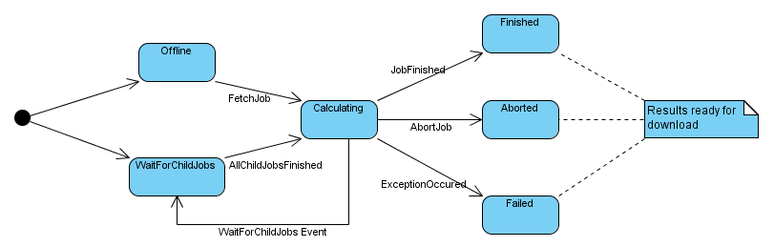
Job Lifecycle

Slide 12
Demo

Slide 13
Future
Deployment
  Deploy Server on HL.Services
  Integrate Client into trunk for wider adoption (& testing)
  Deploy more Slaves (Blade Nodes, Labs)
Server
  New Administration GUI (HL 3.3 Style)
Slave
  Implement as Windows Service & Standalone HL.Application
Plugin-Management
  Required Plugins can be submitted with Job
  Store in DB
Job-Control
  Abort, Restart, Pause, …
Hive for Algorithms
  Algorithms can produce child-jobs during runtime and wait for results
  e.g. Island GP, MetaOptimization, …

Slide 14
end.

Slide 15
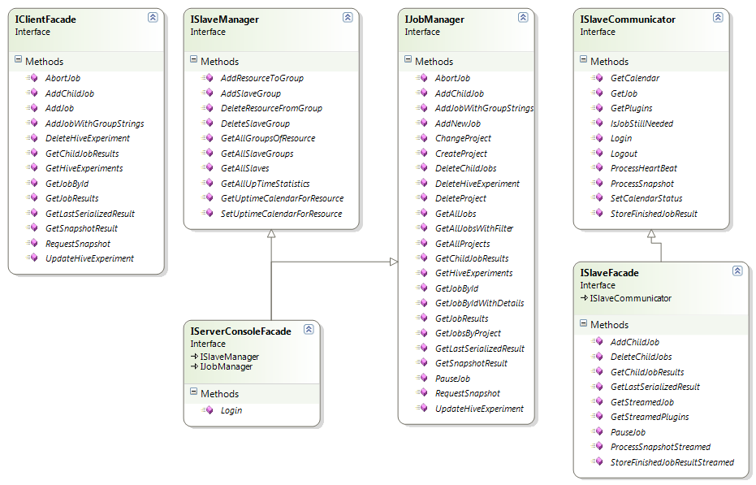
Hive Services*
*Subject of future simplifications

