Slide 1
HeuristicLab 3.0
Overview

Slide 2
Motivation
genericity
  no focus on any particular heuristic optimization paradigm
  suitable for any kind of algorithm
  suitable for any kind of problem and solution representation
modularity
  plug-ins
usability
  extensive use of graphical user interfaces (WinForms)
  step-wise algorithm execution
  persistence
  interactive algorithm engineering
parallelism
  integration of parallel algorithms
  separation of algorithms and parallelization concept

Slide 3
Plugin Infrastructure
using HeuristicLab.PluginInfrastructure;
namespace MyProject {
[ClassInfo(Name = "My Project", Version = "0.99.0.0", Description = "Just an example plugin")]
[PluginFile(Filename = "MyProject.dll", Filetype = PluginFileType.Assembly)]
[PluginFile(Filename = "ZipLibrary.dll", Filetype = PluginFileType.Assembly)]
[PluginFile(Filename = "Database.db", Filetype = PluginFileType.Data)]
[Dependency(Dependency = "HeuristicLab.Data")]
[Dependency(Dependency = "HeuristicLab.Random")]
public class MyProjectPlugin : PluginBase {
}
}
a plugin can contain multiple files (assemblies, data files, images, icons, …)
plugins may depend on each other
plugin meta-data (descriptions, dependencies, etc.) are stored in the code files (attributes)
no XML description file like in HeuristicLab 2.0
plugin infrastructure enables drop-in installation (similar to eclipse)

Slide 4
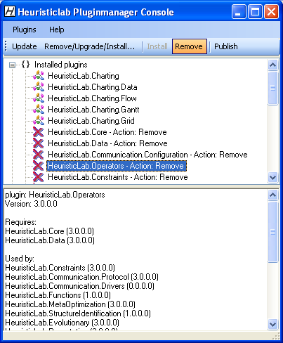
Plugin Infrastructure
plugin manager
  inspired by Debian package management system
  plugins are deployed as ZIP archives
  plugin manager minds dependencies
    required plugins are automatically installed
    dependent plugins are automatically removed
  HTTP-based updating of plugins
  plugins can be installed and removed at runtime
    each application has its own application domain

Slide 5
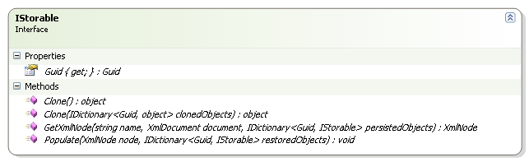
Persistence
basic interface IStorable
  defines unique identifier (GUID)
    Guid Guid { get; }
  defines methods for cloning
    object Clone()
    object Clone(IDictionary<Guid, object> clonedObjects)
  defines methods for persisting to and restoring from XML
    XmlNode GetXmlNode(string name, XMLDocument document, IDictionary<Guid, IStorable> persistedObjects>)
    void Populate(XmlNode node, IDictionary<Guid, IStorable> restoredObjects)
  implemented by abstract base class StorableBase
multiple references to a single object are handled correctly
cyclical object graphs can be cloned or persisted automatically
deep cloning is used by default

Slide 6
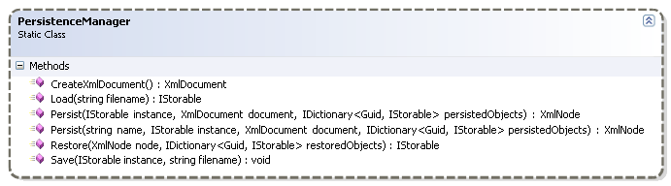
Persistence
static class PersistenceManager
  provides auxiliary methods for persistence
    Load and Save to write IStorable to or to restore it from disk
    Persist and Restore to start persisting or restoring of single IStorable
  by default type names are used as XML tags
  Persist offers parameter (name) to specify some other name as XML tag

Slide 7
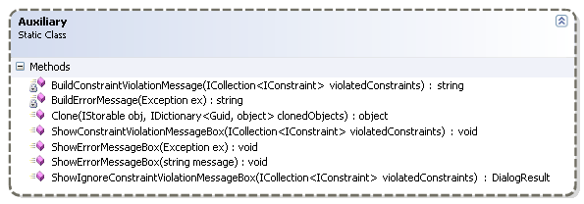
Persistence
static class Auxiliary
  provides auxiliary method for cloning
    Clone to start cloning of a single IStorable
  checks if cloning is necessary or if object has already been cloned
  provides several other methods for showing error messages
methods of PersistenceManager and Auxiliary have to be used to enable correct persisting / cloning of cyclical object graphs

Slide 8
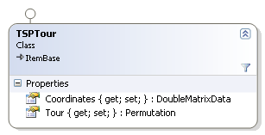
Persistence
persistence code in class TSPTour
example XML snippet
public override XmlNode GetXmlNode(string name, XmlDocument document, IDictionary<Guid, IStorable> persistedObjects) {
XmlNode node = base.GetXmlNode(name, document, persistedObjects);
node.AppendChild(PersistenceManager.Persist("Coordinates", Coordinates, document, persistedObjects));
node.AppendChild(PersistenceManager.Persist("Tour", Tour, document, persistedObjects));
return node;
}
public override void Populate(XmlNode node, IDictionary<Guid, IStorable> restoredObjects) {
base.Populate(node, restoredObjects);
myCoordinates = (DoubleMatrixData)PersistenceManager.Restore(node.SelectSingleNode("Coordinates"), restoredObjects);
myTour = (Permutation)PersistenceManager.Restore(node.SelectSingleNode("Tour"), restoredObjects);
}
<VariableInjector Type="HeuristicLab.Operators.VariableInjector, HeuristicLab.Operators" GUID="65e6153d-18a6-4a9a-9b04-77732e8612b6"
Name="VariableInjector">
<SubOperators />
<VariableInfos />
<Variables>
<Variable Type="HeuristicLab.Core.Variable, HeuristicLab.Core" GUID="d971503d-2ed0-43b2-bc6b-1bce4676dc51" Name="PopulationSize">
<Value Type="HeuristicLab.Data.IntData, HeuristicLab.Data" GUID="0f36459e-1910-4852-91a6-ec37a9767df7">100</Value>
</Variable>
<Variable Type="HeuristicLab.Core.Variable, HeuristicLab.Core" GUID="cb899fcb-76c3-4f86-9699-91cb6ee62420" Name="EvaluatedSolutions">
<Value Type="HeuristicLab.Data.IntData, HeuristicLab.Data" GUID="4bd5b9ae-4ee2-4063-8e17-37972eae50b7">0</Value>
</Variable>
</Variables>
</VariableInjector>

Slide 9
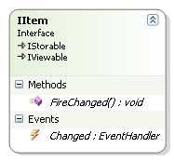
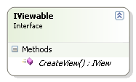
Items
interface IItem
  implements IStorable and IViewable
  base class for (almost) every HeuristicLab object
    data, variables, operators, engines, …
  defines Changed event
  defines method FireChanged to fire Changed event manually
    has to be called if contained complex objects are changed and don't provide an event-based notification (arrays, e.g.)
  implemented by abstract base class ItemBase
interface IViewable
  defines method CreateView for creating a view for an object
  usually a view is a Windows Forms control
  implemented by base class ViewBase
all objects implementing IItem can be shown on the user interface (GUI)
views of complex objects can be assembled using views of their parts
strict use of MVC pattern

Slide 10
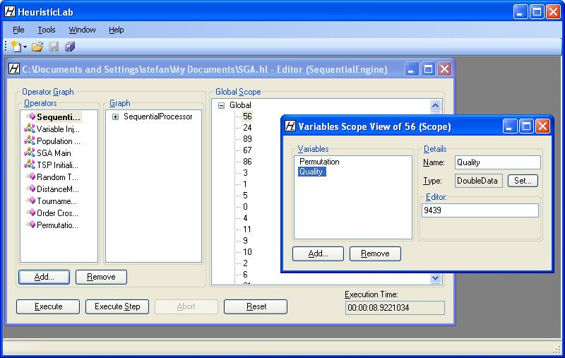
Views
Engine
Operator
Graph
Scope
Scope
Variable
Data

Slide 11
Modeling Algorithms
what is an algorithm?
3 main aspects
  instructions
  sequence of execution
  result
we have to model
  operators modifying data
  graphs of operators representing the sequence of execution
"A finite set of unambiguous instructions performed in a prescribed sequence to achieve a goal, especially a mathematical rule or procedure used to compute a desired result. Algorithms are the basis for most computer programming."
© The American Heritage Dictionary of the English Language

Slide 12
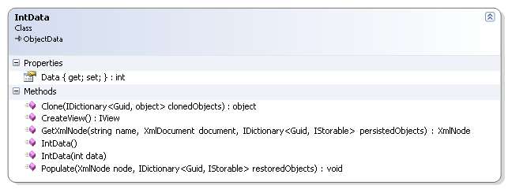
Data
data is represented as objects
  data objects have to implement IItem (are storable and viewable)
  persistence methods have to be implemented
  custom views can be provided
namespace HeuristicLab.Data contains several ready to use data objects
  wrapper objects for system types
    IntData, IntArrayData, IntMatrixData, DoubleData, …
  collections
    ItemList

Slide 13
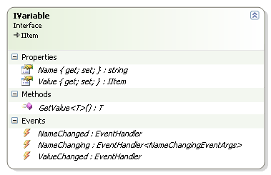
Variables
operators manipulate data
data objects need names to be accessible
interface IVariable
  contains name (Name) and data object (Value)
  defines generic method GetValue to access value
  various events to signal changes (MVC)
  implemented by Variable
IVariable implements IItem
  variables themselves can be
  values of variables
  required for meta-programming
  more on that later …

Slide 14
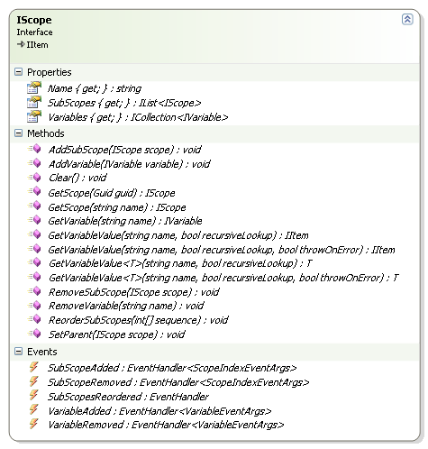
Scopes
variables are organized in scopes
interface IScope
  hierarchical container of variables
  contains variables (Variables)
  contains sub-scopes (SubScopes)
  defines several methods to get/add/remove variables and sub-scopes
  defines method GetVariableValue to perform recursive variable lookup towards the root scope
    variables with identical names hide variables of parent scopes
  events to signal changes (MVC)
  implemented by Scope
scopes build an n-ary tree structure
operators work on scopes
  get variables, manipulate, write back

Slide 15
Operators
operators represent basic instructions of algorithms
operators manipulate scopes (modify variables and/or sub-scopes)
operators decide which operators are executed next
interface IOperator
  contains sub-operators (SubOperators)
  contains local variables (Variables)
  contains meta-information about variables (VariableInfos)
  defines methods to manipulate its data
  events to signal changes
  defines method Execute to execute the operator on a specific scope
  defines GetVariableValue methods for conveniant variable lookup (either in the local variables or in the scope)
  implemented by abstract base class OperatorBase
operators store references to their successor operators (sub-operators)
  build a graph structure (execution graph)

Slide 16
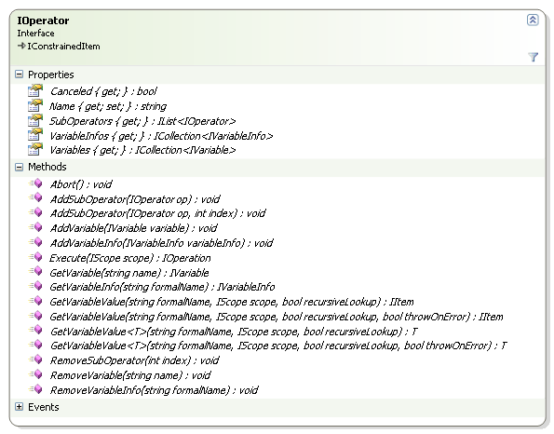
Operators

Slide 17
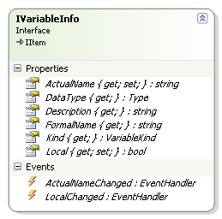
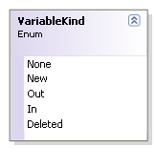
Variable Infos
operators have to be independent of concrete variable names
for example, functionality of a counter operator:
  get variable from scope
  increase the variable's value by 1
  write new variable value back into the scope
mechanism needed to translate formal variable names
into actual variable names
  formal variable name is used by the operator to identify a variable
  actual variable name is the real name of the variable in the scope
interface IVariableInfo
  stores meta-information about variables
    actual name, formal name, data type, description, kind, …
  used by operators to define which variables are required
each operator has to define a variable info object for each variable it requires
  usually done in the operator's constructor
actual names can be set by the user when assembling an algorithm
formal/actual name translation is automatically performed when using an operators GetVariableValue method

Slide 18
Example: Counter
public class Counter : OperatorBase {
public Counter() {
AddVariableInfo(
new VariableInfo("Value", // formal name
"Counter value", // description
typeof(IntData), // data type
VariableKind.In | VariableKind.Out) // kind
);
}
public override IOperation Apply(IScope scope) {
// perform formal/actual name translation
IntData value = GetVariableValue<IntData>("Value", scope, true);
value.Data++;
return null;
}
}

Slide 19
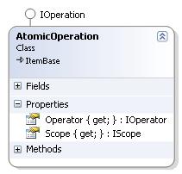
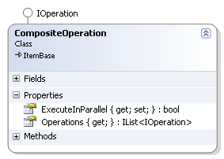
Operations
operators store references to their sub-operators
after execution operators have to decide which operators are executed next
to enable step-wise execution and parallelism operators should not directly execute their successor operators
operators that should be executed next and the corresponding scopes are represented as operations and returned to the engine
interface IOperation
  marker interface inherited from IItem
  doesn't contain anything
  implemented by AtomicOperation and CompositeOperation (composite pattern)
class AtomicOperation
  represents a single operation
  contains an operator (Operator) and a scope (Scope) on which the operator should be executed
class CompositeOperation
  represents an operation consisting of several other operations
  contains a collection of sub-operations (Operations)
  contains flag to indicate if sub-operations can be executed in parallel (ExecuteInParallel)

Slide 20
Example: ConditionalBranch
public class ConditionalBranch : OperatorBase {
public ConditionalBranch() {
AddVariableInfo(new VariableInfo("Condition",
"A boolean variable that decides the branch",
typeof(BoolData),
VariableKind.In));
}
public override IOperation Apply(IScope scope) {
BoolData resultData = GetVariableValue<BoolData>("Condition", scope, true);
bool result = resultData.Data;
if (result)
return new AtomicOperation(SubOperators[0], scope); // true branch
else
return new AtomicOperation(SubOperators[1], scope); // false branch
return null;
}
}

Slide 21
Example: SequentialProcessor, UniformParallelSubScopesProcessor
public class SequentialProcessor : OperatorBase {
public override IOperation Apply(IScope scope) {
CompositeOperation next = new CompositeOperation();
for (int i = 0; i < SubOperators.Count; i++)
next.AddOperation(new AtomicOperation(SubOperators[i], scope));
return next;
}
}
public class UniformParallelSubScopesProcessor : OperatorBase {
public override IOperation Apply(IScope scope) {
CompositeOperation next = new CompositeOperation();
next.ExecuteInParallel = true;
for (int i = 0; i < scope.SubScopes.Count; i++)
next.AddOperation(new AtomicOperation(SubOperators[0], scope.SubScopes[i]));
return next;
}
}

Slide 22
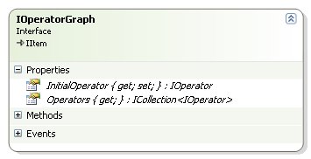
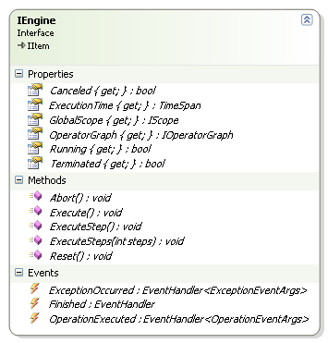
Engines
operators must not call their successor operators directly
engine is responsible for operator execution
engines are able to deal with parallelism
interface IOperatorGraph
  represents an algorithm (a graph of operators)
  contains an initial operator (InitialOperator) and a list of all operators (Operators)
  implemented by OperatorGraph
interface IEngine
  handles execution of operator graphs
  contains an operator graph (OperatorGraph) and a global scope (GlobalScope)
  defines methods to start, stop or abort execution
  implemented by SequentialEngine and ThreadParallelEngine
each execution start with an empty global scope

Slide 23
Architecture
SGA
TSP
Selection
Random
Logging
Sequential
Engine
ThreadParallel
Engine
Permutation
Evolutionary
Operators
Constraints
Data
Core
Plugin Infrastructure
.NET 2.0 / 3.5

Slide 24
Demonstration

