Slide 1




Optimizing External Applications with HeuristicLab
A. Beham, M. Kommenda
Heuristic and Evolutionary Algorithms Laboratory (HEAL)
School of Informatics/Communications/Media, Campus Hagenberg
University of Applied Sciences Upper Austria

Slide 2


Instructor Biographies
Andreas Beham
  Research Associate (since 2007)
  Team: Combinatorial and Simulation-based Optimization
  Graduate of Johannes Kepler University
  PhD in progress
  Member of the HEAL research group
  Architect of HeuristicLab
  http://heal.heuristiclab.com/team/beham
Michael Kommenda
  Research Associate (since 2008)
  Team: System Identification and Data Analysis
  Graduate of University of Applied Sciences Upper Austria
  PhD in progress
  Member of the HEAL research group
  Architect of HeuristicLab
  http://heal.heuristiclab.com/team/kommenda

Slide 3
Latest Version of this Tutorial
An up-to-date version of this tutorial can be downloaded from the HeuristicLab website
  http://dev.heuristiclab.com/trac.fcgi/browser/misc/documentation/Tutorials

Slide 4
Agenda
Objectives of the Tutorial
Introduction
Where to get HeuristicLab?
Plugin Infrastructure
Graphical User Interface
Available Algorithms & Problems
Demonstration Part I: External Evaluation Problem
Demonstration Part II: MATLAB and Scilab Parameter Optimization Problem
Demonstration Part III: Programmable Problem
Some Additional Features
Planned Features
Team
Suggested Readings
Bibliography
Questions & Answers

Slide 5
Objectives of the Tutorial
Introduce general motivation and design principles of HeuristicLab
Show where to get HeuristicLab
Explain basic GUI usability concepts
Demonstrate basic features
Demonstrate optimization of parameters in external applications
Demonstrate optimization of parameters in MATLAB and Scilab
Demonstrate optimization of custom problem definitions
Outline some additional features

Slide 6
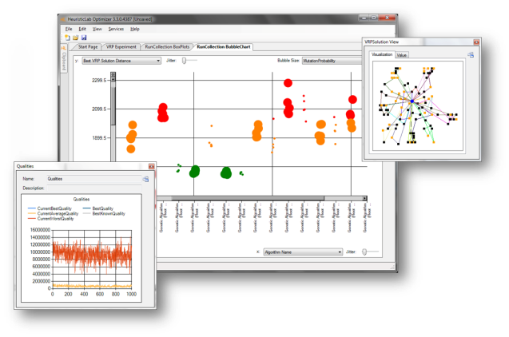
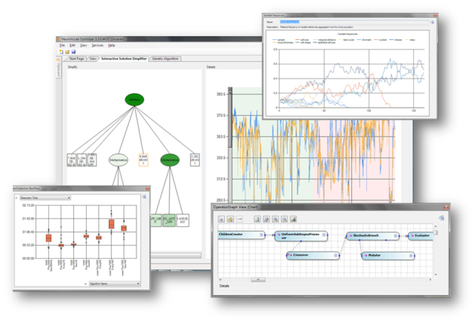

Introduction
Motivation and Goals
  graphical user interface
  paradigm independence
  multiple algorithms and problems
  large scale experiments and analyses
  parallelization
  extensibility, flexibility and reusability
  visual and interactive algorithm development
  multiple layers of abstraction
Facts
  development of HeuristicLab started in 2002
  based on Microsoft .NET and C#
  used in research and education
  second place at the Microsoft Innovation Award 2009
  open source (GNU General Public License)
  version 3.3.0 released on May 18th, 2010
  latest version 3.3.16 "Prague"
    released on July 31st, 2019

Slide 7

Where to get HeuristicLab?
Download binaries
  deployed as ZIP archives
  latest stable version 3.3.16 "Prague"
    released on July 31st, 2019
  daily trunk builds
  http://dev.heuristiclab.com/download
Check out sources
  SVN repository
  HeuristicLab 3.3.16 tag
    https://src.heuristiclab.com/svn/core/tags/3.3.16
  Stable development version
    https://src.heuristiclab.com/svn/core/stable
License
  GNU General Public License (Version 3)
System requirements
  Microsoft .NET Framework 4.5
  enough RAM and CPU power ;-)

Slide 8
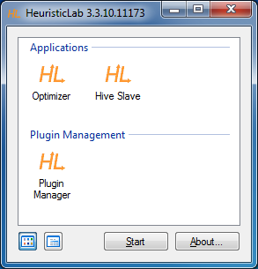
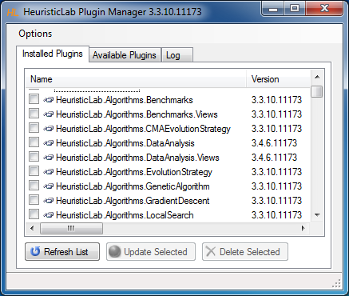
Plugin Infrastructure
HeuristicLab consists of many assemblies
  160+ plugins in HeuristicLab 3.3.16
  plugins can be loaded or unloaded at runtime
  plugins can be updated via internet
  application plugins provide GUI frontends
Extensibility
  developing and deploying new plugins is easy
  dependencies are explicitly defined, automatically checked and resolved
  automatic discovery of interface implementations (service locator pattern)
Plugin Manager
  GUI to check, install, update or delete plugins

Slide 9
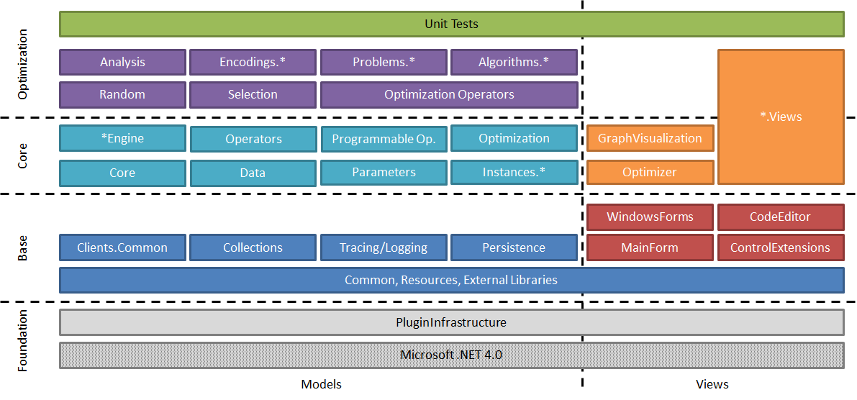
Plugin Architecture

Slide 10
Graphical User Interface
HeuristicLab GUI is made up of views
  views are visual representations of content objects
  views are composed in the same way as their content
  views and content objects are loosely coupled
  multiple different views may exist for the same content
Drag & Drop
  views support drag & drop operations
  content objects can be copied or moved (shift key)
  enabled for collection items and content objects

Slide 11
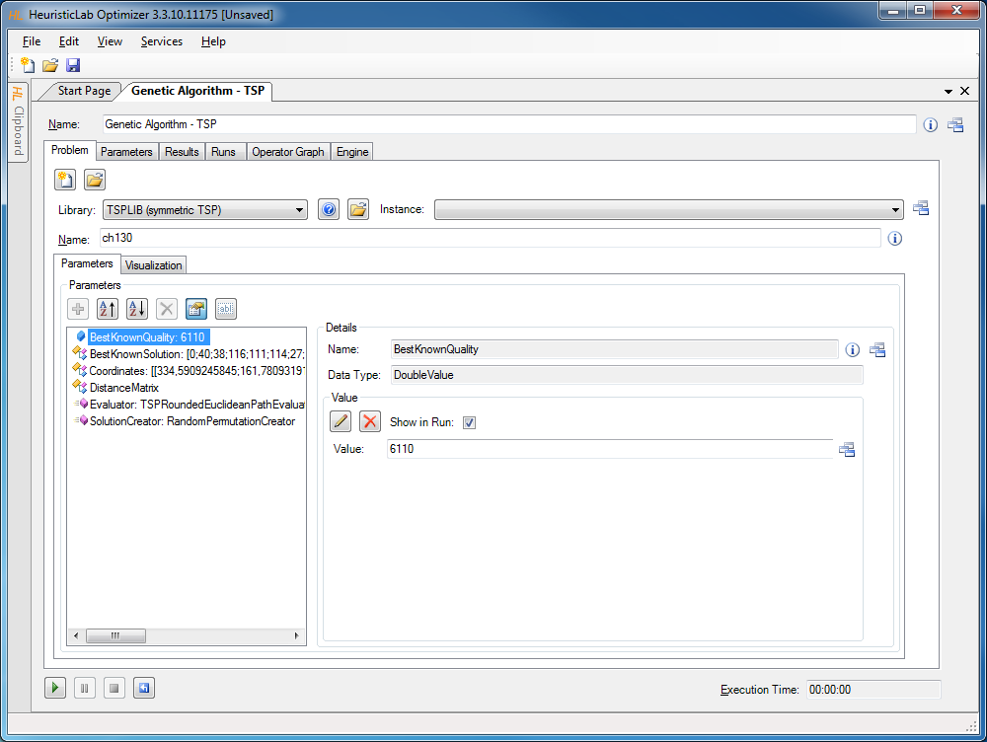
Graphical User Interface
Algorithm View
Problem View
Parameter
Collection
View
Parameter View
Double Value View

Slide 12
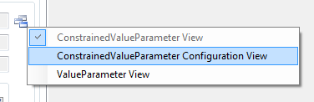
Graphical User Interface
ViewHost
  control which hosts views
  right-click on windows icon to switch views
  double-click on windows icon to open another view
  drag & drop windows icon to copy contents

Slide 13
Available Algorithms
Population-based
CMA-ES
Evolution Strategy
Genetic Algorithm
Offspring Selection Genetic Algorithm (OSGA)
Island Genetic Algorithm
Island Offspring Selection Genetic Algorithm
Parameter-less Population Pyramid (P3)
SASEGASA
Relevant Alleles Preserving GA (RAPGA)
Age-Layered Population Structure (ALPS)
Genetic Programming
NSGA-II
Scatter Search
Particle Swarm Optimization
Trajectory-based
Local Search
Tabu Search
Robust Taboo Search
Variable Neighborhood Search
Simulated Annealing
Data Analysis
Linear Discriminant Analysis
Linear Regression
Multinomial Logit Classification
k-Nearest Neighbor
k-Means
Neighbourhood Component Analysis (NCA)
Artificial Neural Networks
Random Forests
Support Vector Machines
Gaussian Processes
Gradient Boosted Trees
Gradient Boosted Regression
Barnes-Hut t-SNE
Kernel Ridge Regression
Elastic-net Regression
Additional Algorithms
Performance Benchmarks
Hungarian Algorithm
Cross Validation
LM-BFGS

Slide 14
Available Problems
Combinatorial Problems
Test Problems (1-max, NK, HIFF, Deceptive Trap)
Traveling Salesman
Probabilistic Traveling Salesman
Vehicle Routing (MDCVRPTW, PDPTW, …)
Knapsack
Bin Packing
Graph Coloring
Job Shop Scheduling
Linear Assignment
Quadratic Assignment
Orienteering
Genetic Programming Problems
Test Problems (Even Parity, MUX)
Symbolic Classification
Symbolic Regression
Symbolic Time-Series Prognosis
Artificial Ant
Lawn Mower
Robocode
Grammatical Evolution
Additional Problems
Single-/Multi-Objective Test Functions
  Ackley, Griewank, Rastrigin, Sphere, etc.
Programmable Problem
External Evaluation Problem
(generic TCP/IP, Scilab, MATLAB)
Regression, Classification, Clustering
Trading

Slide 15
Agenda
Objectives of the Tutorial
Introduction
Where to get HeuristicLab?
Plugin Infrastructure
Graphical User Interface
Available Algorithms & Problems
Demonstration Part I: External Evaluation Problem
Demonstration Part II: MATLAB and Scilab Parameter Optimization Problem
Demonstration Part III: Programmable Problem
Some Additional Features
Planned Features
Team
Suggested Readings
Bibliography
Questions & Answers

Slide 16
Demonstration Part I:
External Evaluation Problem
Optimize parameters of an existing simulation model
Implement necessary steps to talk with HeuristicLab

Slide 17
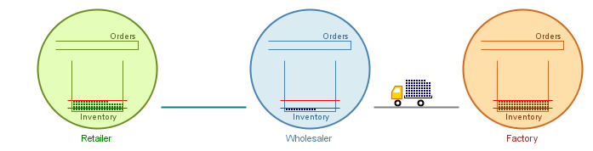
Supply Chain Simulation
(s, S) Order Policy
  3 Echelons and 2 Parameters per Echelon
  Minimize Inventory and Ordering Costs
  Maintain a minimum service level
    Bound on the waiting time due to „out of stock“ situations

Slide 18
Supply Chain Simulation
Create a new simulation experiment for evaluating parameters from HeuristicLab
Create the problem definition in HeuristicLab
Optimize

Slide 19
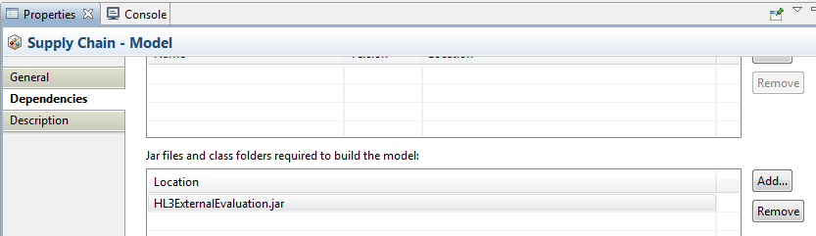
Supply Chain Simulation
Download communication helper library
  http://dev.heuristiclab.com/trac.fcgi/wiki/Documentation/Howto/OptimizeExternalApplications#no1
Add library as dependency to the model

Slide 20
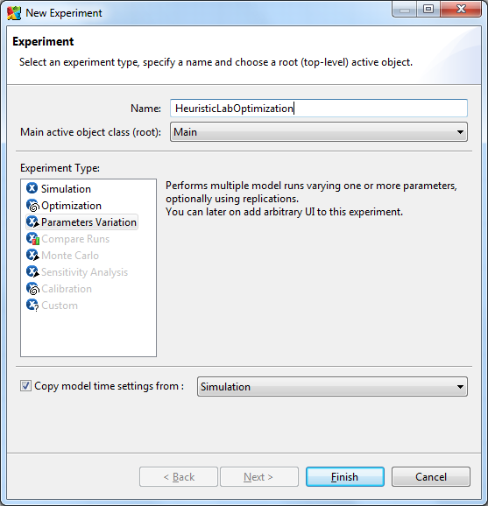
Supply Chain Simulation
The model is included as a sample in AnyLogic
Open the model and create a new experiment of type „Parameters Variation“

Slide 21
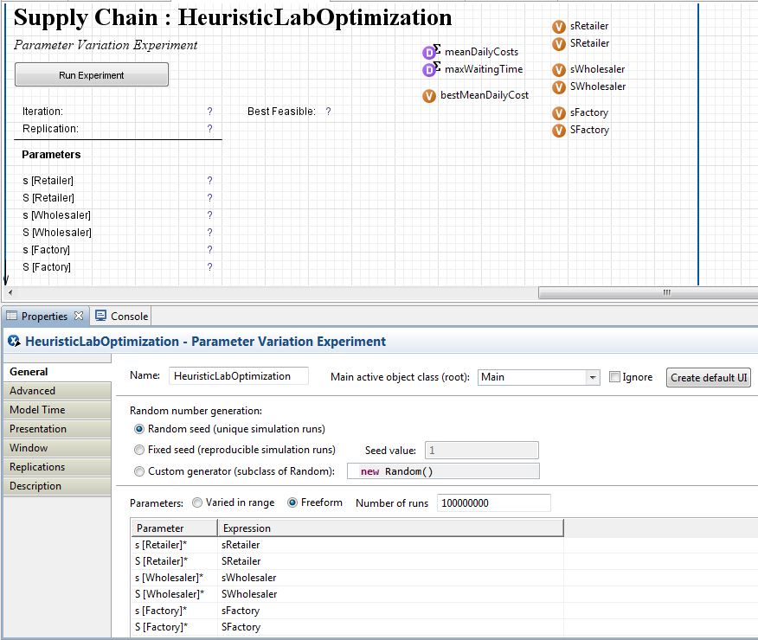
Supply Chain Simulation
Configure the experiment
  Create the default user interface by clicking the button
  Add one variable for each parameter and add statistics for collecting quality relevant information over multiple replications
  Select to vary parameters Freeform, use an arbitrary, but high number of runs and specify the variable that is assigned to each parameter
  Optional: remember the best identified solution so far
2
1
3

Slide 22
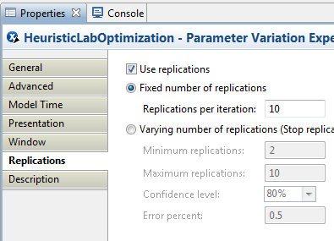
Supply Chain Simulation
Switch to the Replications tab
Check the box „Use replications“
Use a fixed number of 10 replications

Slide 23
Supply Chain Simulation
How do parameter variation experiments work in AnyLogic?
In an experiment run there are N iterations
In each iteration R runs execute
N = „Number of runs“ on the General tab
R = „Replications per iteration“

Slide 24
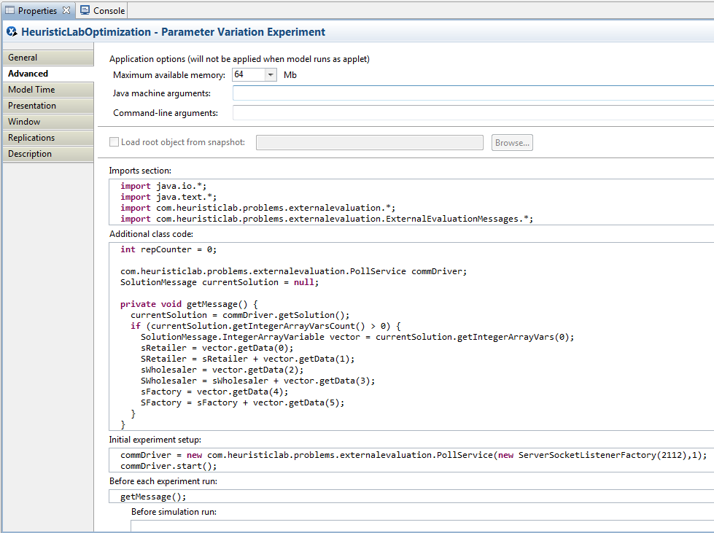
Supply Chain Simulation
Switch to the Advanced tab, here we need to enter some code
  Initialize the communication
  Receive parameters from HeuristicLab
  Collect statistics after each run
  Send back the averaged results and continue with step 2

Slide 25
Supply Chain Simulation
Imports section:
Additional class code:
import java.io.*;
import java.text.*;
import com.heuristiclab.problems.externalevaluation.*;
import com.heuristiclab.problems.externalevaluation.ExternalEvaluationMessages.*;
com.heuristiclab.problems.externalevaluation.PollService commDriver;
SolutionMessage currentSolution = null;
private void getMessage() {
currentSolution = commDriver.getSolution();
if (currentSolution.getIntegerArrayVarsCount() > 0) {
SolutionMessage.IntegerArrayVariable vector = currentSolution.getIntegerArrayVars(0);
sRetailer = vector.getData(0);
SRetailer = sRetailer + vector.getData(1);
sWholesaler = vector.getData(2);
SWholesaler = sWholesaler + vector.getData(3);
sFactory = vector.getData(4);
SFactory = sFactory + vector.getData(5);
}
}

Slide 26
Supply Chain Simulation
Initial experiment setup:
Before each experiment run:
After simulation run:
commDriver = new com.heuristiclab.problems.externalevaluation.PollService(new ServerSocketListenerFactory(2112),1);
commDriver.start();
getMessage();
meanDailyCosts.add(root.meanDailyCost());
maxWaitingTime.add(root.histWaitingTime.max());

Slide 27
Supply Chain Simulation
After iteration:
double fitness = 0;
Boolean isFeasible = maxWaitingTime.max() < 0.001;
if (isFeasible) {
fitness = meanDailyCosts.mean();
if (meanDailyCosts.mean() < bestMeanDailyCost)
bestMeanDailyCost = meanDailyCosts.mean();
} else {
fitness = 2000 + maxWaitingTime.max();
}
try {
commDriver.sendQuality(currentSolution, fitness);
} catch (IOException e) { /* handle error */ }
meanDailyCosts.reset();
maxWaitingTime.reset();
getMessage();

Slide 28
Supply Chain Simulation
Create a new simulation experiment for evaluating parameters from HeuristicLab
Create the problem definition in HeuristicLab
Optimize

Slide 29
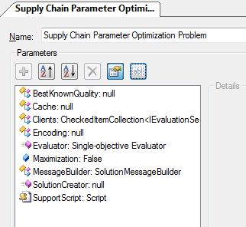
Supply Chain Simulation
Cache: optional parameter that caches solutions and their corresponding quality
Clients: the simulation model instances that can evaluate parameters
Encoding: The encoding that describes a solution, e.g. a vector of integer values
Evaluator: The operator that will extract the parameters and transmit them to the model
Maximization: Whether the returned fitness is to be minimized or maximized
SolutionCreator: The operator that will construct the initial solutions
SupportScript: Additional code for analyzing solution candidates as well as ability to define a neighborhood function

Slide 30
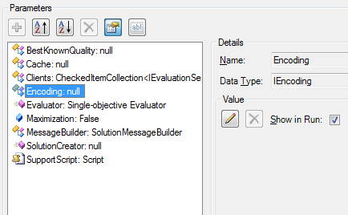
Supply Chain Simulation
Click on the Encoding parameter
Click on the pencil icon to choose an encoding

Slide 31
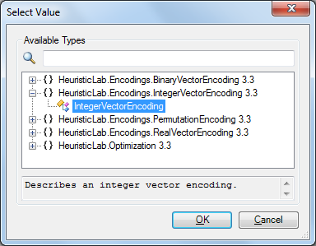
Supply Chain Simulation
Select the IntegerVectorEncoding from the list of available types
Click OK

Slide 32
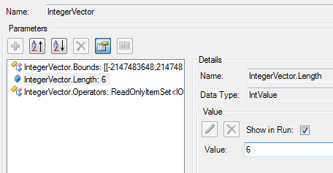
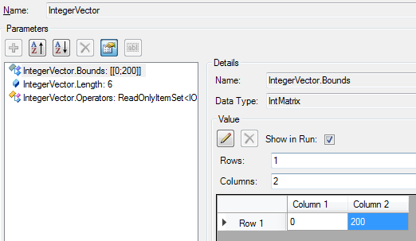
Supply Chain Simulation
Adjust the parameters of the Encoding
  Change the Length to 6
  Change the Bounds to be 0 and 200 for all 6 dimensions
The columns in the bounds specify lower and upper bound for each dimension respectively
  If you have less rows in the bounds than dimensions in the vector, the bounds will be cycled

Slide 33
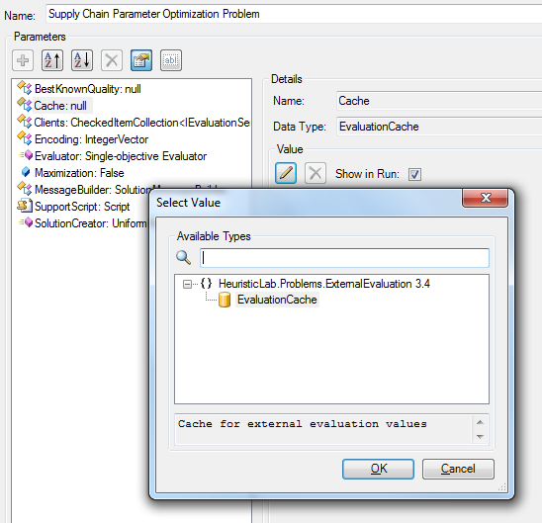
Supply Chain Simulation
Click on the Cache parameter
Click on the pencil icon to assign a value
  A dialog will pop up
In the dialog select the EvaluationCache
Click Ok
1
2
3

Slide 34
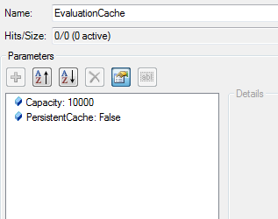
Supply Chain Simulation
The cache will store the solution message and the returned quality
New solution messages will be compared against those already inside the cache
The capacity of the cache can be adjusted
PersistentCache determines if the cache should be stored when the problem or algorithm is saved

Slide 35
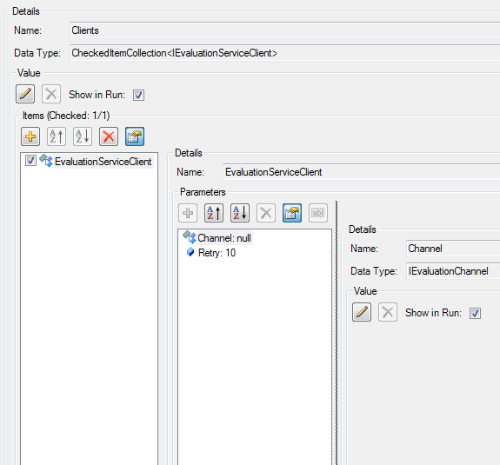
Supply Chain Simulation
Now set up the client machine that runs the simulation model
Click on the Client parameter
Click on EvaluationServiceClient
Click on the Channel parameter
Click the pencil icon to set a new channel

Slide 36
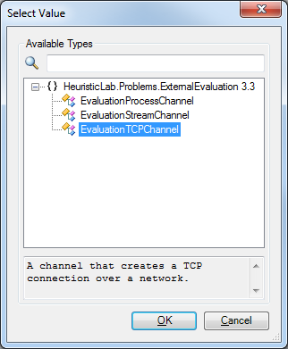
Supply Chain Simulation
Select the EvaluationTCPChannel for communicating over a TCP/IP connection
Click OK

Slide 37
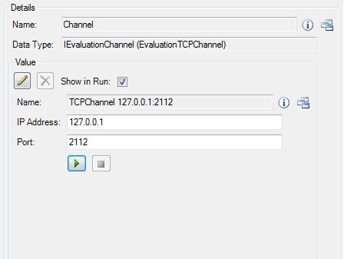
Supply Chain Simulation
Enter the IP address of the machine that the models runs on, use 127.0.0.1 if the model runs on the same machine
We configured our model to listen on port 2112 so we enter this information as Port

Slide 38
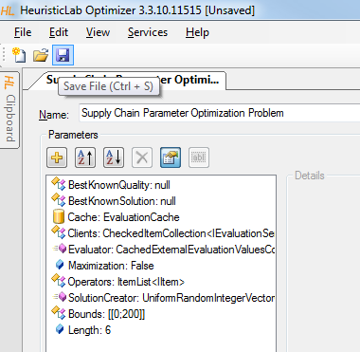
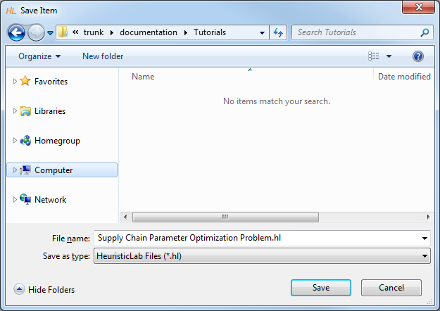
Supply Chain Simulation
The problem is now configured
Click the save button to store the external problem definition into a file

Slide 39
Supply Chain Simulation
Create a new simulation experiment for evaluating parameters from HeuristicLab
Create the problem definition in HeuristicLab
Optimize

Slide 40
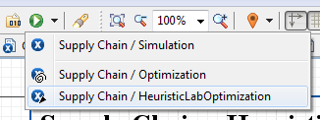
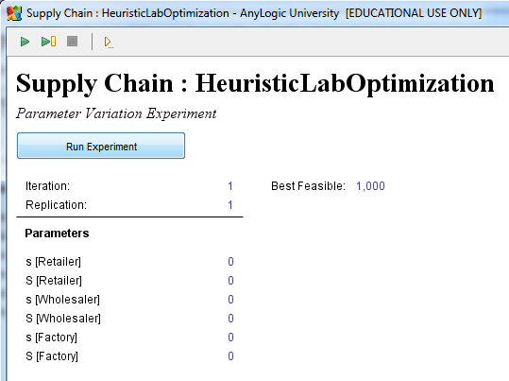
Supply Chain Simulation
In AnyLogic click the arrow next to the green play button and select our newly created experiment
Click to run the experiment at which point the model will wait to receive a solution message
1
2

Slide 41
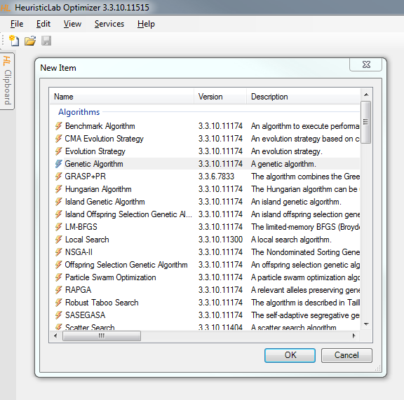
Supply Chain Simulation
In HeuristicLab click on the „New Item“ button to open the list of creatable items
Select the Genetic Algorithm entry
Click OK

Slide 42
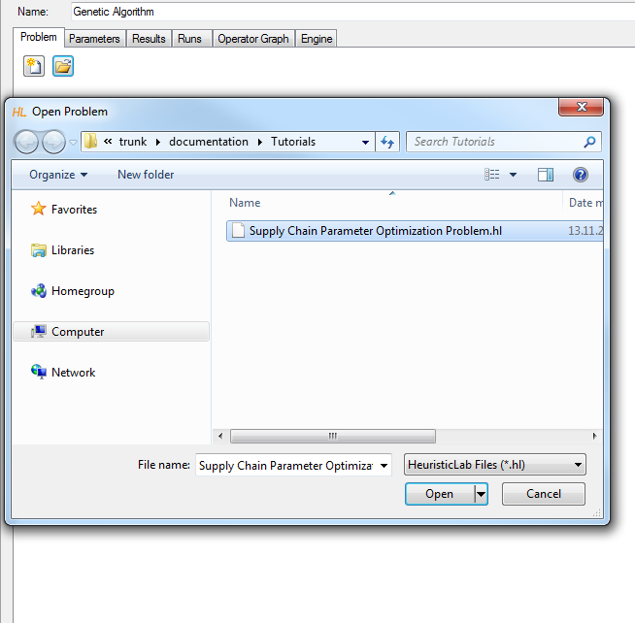
Supply Chain Simulation
Click on the Open button and select the previously saved problem definition
Click Open in the dialog

Slide 43
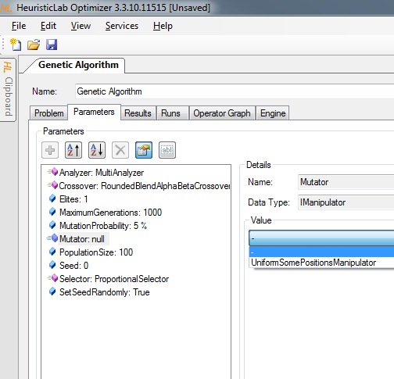
Supply Chain Simulation
Click on the Mutator parameter
Select the manipulator that we have added to the operators list in one of the previous steps
Switch to the Results tab and hit the play button at the bottom

Slide 44
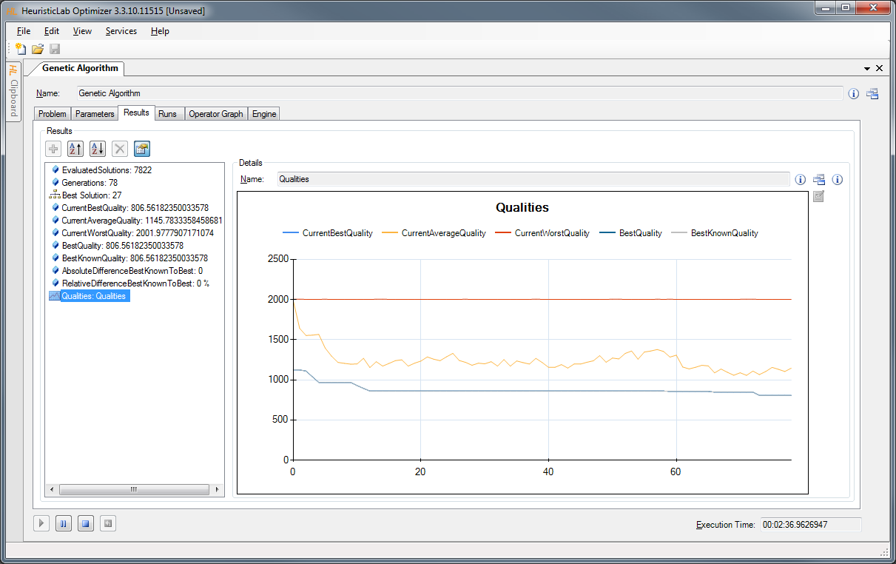
Supply Chain Simulation

Slide 45
Agenda
Objectives of the Tutorial
Introduction
Where to get HeuristicLab?
Plugin Infrastructure
Graphical User Interface
Available Algorithms & Problems
Demonstration Part I: External Evaluation Problem
Demonstration Part II: MATLAB and Scilab Parameter Optimization Problem
Demonstration Part III: Programmable Problem
Some Additional Features
Planned Features
Team
Suggested Readings
Bibliography
Questions & Answers

Slide 46
Demonstration Part II:
Parameter Optimization Problem
Parameter Optimization of Differential Equation Systems (Scilab)

Slide 47
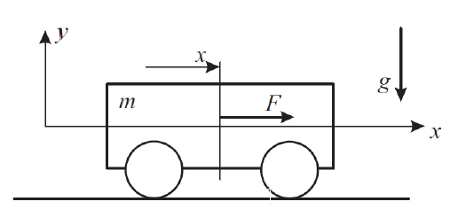
Electric cart simulation
Identify unknown parameter values of a simulation model
Measure movements of an electric cart with known power
Adapt parameters of an simulation model to match those measurements

Slide 48
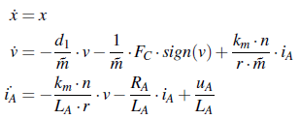
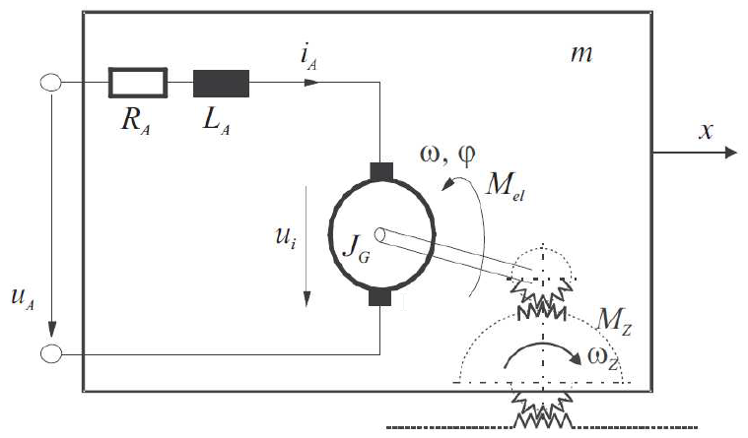
Electric cart simulation
Identify friction coefficients d₁, F_{C} and mass m
Voltage u_{A} and initial values for position x, velocity v and amperage i_{A} are known
Simulate changes according to differential equations

Slide 49
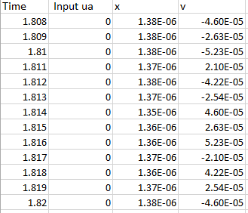
Measurements

Slide 50
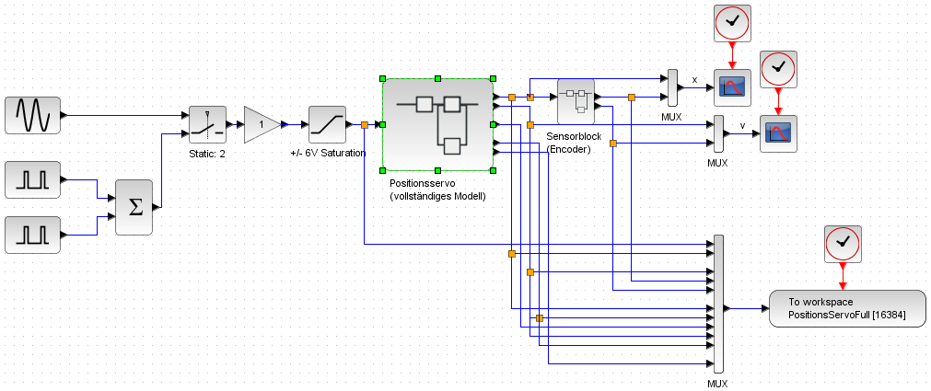
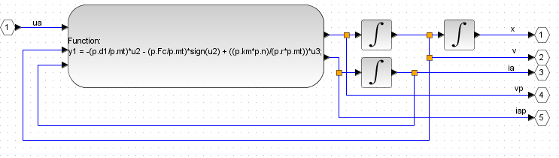
Simulation in Scilab

Slide 51
Parameter Optimization
Create a new Scilab parameter optimization problem in HeuristicLab
Configure the problem with your scripts in HeuristicLab
Optimize

Slide 52
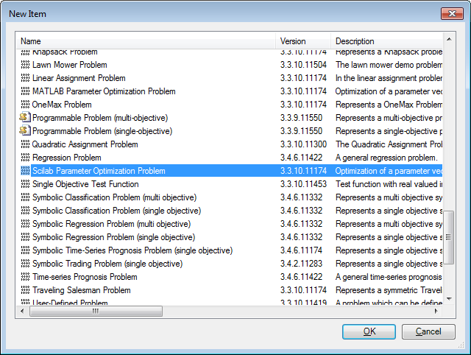
Parameter Optimization

Slide 53
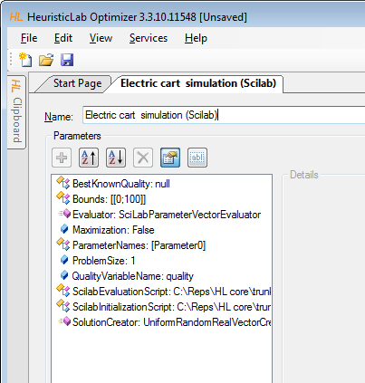
Parameter Optimization
Specify path
to Scilab scripts
Initialization script
Evaluation script

Slide 54
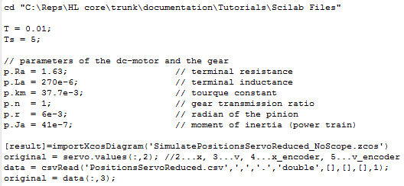
Initialization Script
Sets constants and time intervals
Loads the simulation model
Reads the measured values from a csv file

Slide 55
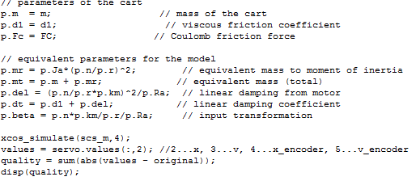
Evaluation Script
Configures and runs the simulation with values from HeuristicLab
Calculates quality as sum of absolute errors between simulated and measured values

Slide 56
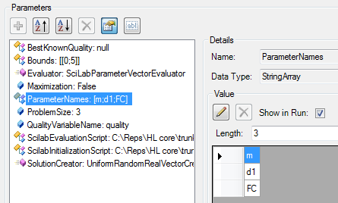
Parameter Optimization
Configure problem size
Configure parameter names
Parameter names are created as variables in Scilab
Adapt bounds

Slide 57
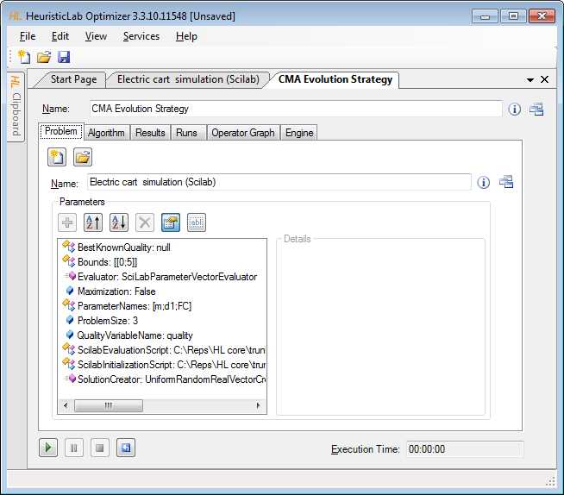
Parameter Optimization
Create CMA-ES
Drop problem
on algorithm

Slide 58
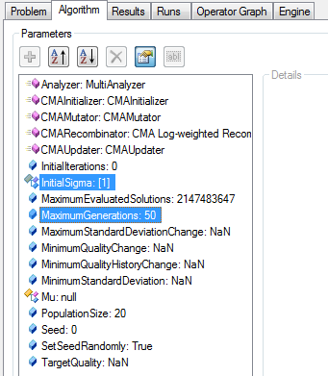
Parameter Optimization
Configure algorithm
  Initial Sigma 1.0
  Maximum Generations 50
Enable CMAAnalzer

Slide 59
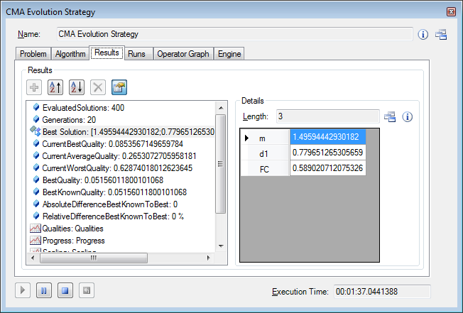
Parameter Optimization
Optimal values (m = 1.5, d1 = 1, FC = 0.5)

Slide 60
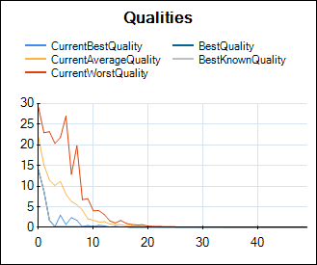
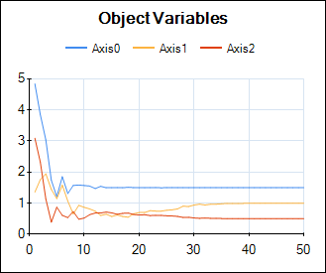
Parameter Optimization

Slide 61
Agenda
Objectives of the Tutorial
Introduction
Where to get HeuristicLab?
Plugin Infrastructure
Graphical User Interface
Available Algorithms & Problems
Demonstration Part I: External Evaluation Problem
Demonstration Part II: MATLAB and Scilab Parameter Optimization Problem
Demonstration Part III: Programmable Problem
Some Additional Features
Planned Features
Team
Suggested Readings
Bibliography
Questions & Answers

Slide 62
Demonstration Part III:
Programmable Problem
Singleobjective Function Optimization
  Solving the Styblinski-Tang function
Multiobjective Function Optimization
  Solving the Fonseca and Fleming function
Non-linear Curve Fitting
  Fitting a 2 dimensional Gaussian distribution to noisy data

Slide 63
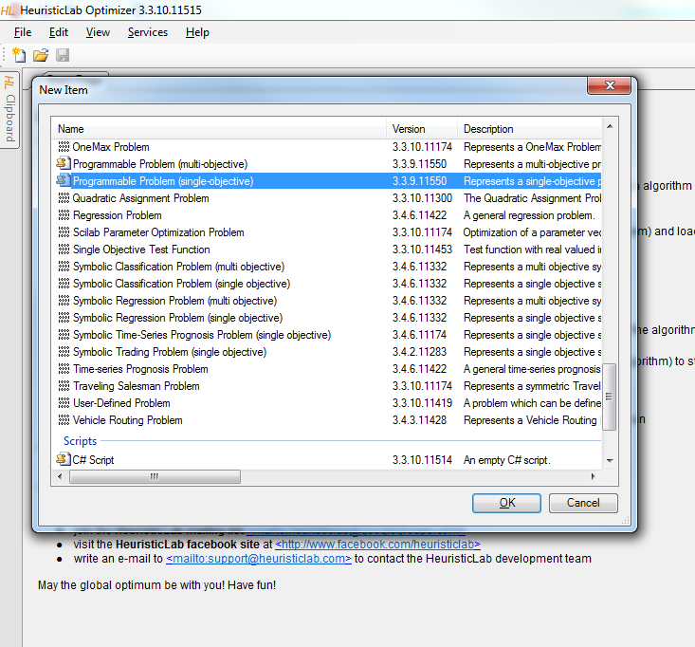
Singleobjective Function Opt.
Click on „New Item“ to get a list of creatables
Create a new Programmable Problem (single-objective) by double clicking it

Slide 64
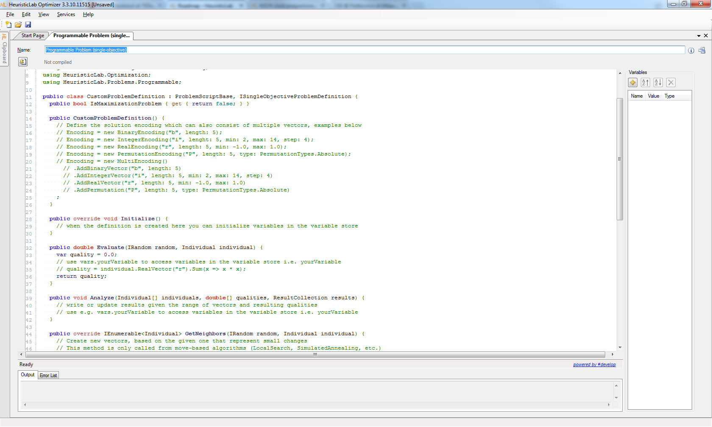
Singleobjective Function Opt.
C# Editor for Writing the Problem Definition

Slide 65
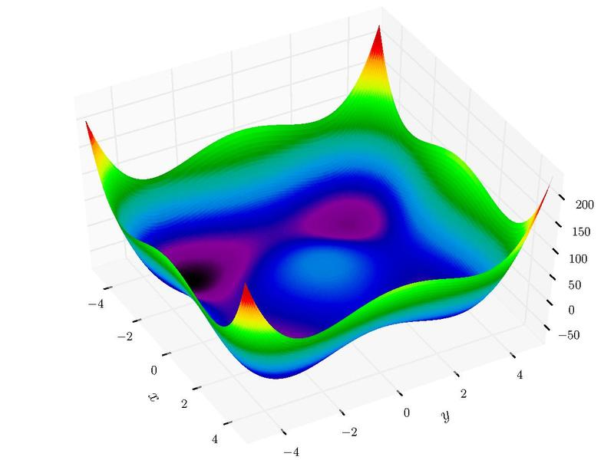

Singleobjective Function Opt.
Styblinski-Tang function:
$$f\left(x\right)=\frac{\sum_{i=1}^{n}{x_{i}^{4}−16x_{i}^{2}+5x_{i}}}{2}$$
with $−5≤x_{i}≤5$

Slide 66
Singleobjective Function Opt.
Choose an appropriate solution encoding
  20-dimensional real-valued vector
  Minimize the fitness value
public bool Maximization { get { return false; } }
public override void Initialize() {
// Define the solution encoding which can also consist of multiple vectors, examples below
// Encoding = new BinaryEncoding("b", length: 5);
// Encoding = new IntegerEncoding("i", lenght: 5, min: 2, max: 14, step: 4);
Encoding = new RealEncoding("vector", length: 20, min: -5.0, max: 5.0);
// Encoding = new PermutationEncoding("P", length: 5, type: PermutationTypes.Absolute);
// Encoding = new MultiEncoding()
// .AddBinaryVector("b", length: 5)
// .AddIntegerVector("i", length: 5, min: 2, max: 14, step: 4)
// .AddRealVector("r", length: 5, min: -1.0, max: 1.0)
// .AddPermutation("P", length: 5, type: PermutationTypes.Absolute)
;
}

Slide 67
Singleobjective Function Opt.
Define the fitness function
public double Evaluate(Individual individual, IRandom random) {
var vector = individual.RealVector("vector");
return vector.Sum(x => x * x * x * x - 16.0 * x * x + 5 * x) / 2.0;
}

Slide 68

Singleobjective Function Opt.
Compile the problem defintion

Slide 69

Singleobjective Function Opt.
Create a suitable optimization algorithm
Select CMA Evolution Strategy
Click OK

Slide 70

Singleobjective Function Opt.
Drag‘n‘Drop

Slide 71

Singleobjective Function Opt.
Switch to the Parameters tab
Click on the Analyzer parameter
Check CMAAnalyzer to get more detailed results
1
2

Slide 72

Singleobjective Function Opt.
Choose suitable parameters
  InitialSigma: 2
  MaximumGenerations: 200
  PopulationSize: 50

Slide 73

Singleobjective Function Opt.

Slide 74


Multiobjective Function Opt.
Fonseca and Fleming function:
$$\text{Minimize}= \left\{\begin{matrix}f_{1}\left(x\right)=1−e^{−\sum_{i=1}^{n}{{(x_{i} − \frac{1}{\sqrt{n}})}^{2}}} \\ f_{2}\left(x\right)=1−e^{−\sum_{i=1}^{n}{{(x_{i} + \frac{1}{\sqrt{n}})}^{2}}}\end{matrix}\right.$$
with $−4≤x≤4$

Slide 75
Multiobjective Function Opt.
Click on „New Item“ to get a list of creatables
Create a new Programmable Problem (multi-objective) by double clicking it

Slide 76
Multiobjective Function Opt.
Choose an appropriate solution encoding
  10-dimensional real-valued vector
  Minimize all fitness values
public bool[] Maximization { get { return new [] { false, false }; } }
public override void Initialize() {
// Define the solution encoding which can also consist of multiple vectors, examples below
// Encoding = new BinaryEncoding("b", length: 5);
// Encoding = new IntegerEncoding("i", lenght: 5, min: 2, max: 14, step: 4);
Encoding = new RealEncoding("vector", length: 10, min: -4.0, max: 4.0);
// Encoding = new PermutationEncoding("P", length: 5, type: PermutationTypes.Absolute);
// Encoding = new MultiEncoding()
// .AddBinaryVector("b", length: 5)
// .AddIntegerVector("i", length: 5, min: 2, max: 14, step: 4)
// .AddRealVector("r", length: 5, min: -1.0, max: 1.0)
// .AddPermutation("P", length: 5, type: PermutationTypes.Absolute)
;
}

Slide 77
Multiobjective Function Opt.
Define the fitness functions
public double[] Evaluate(Individual individual, IRandom random) {
var qualities = new double[2];
var vector = individual.RealVector("vector");
var n = vector.Length;
qualities[0] = 1.0 - Math.Exp(- vector.Sum(x => Math.Pow(x - 1.0/Math.Sqrt(n), 2)));
qualities[1] = 1.0 - Math.Exp(- vector.Sum(x => Math.Pow(x + 1.0/Math.Sqrt(n), 2)));
return qualities;
}

Slide 78

Multiobjective Function Opt.
Compile the problem defintion

Slide 79

Multiobjective Function Opt.
Create a suitable optimization algorithm
Select NSGA-II
Click OK

Slide 80

Multiobjective Function Opt.
Drag‘n‘Drop

Slide 81

Multiobjective Function Opt.
Adjust the parameters
Set Crossover: SBX
Set Mutator: Polynomial

Slide 82


Multiobjective Function Opt.

Slide 83

Non-linear Curve Fitting
In this example: Fitting a 2 dimensional Gaussian distribution to noisy data
We will create a random dataset as instance
We will then fit the parameters

Slide 84

Non-linear Curve Fitting
The probability density function for a k dimensional Gaussian distribution is given
For 2 dimensional Gaussian distribution we need to fit a total of 5 parameters
  μ (2 dimensions)
  Σ (3 dimensions due to symmetry)
Source: http://en.wikipedia.org/wiki/Multivariate_normal_distribution

Slide 85

Non-linear Curve Fitting
To generate the dataset, first create a new C# Script
Then enter the code that generates the data on the next slide

Slide 86
Non-linear Curve Fitting
public class MyScript : HeuristicLab.Scripting.CSharpScriptBase {
public override void Main() {
var cov = new double[,] { { 1, 0.5 }, { 0.5, 2 } };
var invCov = GetInverse(cov);
var mu = new double[] { 3, 4 };
var rand = new MersenneTwister();
var nd = new NormalDistributedRandom(rand, 0, 0.01);
var sampleSize = 500;
var data = new DoubleMatrix(sampleSize, 3);
for (var i = 0; i < sampleSize; i++) {
data[i, 0] = rand.NextDouble() * 10;
data[i, 1] = rand.NextDouble() * 10;
data[i, 2] = TwoDGauss(data[i, 0], data[i, 1], mu, cov, invCov) + nd.NextDouble();
}
vars.data = data;
}
private double TwoDGauss(double x, double y, double[] mu, double[,] cov, double[,] invCov) {
var a = x - mu[0];
var b = y - mu[1];
return 1.0 / (2.0 * Math.PI * Math.Sqrt(GetDeterminant(cov)))
* Math.Exp(-0.5 * ((a * invCov[0, 0] + b * invCov[1, 0]) * a + (a * invCov[0, 1] + b * invCov[1, 1]) * b));
}
private double[,] GetInverse(double[,] m) {
var det = GetDeterminant(m);
return new double[,] { { m[1, 1] / det, -m[0, 1] / det }, { -m[1, 0] / det, m[0, 0] / det } };
}
private double GetDeterminant(double[,] m) {
return m[0, 0] * m[1, 1] - m[0, 1] * m[1, 0];
}
}

Slide 87

Non-linear Curve Fitting
Run the script by clicking the run button or by hitting F5
The data will be generated as a matrix and appear in the VariableStore

Slide 88

Non-linear Curve Fitting
Create a new single-objective programmable problem
Drag‘n‘drop the data from the script onto the problem‘s VariableStore
Code the problem definition
Compile the problem

Slide 89

Non-linear Curve Fitting
Drag‘n‘Drop

Slide 90
Non-linear Curve Fitting
public bool Maximization { get { return false; } }
public override void Initialize() {
Encoding = new RealVectorEncoding("r", length: 5, min: 0.0, max: 10.0);
}
public double Evaluate(Individual individual, IRandom random) {
var vec = individual.RealVector("r");
var mu = new double[] { vec[0], vec[1] };
var cov = new double[,] { { vec[2], vec[3] }, { vec[3], vec[4] } };
var invCov = GetInverse(cov);
var data = (DoubleMatrix)vars.data;
var quality = 0.0;
for (var i = 0; i < data.Rows; i++) {
var estimated = TwoDGauss(data[i, 0], data[i, 1], mu, cov, invCov);
if (double.IsNaN(estimated) || double.IsInfinity(estimated)) quality += 1000;
else quality += (estimated - data[i, 2]) * (estimated - data[i, 2]);
}
return quality / data.Rows;
}
private double TwoDGauss(double x, double y, double[] mu, double[,] cov, double[,] invCov) {
var a = x - mu[0];
var b = y - mu[1];
return 1.0 / (2.0 * Math.PI * Math.Sqrt(GetDeterminant(cov)))
* Math.Exp(-0.5 * ((a * invCov[0, 0] + b * invCov[1, 0]) * a + (a * invCov[0, 1] + b * invCov[1, 1]) * b));
}
private double[,] GetInverse(double[,] m) {
var det = GetDeterminant(m);
return new double[,] { { m[1, 1] / det, -m[0, 1] / det }, { -m[1, 0] / det, m[0, 0] / det } };
}
private double GetDeterminant(double[,] m) {
return m[0, 0] * m[1, 1] - m[0, 1] * m[1, 0];
}

Slide 91
Non-linear Curve Fitting
Note that in the evaluation function we took care of degenerate cases
If the estimation of the model is not a double number or infinity, an arbitrary, but high number is returned as a goodness of fit
for (var i = 0; i < data.Rows; i++) {
var estimated = TwoDGauss(data[i, 0], data[i, 1], mu, cov, invCov);
if (double.IsNaN(estimated) || double.IsInfinity(estimated)) quality += 1000;
else quality += (estimated - data[i, 2]) * (estimated - data[i, 2]);
}

Slide 92

Non-linear Curve Fitting
Create a new suitable algorithm, e.g. CMA-ES
Drop the problem onto the algorithm
Set the algorithm parameters
  MaximumGenerations: 200
  InitialSigma: 5
Run the algorithm

Slide 93

Non-linear Curve Fitting

Slide 94
Agenda
Objectives of the Tutorial
Introduction
Where to get HeuristicLab?
Plugin Infrastructure
Graphical User Interface
Available Algorithms & Problems
Demonstration Part I: External Evaluation Problem
Demonstration Part II: MATLAB and Scilab Parameter Optimization Problem
Demonstration Part III: Programmable Problem
Some Additional Features
Planned Features
Team
Suggested Readings
Bibliography
Questions & Answers

Slide 95

Some Additional Features
HeuristicLab Hive
  parallel and distributed execution of algorithms
  and experiments on many computers in a network
Optimization Knowledge Base (OKB)
  database to store algorithms, problems, parameters and results
  open to the public
  open for other frameworks
  analyze and store characteristics of problem instances and problem classes
Parameter grid tests and meta-optimization
  automatically create experiments to test large ranges of parameters
  apply heuristic optimization algorithms to find optimal parameter settings for heuristic optimization algorithms
Statistics
  statistical tests and automated statistical analysis

Slide 96
Planned Features
Algorithms & Problems
  steady-state genetic algorithm
  unified tabu search for vehicle routing
  estimation of distribution algorithms
  evolution of arbitrary code (controller, etc.)
  …
Cloud Computing
  port HeuristicLab Hive to Windows Azure
Have a look at the HeuristicLab roadmap
  http://dev.heuristiclab.com/trac.fcgi/roadmap
Any other ideas, requests or recommendations?
  join our HeuristicLab Google group heuristiclab@googlegroups.com
  write an e-mail to support@heuristiclab.com

Slide 97

HeuristicLab Team
Heuristic and Evolutionary Algorithms Laboratory (HEAL)
School of Informatics, Communications and Media
University of Applied Sciences Upper Austria
Softwarepark 11
A-4232 Hagenberg
AUSTRIA
WWW: http://heal.heuristiclab.com

Slide 98


Suggested Readings
S. Voß, D. Woodruff (Edts.)
Optimization Software Class Libraries
Kluwer Academic Publishers, 2002
M. Affenzeller, S. Winkler, S. Wagner, A. Beham
Genetic Algorithms and Genetic Programming
Modern Concepts and Practical Applications
CRC Press, 2009

Slide 99
Bibliography
S. Wagner, M. Affenzeller
HeuristicLab: A generic and extensible optimization environment
Adaptive and Natural Computing Algorithms, pp. 538-541
Springer, 2005
S. Wagner, S. Winkler, R. Braune, G. Kronberger, A. Beham, M. Affenzeller
Benefits of plugin-based heuristic optimization software systems
Computer Aided Systems Theory - EUROCAST 2007, Lecture Notes in Computer Science, vol. 4739, pp. 747-754
Springer, 2007
S. Wagner, G. Kronberger, A. Beham, S. Winkler, M. Affenzeller
Modeling of heuristic optimization algorithms
Proceedings of the 20th European Modeling and Simulation Symposium, pp. 106-111
DIPTEM University of Genova, 2008
S. Wagner, G. Kronberger, A. Beham, S. Winkler, M. Affenzeller
Model driven rapid prototyping of heuristic optimization algorithms
Computer Aided Systems Theory - EUROCAST 2009, Lecture Notes in Computer Science, vol. 5717, pp. 729-736
Springer, 2009
S. Wagner
Heuristic optimization software systems - Modeling of heuristic optimization algorithms in the HeuristicLab software environment
Ph.D. thesis, Johannes Kepler University Linz, Austria, 2009.
S. Wagner, A. Beham, G. Kronberger, M. Kommenda, E. Pitzer, M. Kofler, S. Vonolfen, S. Winkler, V. Dorfer, M. Affenzeller
HeuristicLab 3.3: A unified approach to metaheuristic optimization
Actas del séptimo congreso español sobre Metaheurísticas, Algoritmos Evolutivos y Bioinspirados (MAEB'2010), 2010
S. Wagner, G. Kronberger, A. Beham, M. Kommenda, A. Scheibenpflug, E. Pitzer, S. Vonolfen, M. Kofler, S. Winkler, V. Dorfer, M. Affenzeller
  Architecture and Design of the HeuristicLab Optimization Environment
  Advanced Methods and Applications in Computational Intelligence, vol. 6, pp. 197-261, Springer, 2014
Detailed list of all publications of the HEAL research group: http://research.fh-ooe.at/de/orgunit/356#showpublications

Slide 100
Questions & Answers
http://dev.heuristiclab.com
heuristiclab@googlegroups.com
http://www.youtube.com/heuristiclab
http://www.facebook.com/heuristiclab

