Slide 1



HeuristicLab Hive
Deep Dive
C. Neumüller, A. Scheibenpflug

Slide 2
Motivation for HeuristicLab Hive
Experiments are very runtime consuming
  many different optimization algorithms and parameter settings have to be executed and analyzed
  very runtime consuming task, but parallelizable
Peak time demands
  HPC infrastructure is overloaded before conference deadlines
Flexible resource usage
  avoid explicit reservations
  resources are used as long as they are needed
  multicore resources can be shared
Utilize desktop computers of FH OÖ and research partners
  hundreds of powerful multicore desktop machines can be used during the night
Notes:
Experimentation with different parameters
Peak times
Usage of university resources

Slide 3
Other Frameworks/Technologies
BOINC
  C/C++, open source
  no client groups, no timetables
Utilify
  .NET, closed source
ParadisEO/ECJ
  specialized for evolutionary algorithms (not generic)
Notes:
several open source frameworks
no c# frameworks

Slide 4
Hive vs. MPI
Hive | MPI
+ Slaves can be deployed anywhere (behind Firewall, NAT) | - Limited to HPC cluster
+ Slave management (groups) | + Node management with HPC tool
+ User/roles management | - No user management
+ Security (encrypted comm.) | - No encryption
+ Jobs/experiments stored in database | - API to send/receive jobs – no database
+ Automatic plugin deployment | - Manual plugin deployment
+ Timetables | + Time management
- No job intercommunication | + Job intercommunication
- Low performance comm. | + High performance comm.
Suited for coarse grained parallelization without intercommunication | Suited for fine grained parallelization with intercommunication
Notes:
several open source frameworks
no c# frameworks

Slide 5
HeuristicLab Hive Requirements
Open source, based on .NET and C#
Distributed execution of arbitrary jobs
  not only HeuristicLab algorithms
Utilization of heterogeneous resources
  HPC infrastructure, desktop computers, …
Scalability and Elasticity
  add or remove slaves at any time (manually)
  helps to overcome demand peaks
Time schedule
  use some resources only during the night, in the holidays, …
Notes:
% * distributed computing of ``jobs'' - mainly heuristiclab algorithms
% * open source c# distributed computing
% * heterogenity - utilization of hpc infrastructure and desktop computers (multi core). also from other networks (bypass firewalls and nats) : because distribution time is not critical
% * elasticity, slaves can be added/removed any time - for peak demand
% * deployment of assemblies
% * security - groups, encryption, sandboxing

Slide 6
HeuristicLab Hive Requirements
Deployment of assemblies
  jobs can specify assembly dependencies
  slave loads assemblies into AppDomain for execution
  no need to update slaves with new versions of software
Security
  jobs can specify to be executed only on specific slaves
  encrypted communication
  sandboxed job execution
Notes:
% * distributed computing of ``jobs'' - mainly heuristiclab algorithms
% * open source c# distributed computing
% * heterogenity - utilization of hpc infrastructure and desktop computers (multi core). also from other networks (bypass firewalls and nats) : because distribution time is not critical
% * elasticity, slaves can be added/removed any time - for peak demand
% * deployment of assemblies
% * security - groups, encryption, sandboxing

Slide 7
HeuristicLab Hive Applications
Metaheuristic Optimization Experiments
  execution of different instances of an algorithm with different parameter settings
  intensively used by HEAL researchers to speed up tests
Algorithm Parallelization
  Meta-Optimization
    special parameter optimization algorithm
    very expensive solution evaluation (done by HiveEngine)
    ongoing master thesis
      time on Hive: 1598,26 days (4 years, 4 months, 16 days)
      during approx. 5 weeks
  Island Genetic Algorithm
    islands compute distributed
    for migration jobs are collected, migration happens locally

Slide 8
Changes in the last 6 months
HeuristicLab.Hive Deep Dive
http://dev.heuristiclab.com
8
Major refactoring in all components
Deploy Server on HL.Services and IIS integration
Prototype of Administration UI
Slave Windows Service and TrayIcon
Installers for Windows Service and TrayIcon
(true) Sandboxing
Better plugin management and plugin storage in DB
Job-Control: Pause, Stop, Abort
Hive Engine
Statistics are captured
Lot‘s of other improvements
Notes:
8

Slide 9
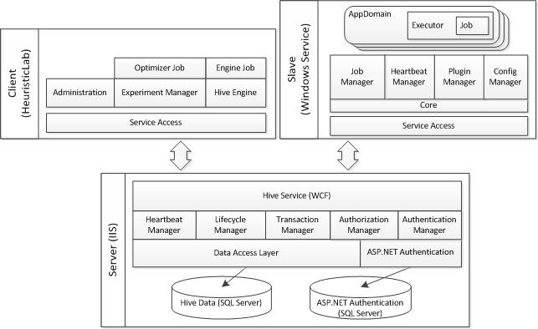
HeuristicLab Hive Architecture
HeuristicLab.Hive Deep Dive
http://dev.heuristiclab.com
9
Notes:
9

Slide 10
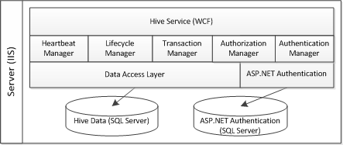
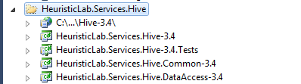
Hive Server
Plugins
IIS deployment
Service implementation
Manager implementation
Unit tests for DAO and service
No usage of IIS
Service contract
Data Transfer Objects (DTOs)
Data Access Objects (DAOs)
Conversion to DTOs
LinqToSql
HeuristicLab.Hive Deep Dive
http://dev.heuristiclab.com
10
Notes:
10

Slide 11
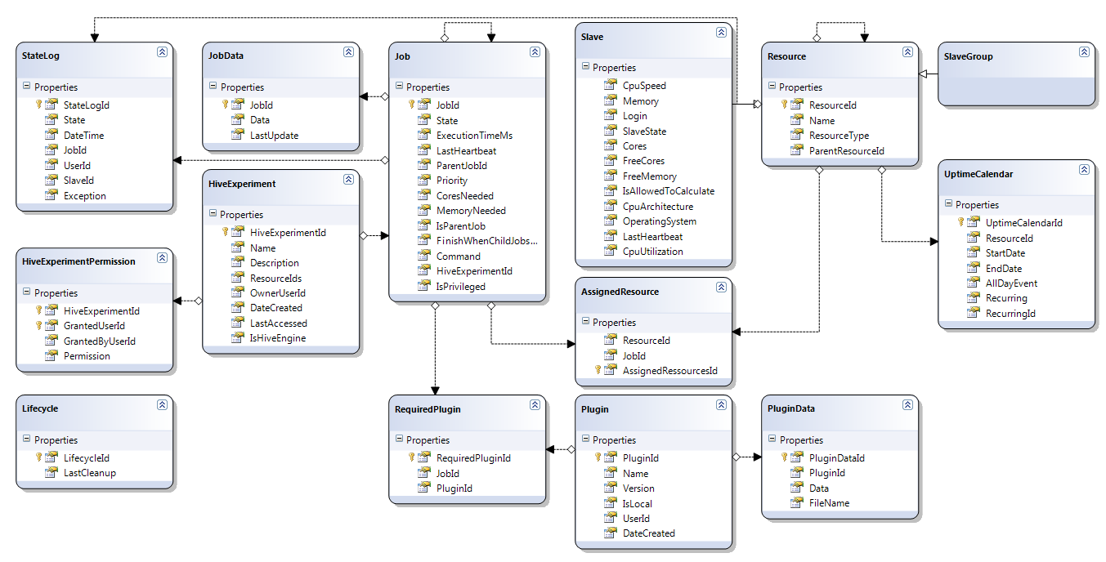
Hive Server
Database
HeuristicLab.Hive Deep Dive
http://dev.heuristiclab.com
11
Notes:
11

Slide 12
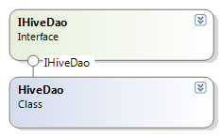
Hive Server
Data Access Layer
HeuristicLab.Hive Deep Dive
http://dev.heuristiclab.com
12
IHiveDao
  CRUD operations for
    Job
    JobData
    Plugin
    PluginData
    Resource
    Slave
    SlaveGroup
    HiveExperiment
    HiveExperimentPermission
    Appointment
  Further methods
    GetWaitingJobs
    AssignJobToResource
    GetStatistics
Notes:
12

Slide 13
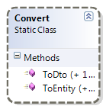
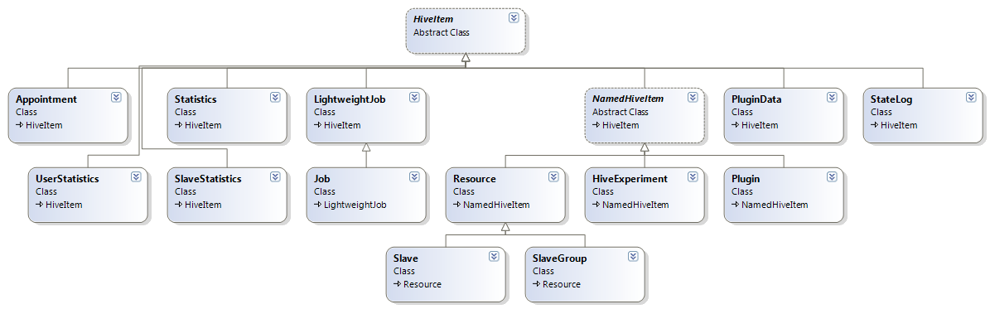
Hive Server
Data Layer - DTOs
LinqToSqlEntities <-> DTOs
Business Logic uses only DTOs
HeuristicLab.Hive Deep Dive
http://dev.heuristiclab.com
13
Notes:
13

Slide 14
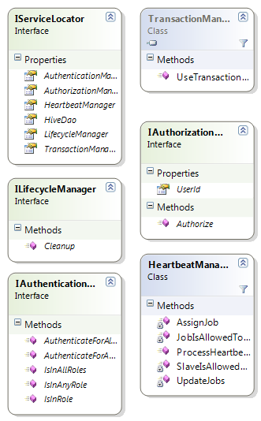
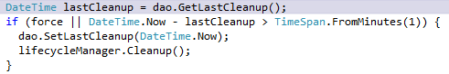
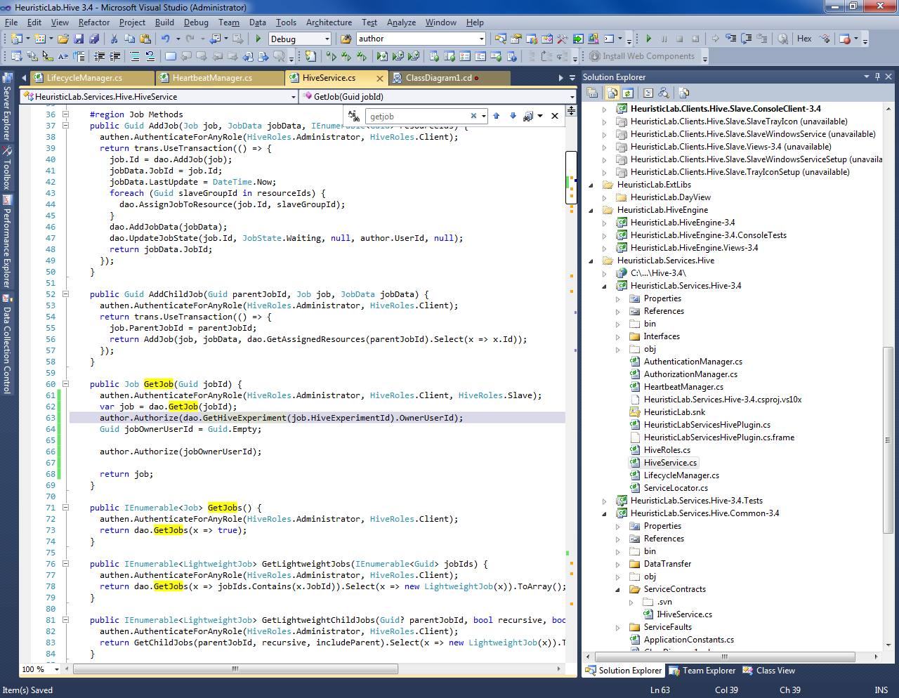
Hive Server
Business Logic
ILifecycleManager
  called 1x per minute
  detection of timeouted slaves/jobs
  update of statistics
IAuthorizationManager
  checking of logged in user
  Autorize(Guid userId) throws exception
IAuthenticationManager
  checks for user roles
HeuristicLab.Hive Deep Dive
http://dev.heuristiclab.com
14
Notes:
14

Slide 15
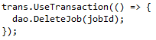
Hive Server
Business Logic
TransactionManager
  UseTransaction(Action action)
  encapsules delegate in transaction
HeartbeatManager
  processes heartbeats
    update of execution time
  returns actions for slave
    assignment of jobs
    pausing/stopping/aborting of jobs
    checks if slave is assigned to job (if not -> abort)
    checks timetable (if not allowed -> pause)
    checks user commands (-> pause/stop)
HeuristicLab.Hive Deep Dive
http://dev.heuristiclab.com
15
Notes:
15

Slide 16
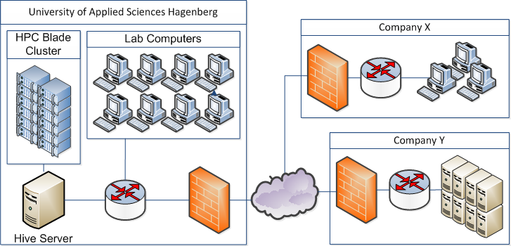
Hive Communication
Slave Communication
  periodic messages containing current status (progress of jobs)
    currently 10 sec.
  communication is initiated only by slaves
  avoid NAT and Firewalls problems
  server response contains next actions
    CalculateJob
    AbortJob
    StopJob
    PauseJob
    DoNothing
    …
Notes:
Möglichkeit zur Ausweitung in die Cloud erwähnen

Slide 17
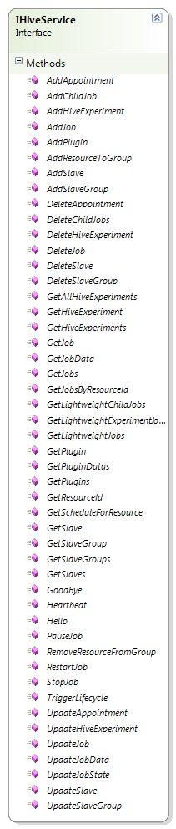
Hive Server
Service
Implemented as PerCall WCF service
Does not contain any state
  for better scalability
HeuristicLab.Hive Deep Dive
http://dev.heuristiclab.com
17
Notes:
17

Slide 18
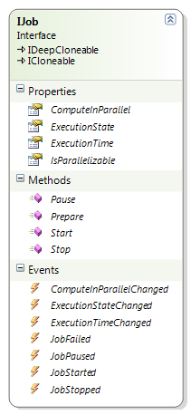
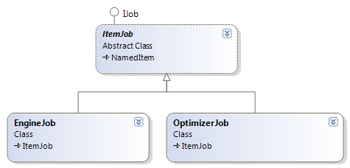
Hive Jobs
HeuristicLab.Hive Deep Dive
http://dev.heuristiclab.com
18
Implementations
  ItemJob
    abstract
    inherits from NamedItem
    encapsulates a HeuristicLab Item
  OptimizerJob
    encapsulates a HeuristicLab Optimizer
    (algorithm/experiment/batchrun)
  EngineJob
    encapsulates a HeuristicLab Engine with InitialOperator
    can execute (a part of) an operator graph
Notes:
18

Slide 19
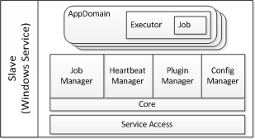
Hive Slave Overview
HeuristicLab.Hive Deep Dive
http://dev.heuristiclab.com
19
Executes jobs from the Hive server
Components:
  Core
    As Windows Service or
    As Console Client
  Slave TrayIcon
    Sits in the taskbar
    Communicates with Windows Service through pipes
    Shows some statistics and current state
  Installers for Windows Service and Slave TrayIcon
Notes:
19

Slide 20
Hive Slave Overview
HeuristicLab.Hive Deep Dive
http://dev.heuristiclab.com
20
Slave sends heartbeats
If schedule, free cores and state permits, jobs are fetched
Plugins for jobs are fetched and cached
Working directory and AppDomain for job is created
Job is executed
Jobs can be paused, stopped, aborted, …or they fail
Slave updates job states
And uploads results if everything worked fine
AppDomain is killed and working directory deleted
Notes:
20

Slide 21
Hive Execution States
HeuristicLab.Hive Deep Dive
http://dev.heuristiclab.com
21
Offline
  Job has been created
Waiting
  Job is waiting for a free Slave
Transferring
  Job is transferred between Slave, Experiment Manager or Server
Calculating
  Job is executed on Slave
Stopped
  Job was stopped by user
Paused
  Job was paused by user
Finished
  Job is finished and results are stored on the Hive server
Notes:
21

Slide 22
Control over job:
Shift of job control:
Method which changes job state:
Method
Offline
Transferring
Waiting
Transferring
Calculating
Transferring
Finished
Client
UploadJob
AssignJob
Server
AddJob
DetermineAction
SendFinished
Job
SendFinished
Job
Slave
HeuristicLab.Hive Deep Dive
http://dev.heuristiclab.com
22

Slide 23
Hive Slave Commands
HeuristicLab.Hive Deep Dive
http://dev.heuristiclab.com
23
SayHello
CalculateJob
StopJob
StopAll
AbortJob
AbortAll
PauseJob
PauseAll
Sleep
Restart
ShutdownSlave
Notes:
23

Slide 24
Hive Slave Components (1/4)
HeuristicLab.Hive Deep Dive
http://dev.heuristiclab.com
24
Notes:
24

Slide 25
Hive Slave Components (2/4)
HeartbeatManager
  Sends Heartbeats with info about slave (jobs…)
  Receives messages from server and puts them into MessageQueue
Core
  Pulls messages from queue
  Decides what to do
  Is responsible for application lifecycle (sleep, restart, shutdown)
  Job related actions are handed over to JobManager
Only Core and HeartbeatManager talk to the Hive server
HeuristicLab.Hive Deep Dive
http://dev.heuristiclab.com
25
Notes:
25

Slide 26
Hive Slave Components (3/4)
JobManager
  Responsible for job handling
  Manages list of SlaveJobs
  Forwards job related events
SlaveJob
  Responsible for a single job
  Starting/Stopping AppDomain
  Reacts to events from AppDomain
  Forwards commands to AppDomain
  Thread for querying Executor
HeuristicLab.Hive Deep Dive
http://dev.heuristiclab.com
26
Notes:
26

Slide 27
Hive Slave Components (4/4)
Executor
  Lives inside the AppDomain
  Receives events from job
  Forwards commands to job
  Proxy for Executor is generated outside the AppDomain
ExecutorQueue
  Communication through AppDomain borders
  SlaveJob pulls messages from ExecutorQueue
  → Blocking call, Executor proxy lease gets renewed
  Can’t set infinite lease time for proxy in a sandbox
HeuristicLab.Hive Deep Dive
http://dev.heuristiclab.com
27
Notes:
27

Slide 28
Hive Slave Sandboxing
HeuristicLab.Hive Deep Dive
http://dev.heuristiclab.com
28
Goal: Prevent execution of malicious code on Slave
AppDomains can be trusted or untrusted
Differences in Security Model .NET Version 4
Assemblies can be trusted or untrusted (mixed AppDomains)
Untrusted code can’t override security critical code (inheritance)
Untrusted code can’t call security critical code
  E.g. MarshallByRefObject
  E.g. GetTypes() on security critical code
So everything has to be not security critical code
  Problems with UI libraries, PluginInfrastructure
Switch between Privileged and Unprivileged Sandboxing
Notes:
28

Slide 29
Hive Slave States
HeuristicLab.Hive Deep Dive
http://dev.heuristiclab.com
29
Offline
  Not connected to Hive
Idle
  Slave has no jobs to calculate
Busy
  Jobs are currently running on slave
Asleep
  No jobs are accepted at the moment
NoService
  The slave windows service is currently not running
Notes:
29

Slide 30
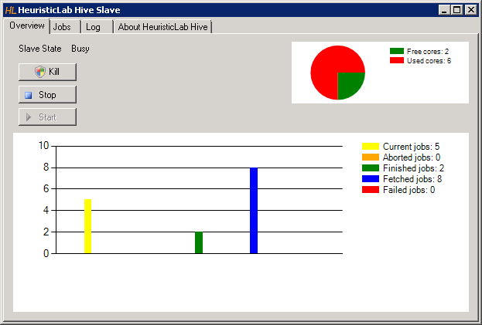
Hive Slave Demo
HeuristicLab.Hive Deep Dive
http://dev.heuristiclab.com
30
Notes:
30

Slide 31
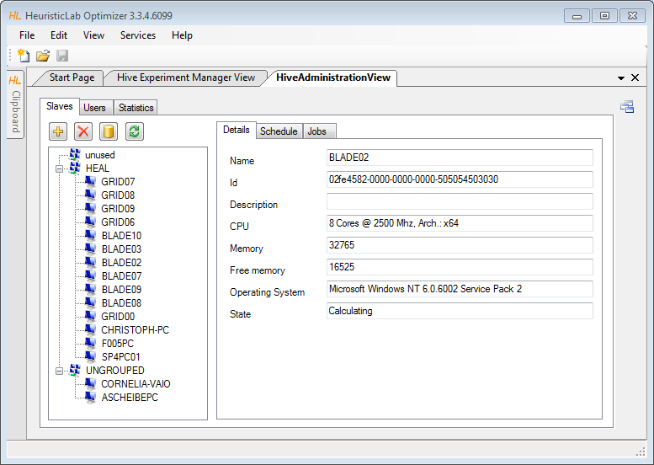
Administration UI
HeuristicLab.Hive Deep Dive
http://dev.heuristiclab.com
31
Notes:
31

Slide 32
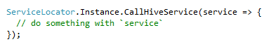
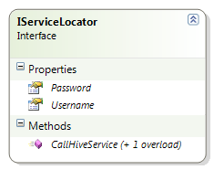
Experiment Manager
Service Communication
HeuristicLab.Hive Deep Dive
http://dev.heuristiclab.com
32
svcutil for generation of
  HiveServiceClient
  DTOs
    new local classes
    extendable with `partial` mechanism
    implement IItem
Service access via ServiceLocator
  uses HeuristicLab username and password (by default)
Notes:
32

Slide 33
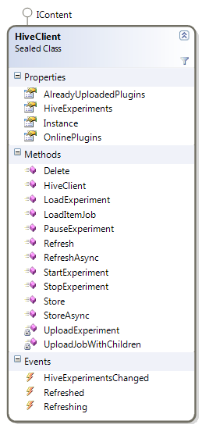
Experiment Manager
Service Communication
HeuristicLab.Hive Deep Dive
http://dev.heuristiclab.com
33
HiveClient
  store and refresh
  holds instances
  StartExperiment is implemented specially
Notes:
33

Slide 34
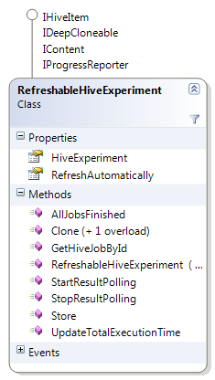
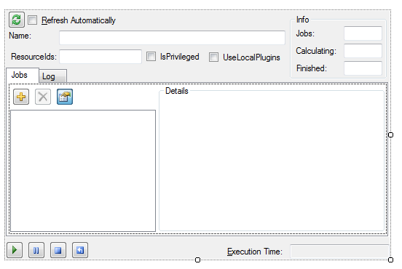
Experiment Manager
Is downloaded
before refresh
Downloads
jobs
HiveJobView
OptimizerHiveJobView
TreeView
HeuristicLab.Hive Deep Dive
http://dev.heuristiclab.com
34
RefreshableHiveExperiment
  encapsulates a HiveExperiment
  automatically refreshes itself
  automatically downloads finished jobs
RefreshableHiveExperimentView
Notes:
34

Slide 35
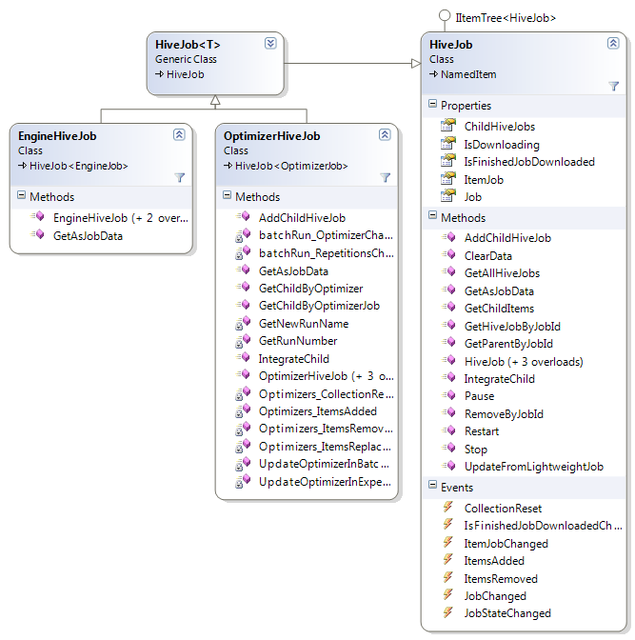
Experiment Manager
HiveJob<T>
  encapsulates Job DTO and ItemJob
  knows about child jobs
OptimizerHiveJob
  listens to optimizer-events
    BatchRun.RepetitionsChanged
    BatchRun.AlgorthmChanged
    Optimizer.OptimizersChanged
    Job.ParallelChanged
  creates/removes child jobs
EngineHiveJob
  removes scope information in GetAsJobData
HeuristicLab.Hive Deep Dive
http://dev.heuristiclab.com
35
Notes:
35

Slide 36
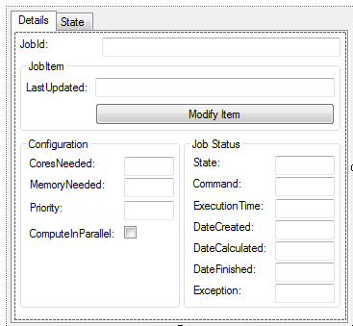
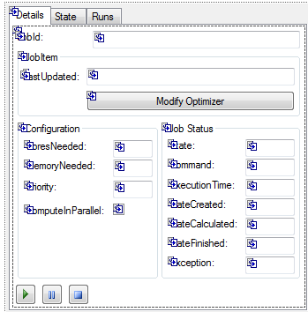
Experiment Manager
HiveJobView
  configuration
  job status information
  state graph
OptimizerJobView
  derived from HiveJobView
  “shortcut” to Runs of the optimizer
  start/pause/stop controls
HeuristicLab.Hive Deep Dive
http://dev.heuristiclab.com
36
Notes:
36

Slide 37
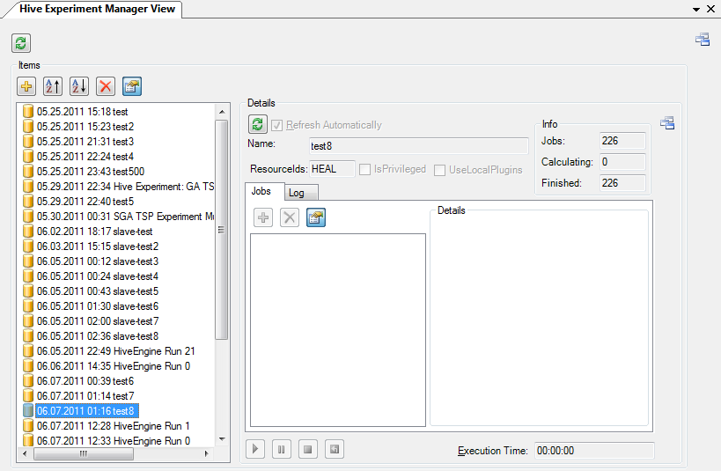
Experiment Manager
ExperimentManagerView
  hive experiments ordered by date
  information about finished jobs before download
HeuristicLab.Hive Deep Dive
http://dev.heuristiclab.com
37
Notes:
37

Slide 38
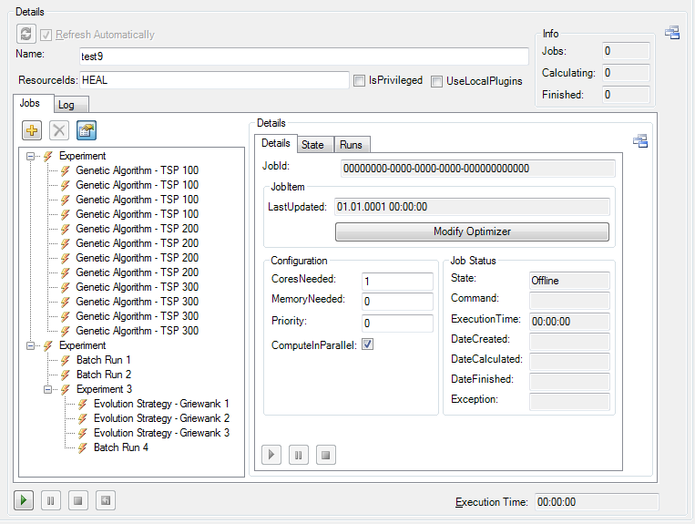
Experiment Manager
HiveExperimentView
  drag and drop support
  TreeView
  Pause->
  Modify->
  Resume
HeuristicLab.Hive Deep Dive
http://dev.heuristiclab.com
38
Notes:
38

Slide 39
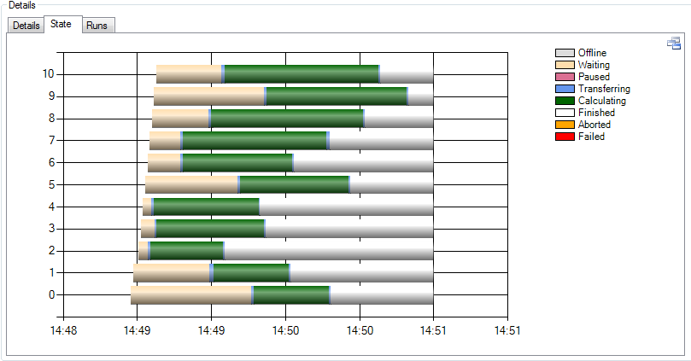
Experiment Manager
StateLog
  every state transition is logged
  nice for analyzing hive behaviour and performance
HeuristicLab.Hive Deep Dive
http://dev.heuristiclab.com
39
Notes:
39

Slide 40
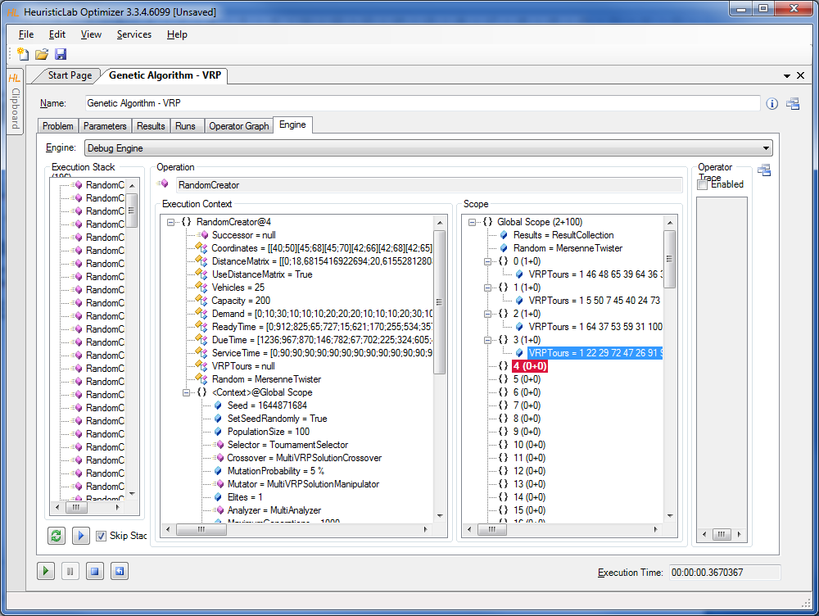
HiveEngine
UniformSubScopesOperators
  Parallel=true
An EngineJob is created for operation in OperationCollection
Each operation contains a reference to a scope tree and execution context tree
Side-scopes are cut away!
Execution context tree is
available but
must not be modified!
Jobs can become large
HeuristicLab.Hive Deep Dive
http://dev.heuristiclab.com
40
Notes:
40

Slide 41
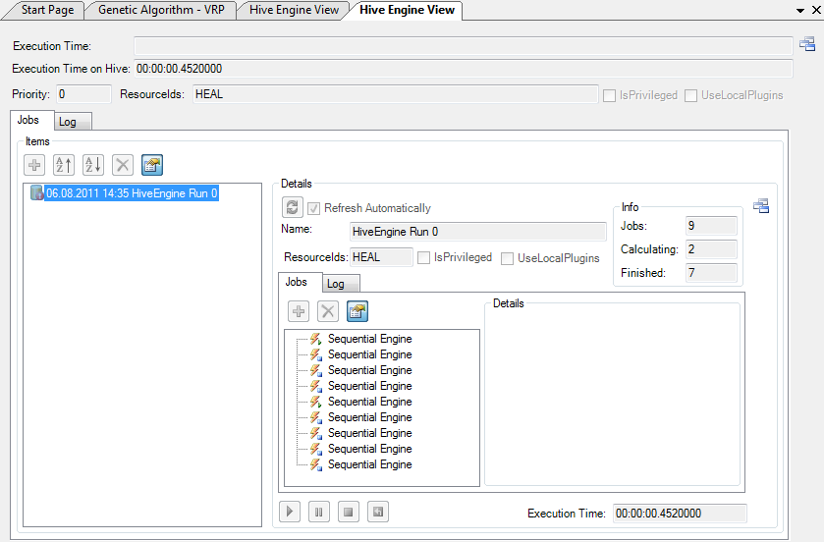
HiveEngine
HiveEngineView
  reuse of RefreshableHiveExperimentView
HeuristicLab.Hive Deep Dive
http://dev.heuristiclab.com
41
Notes:
41

Slide 42
Hive Statistics
HeuristicLab.Hive Deep Dive
http://dev.heuristiclab.com
42
Captures hive status
  every minute
  also deleted jobs count in statistics
  per user
    total execution time
    used cores
    total execution time (only of finished jobs)
    start-to-end time (only of finished jobs)
  per slave
    cores
    free cores
    memory
    free memory
    cpu usage
No HL views yet
Notes:
42

Slide 43
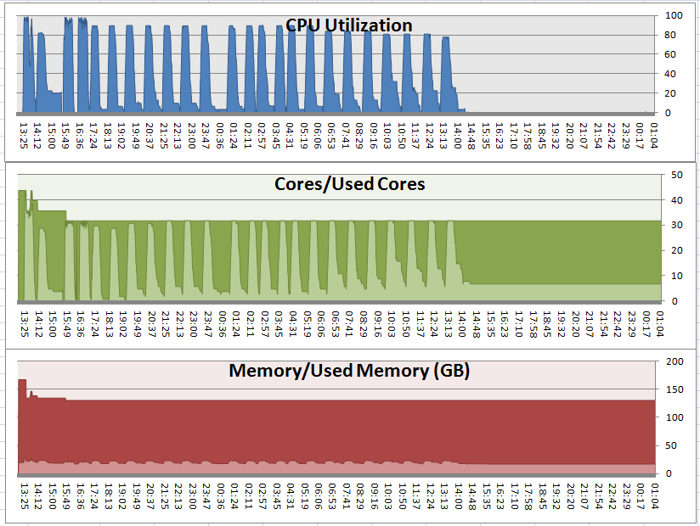
Hive Statistics
HeuristicLab.Hive Deep Dive
http://dev.heuristiclab.com
43
Excel visualization of a HiveEngine run of MetaOptimization
Notes:
43

Slide 44
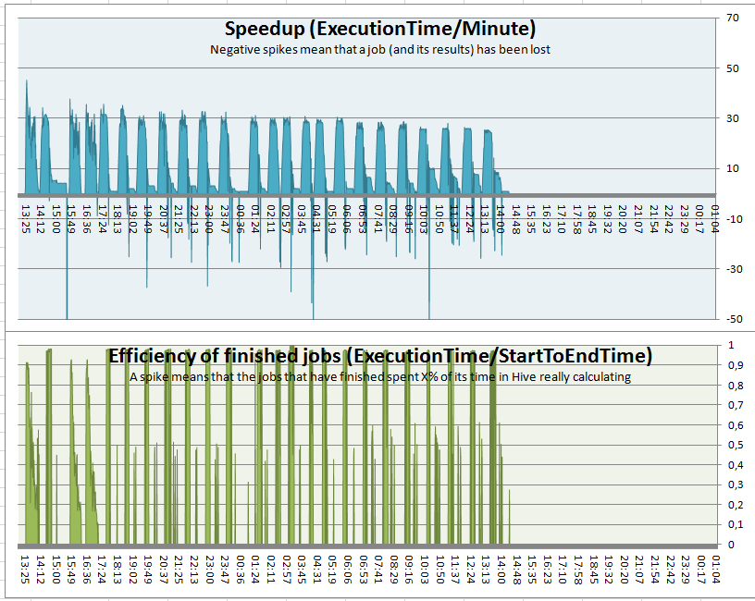
Hive Statistics
HeuristicLab.Hive Deep Dive
http://dev.heuristiclab.com
44
Excel visualization of a HiveEngine run of MetaOptimization
Notes:
44

Slide 45
To be done…
HeuristicLab.Hive Deep Dive
http://dev.heuristiclab.com
45
Use checksums for comparing assemblies → remove UseLocalPlugins
Experiment sharing
ExperimentManager and HiveEngine stabilization
Deployment in labs
Documentation
Code review
Testing!
Notes:
45

Slide 46
Future
HeuristicLab.Hive Deep Dive
http://dev.heuristiclab.com
46
Administration UI
  Refactoring
  Charts for collected statistics
  User management (privileged role, priorities)
  View and manage jobs on slave or in a group
  View and manage jobs of users
TreeView refactoring
Improve scheduling
Priorities (DB + UI)
Integration with OKB computer and user management
Database timeouts (many large jobs at once are evil!)
Notes:
46

Slide 47

End of dive
HeuristicLab.Hive Deep Dive
http://dev.heuristiclab.com
47
Thanks for your attention!

