Slide 1




Programming HeuristicLab
Algorithms and Problems
A. Scheibenpflug
Heuristic and Evolutionary Algorithms Laboratory (HEAL)
School of Informatics/Communications/Media, Campus Hagenberg
University of Applied Sciences Upper Austria

Slide 2
Overview
HL Algorithm Model
Parameters, Operators and Scopes
Algorithms
Problems

Slide 3
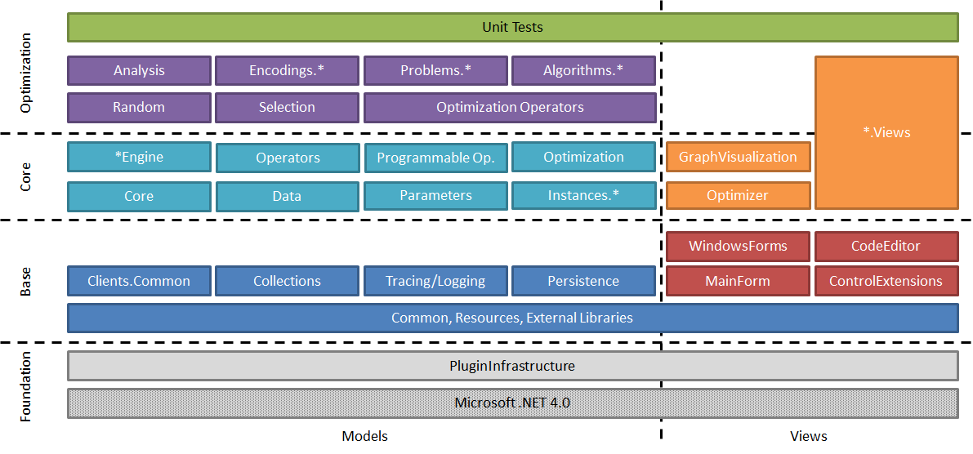
Where are we?

Slide 4
HL Algorithm Model
Typically, HL algorithms are constructed by chaining together operators
An engine executes these operators
  Enables pausing and debugging
  Available engines:
    Sequential engine
    Parallel engine
    Debug engine
    (Hive engine)

Slide 5
HL Algorithm Model

Slide 6
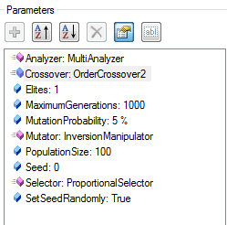
Parameters
Used to configure algorithms, problems and operators
Used for accessing variables in the scope
E.g. population size, analyzers, crossover operator
Operators
  Look up these parameters from the algorithm, problem or scope
  Use them to store values (in the scope tree)

Slide 7
Parameters
ValueParameter:
  Stores a value (Item) that can be looked up. E.g. mutation rate, crossover operator,…
LookupParameter:
  Looks up parameters/items (variables) from the scope/parent scopes.
ConstrainedValueParameter:
  Contains a list of selectable values.
ScopeTreeLookupParameter:
  Goes down the scope tree and looks up variables.
ScopeParameter:
  Returns the current scope.
ValueLookupParameter, OptionalConstrainedValueParameter, OperatorParameter, FixedValueParameter, OptionalValueParameter,…

Slide 8
Scopes
A scope is a node in the scope tree
Contains link to parent and sub-scopes
Contains variables (e.g. solutions or their quality)
Operators usually work on scopes (either directly or through parameters)
Example - Selection:

Slide 9
Operators
Inherit from SingleSuccessorOperator
Override the Apply() method
Must return base.Apply()
  Returns successor operation
Use ExecutionContext to access scopes
Or better: Use parameters to retrieve scopes, values from scopes or manipulate them

Slide 10
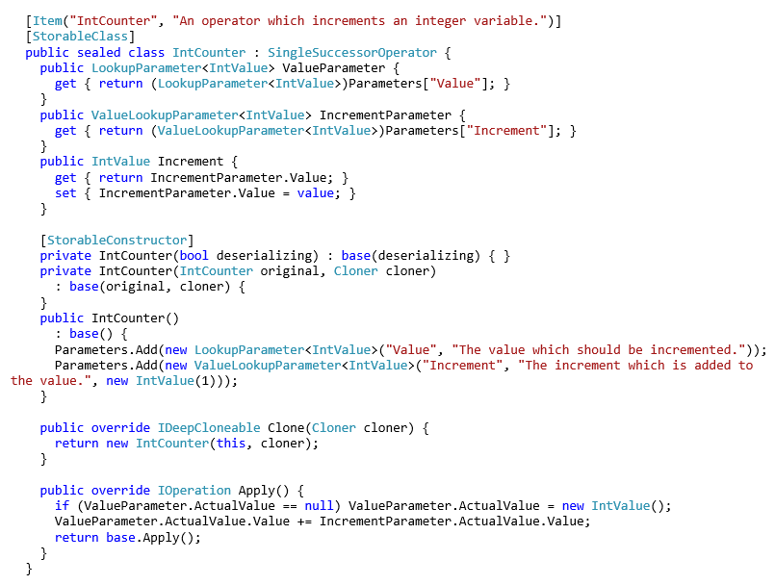
Operators
A operator that increments a value from the scope by „Increment“
For easier access to parameter values
A parameter for retrieving „Value“ (default name, can be configure with ActualValue) from scope or parent scopes
If the value is not found it can also be created in the scope

Slide 11
Base classes/interfaces for algorithms

Slide 12
Base classes/interfaces for algorithms
IExecutable (Executable):
  Defines methods for starting, stopping, etc. of algorithms
IOptimizer:
  Contains a run collection
IAlgorithm:
  Contains a problem on which the algorithm is applied as well as a result
Algorithm:
  Base class, implements IAlgorithm
EngineAlgorithm:
  Extensions for execution with an engine (operator graph, scope, engine)
HeuristicOptimizationEngineAlgorithm:
  Specifies problem: IHeuristicOptimizationProblem

Slide 13
What does an HL algorithm do?
Create operator graph of algorithm by chaining together operators (the actual algorithm)
Offer user configuration options through parameters
Discover operators from the Operators collection of the problem
Parameterize/wire (react to changes in operators) operators where necessary

Slide 14
Problems
Use encodings for representing solutions
Encodings consist of solution candidate definitions and corresponding operators
Problems contain
  the evaluator
  the solution creator
Define maximization or minimization
Contain the „problem data“ (e.g. a distance matrix, a simulation, a function definition), usually supplied by a ProblemInstanceProvider
Can be single- or multi-objective
Configured with parameters

Slide 15
Problem Architecture

Slide 16
Base classes/interfaces for problems

Slide 17
Base classes/interfaces for problems
IProblem:
  Contains the operators collection; all operators that can be used by the problem, algorithm and user
IHeuristicOptimizationProblem:
  Defines solution creator and evaluator
Problem, HeuristicOptimizationProblem and Single/MultiObjectiveHeuristicOptimizationProblem provide abstract base classes

Slide 18
Recap: What does a HL problem do?
Defines used encoding
Defines single/multi objective
Defines min/maximization
Discovers correct operators
  Are used by the algorithm
Wires/parameterizes operators
Loads problem data using a corresponding problem instance provider

Slide 19
Useful Links
http://dev.heuristiclab.com/trac/hl/core/wiki/UsersHowtos
http://dev.heuristiclab.com/trac/hl/core/wiki/Publications
heuristiclab@googlegroups.com
http://www.youtube.com/heuristiclab

